Slide 1
Infill Generation for PLA 3D Models
Ricardo Ponce
Nathan Rowe
Computer Science

Slide 2
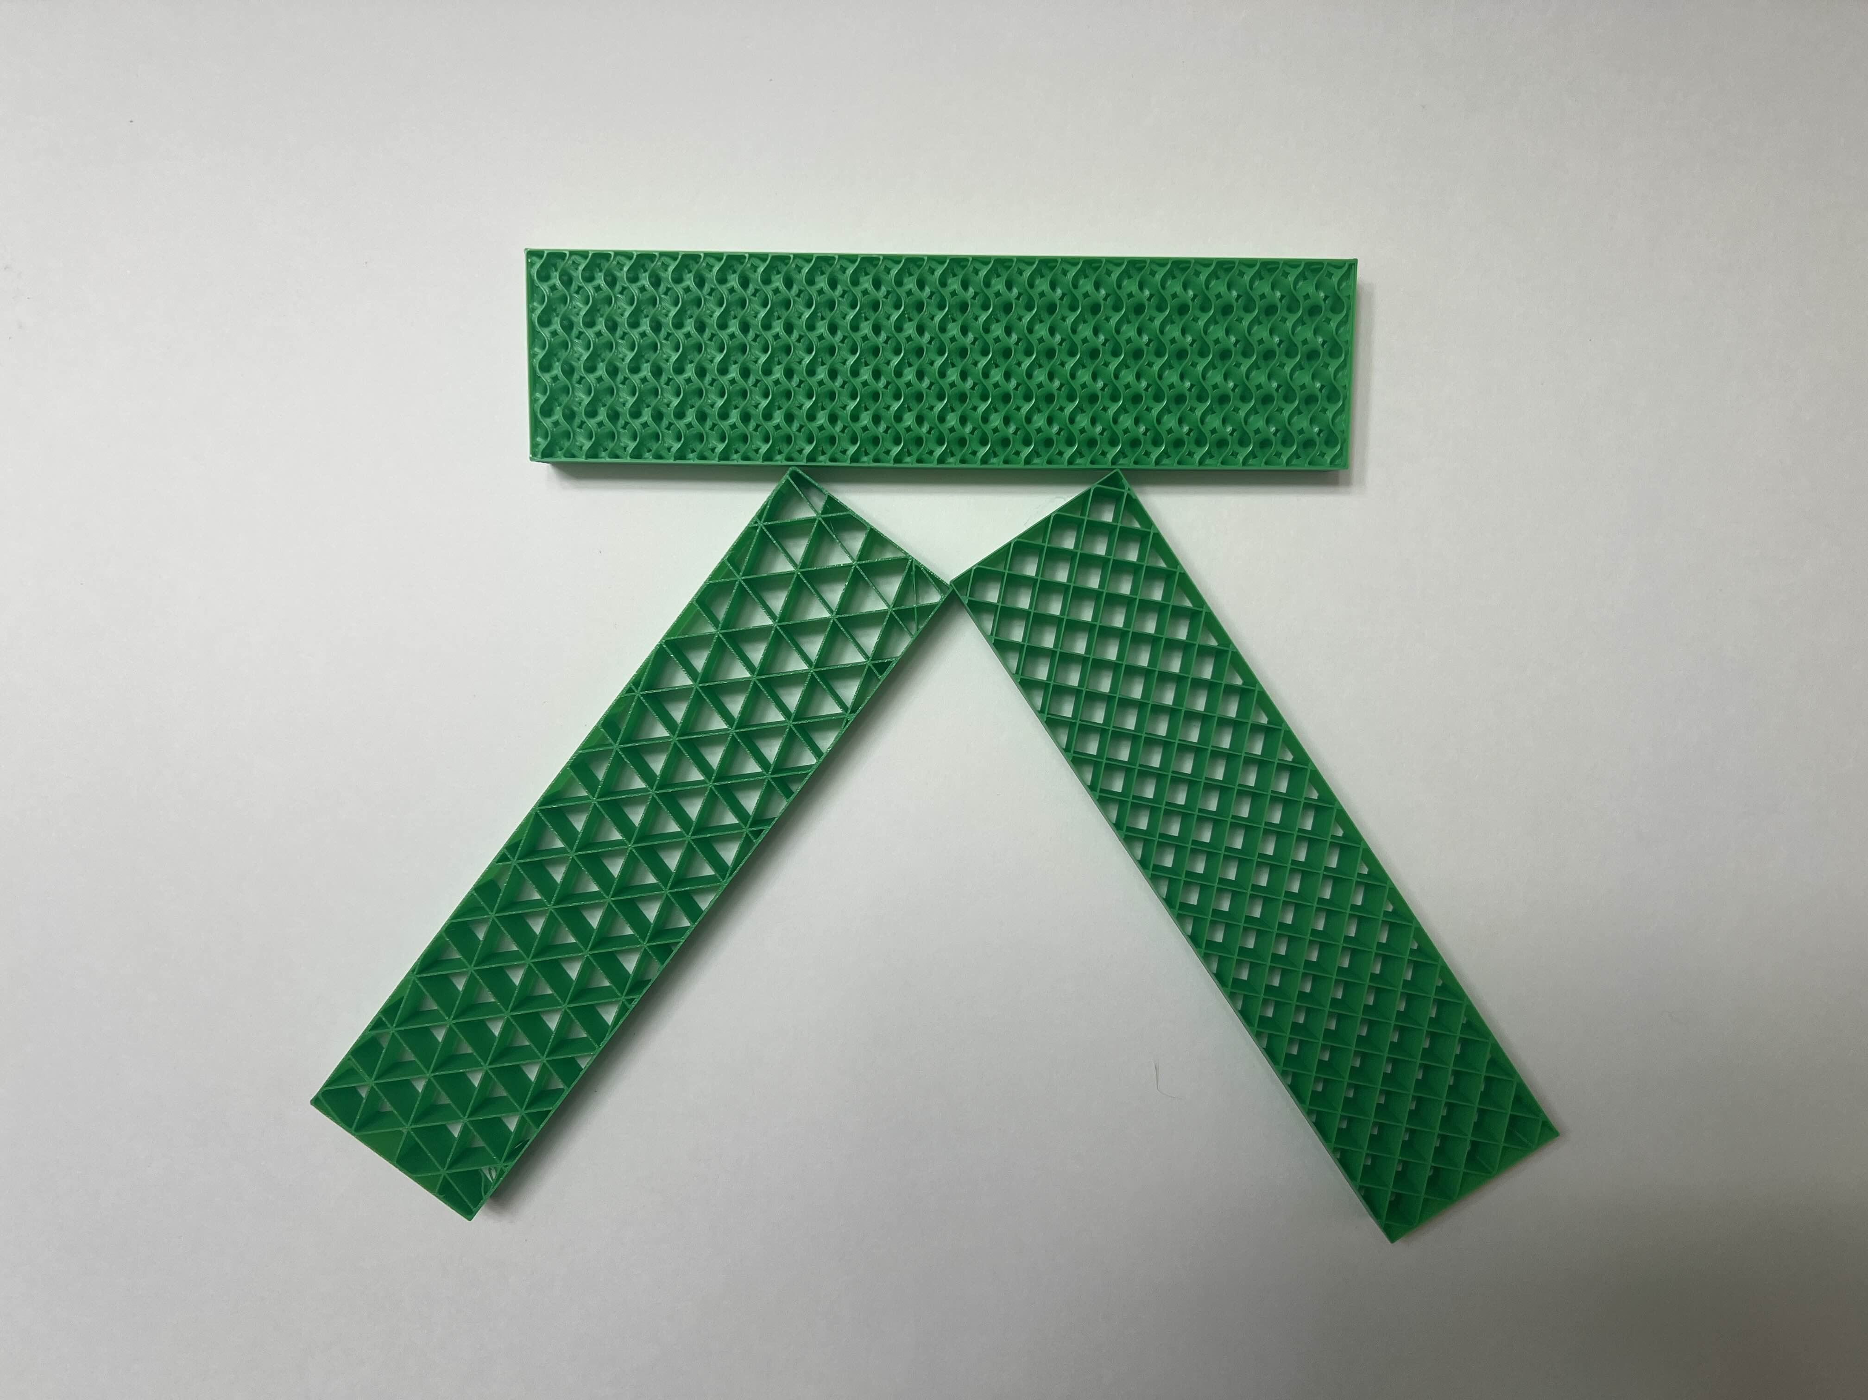
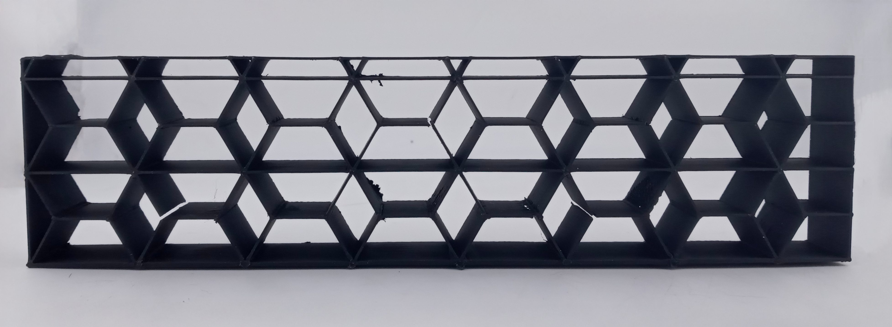
Introduction
Provide a new infill pattern not implemented by CURA or Bambu Studio
Research current implemented infill patterns
Slicer Implementation in Grasshopper/Rhino with ExtruderTurtle
Test new infill pattern with a Tensile Stress
Compare results with existing patterns

Slide 3
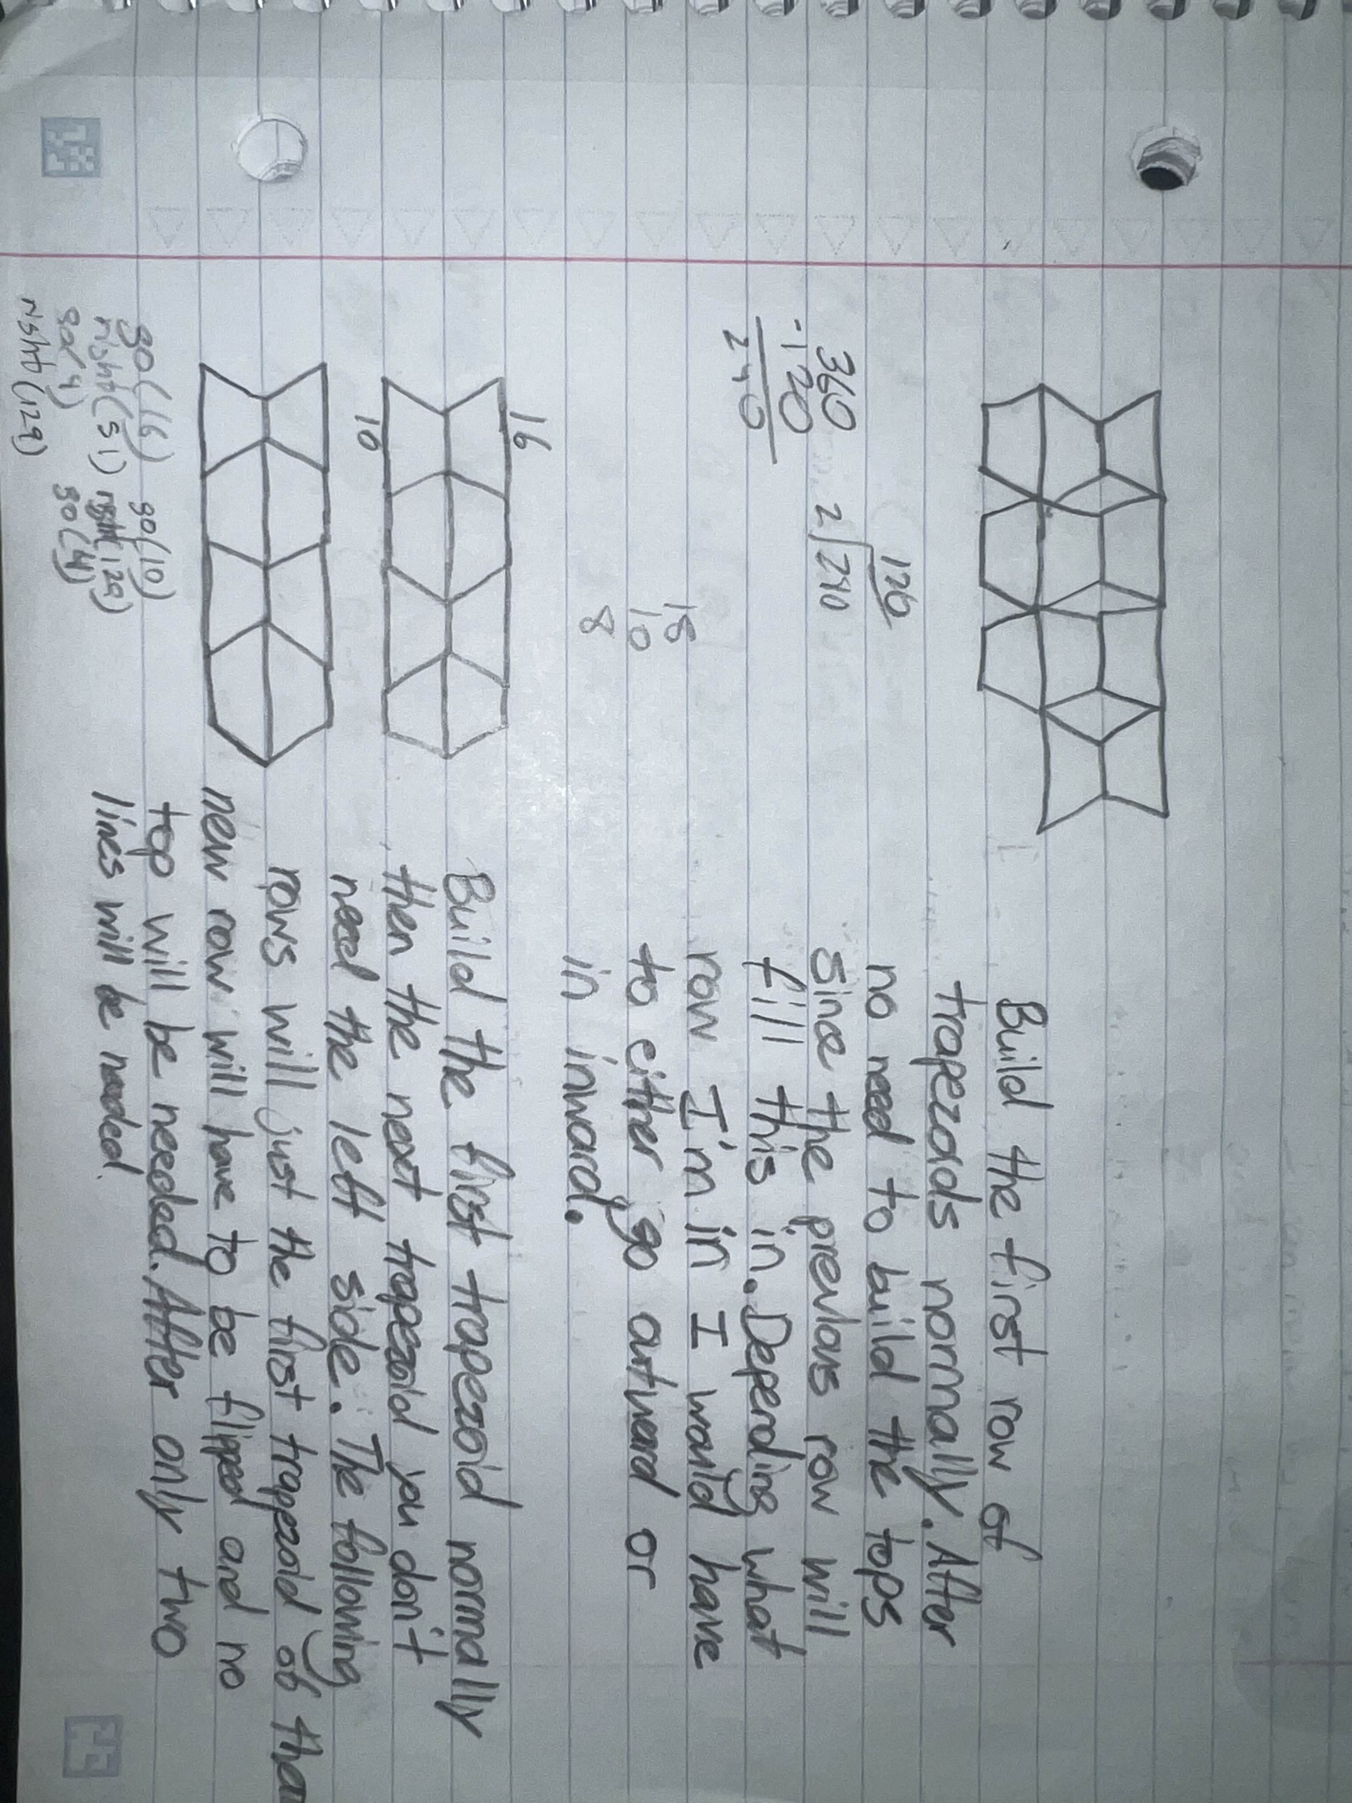
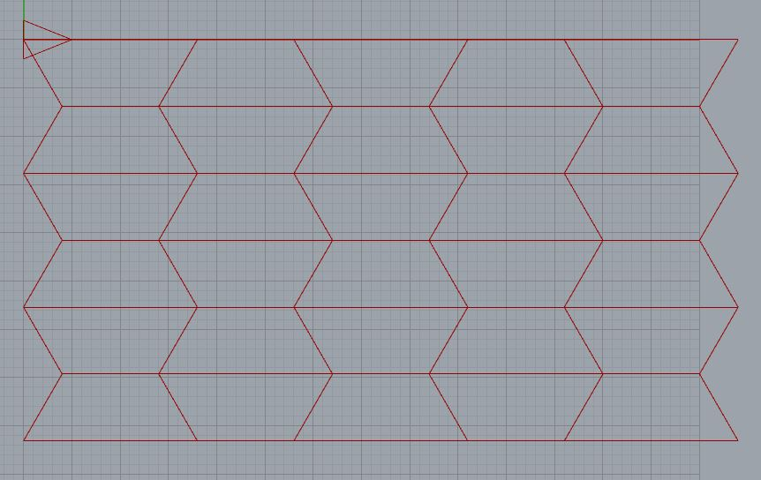
Process - Design
Paper sketches
Proof of concept
Logic Design
Extruder Turtle
Prototyping
Experiment with Printer

Slide 4
Process - Design
Lattice Intersection: CurveBrepIntersect() used to get lattice within model
Toolpath Generation: Turtle traversal of adjacency list of infill edges defined by (start point, end point) at each layer.

Slide 5
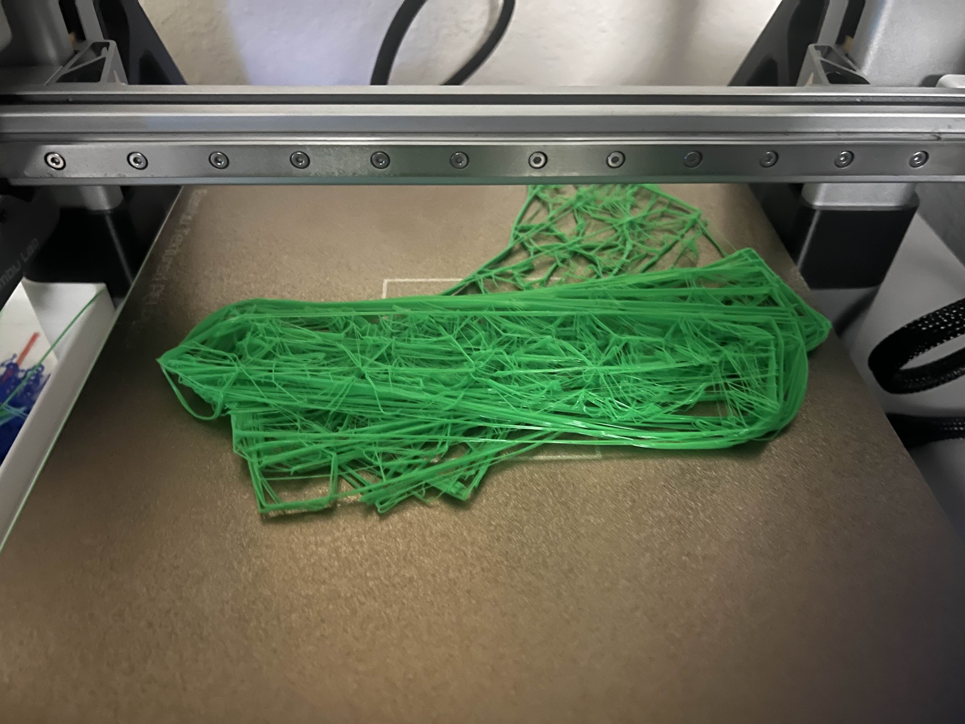
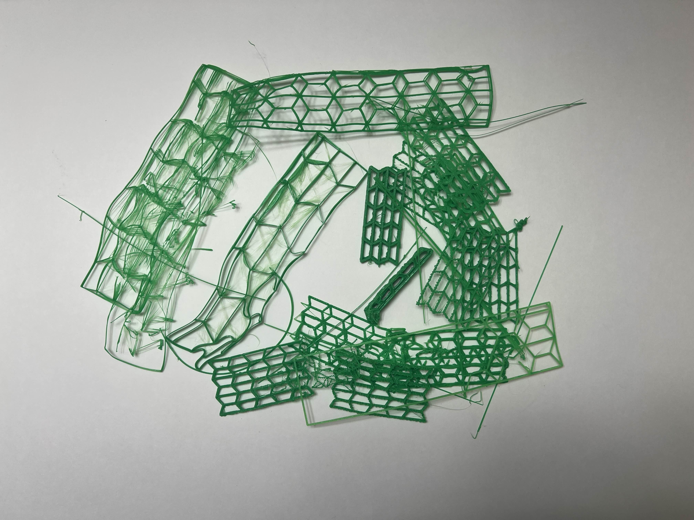
Process – Challenges
Filament smearing on layers
Rhino/grasshopper doesn’t know how to deal with intercepting lines.
Infill generation for non-linear z-axis models

Slide 6
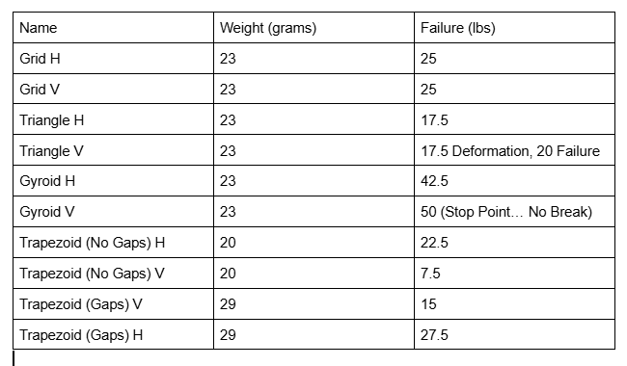
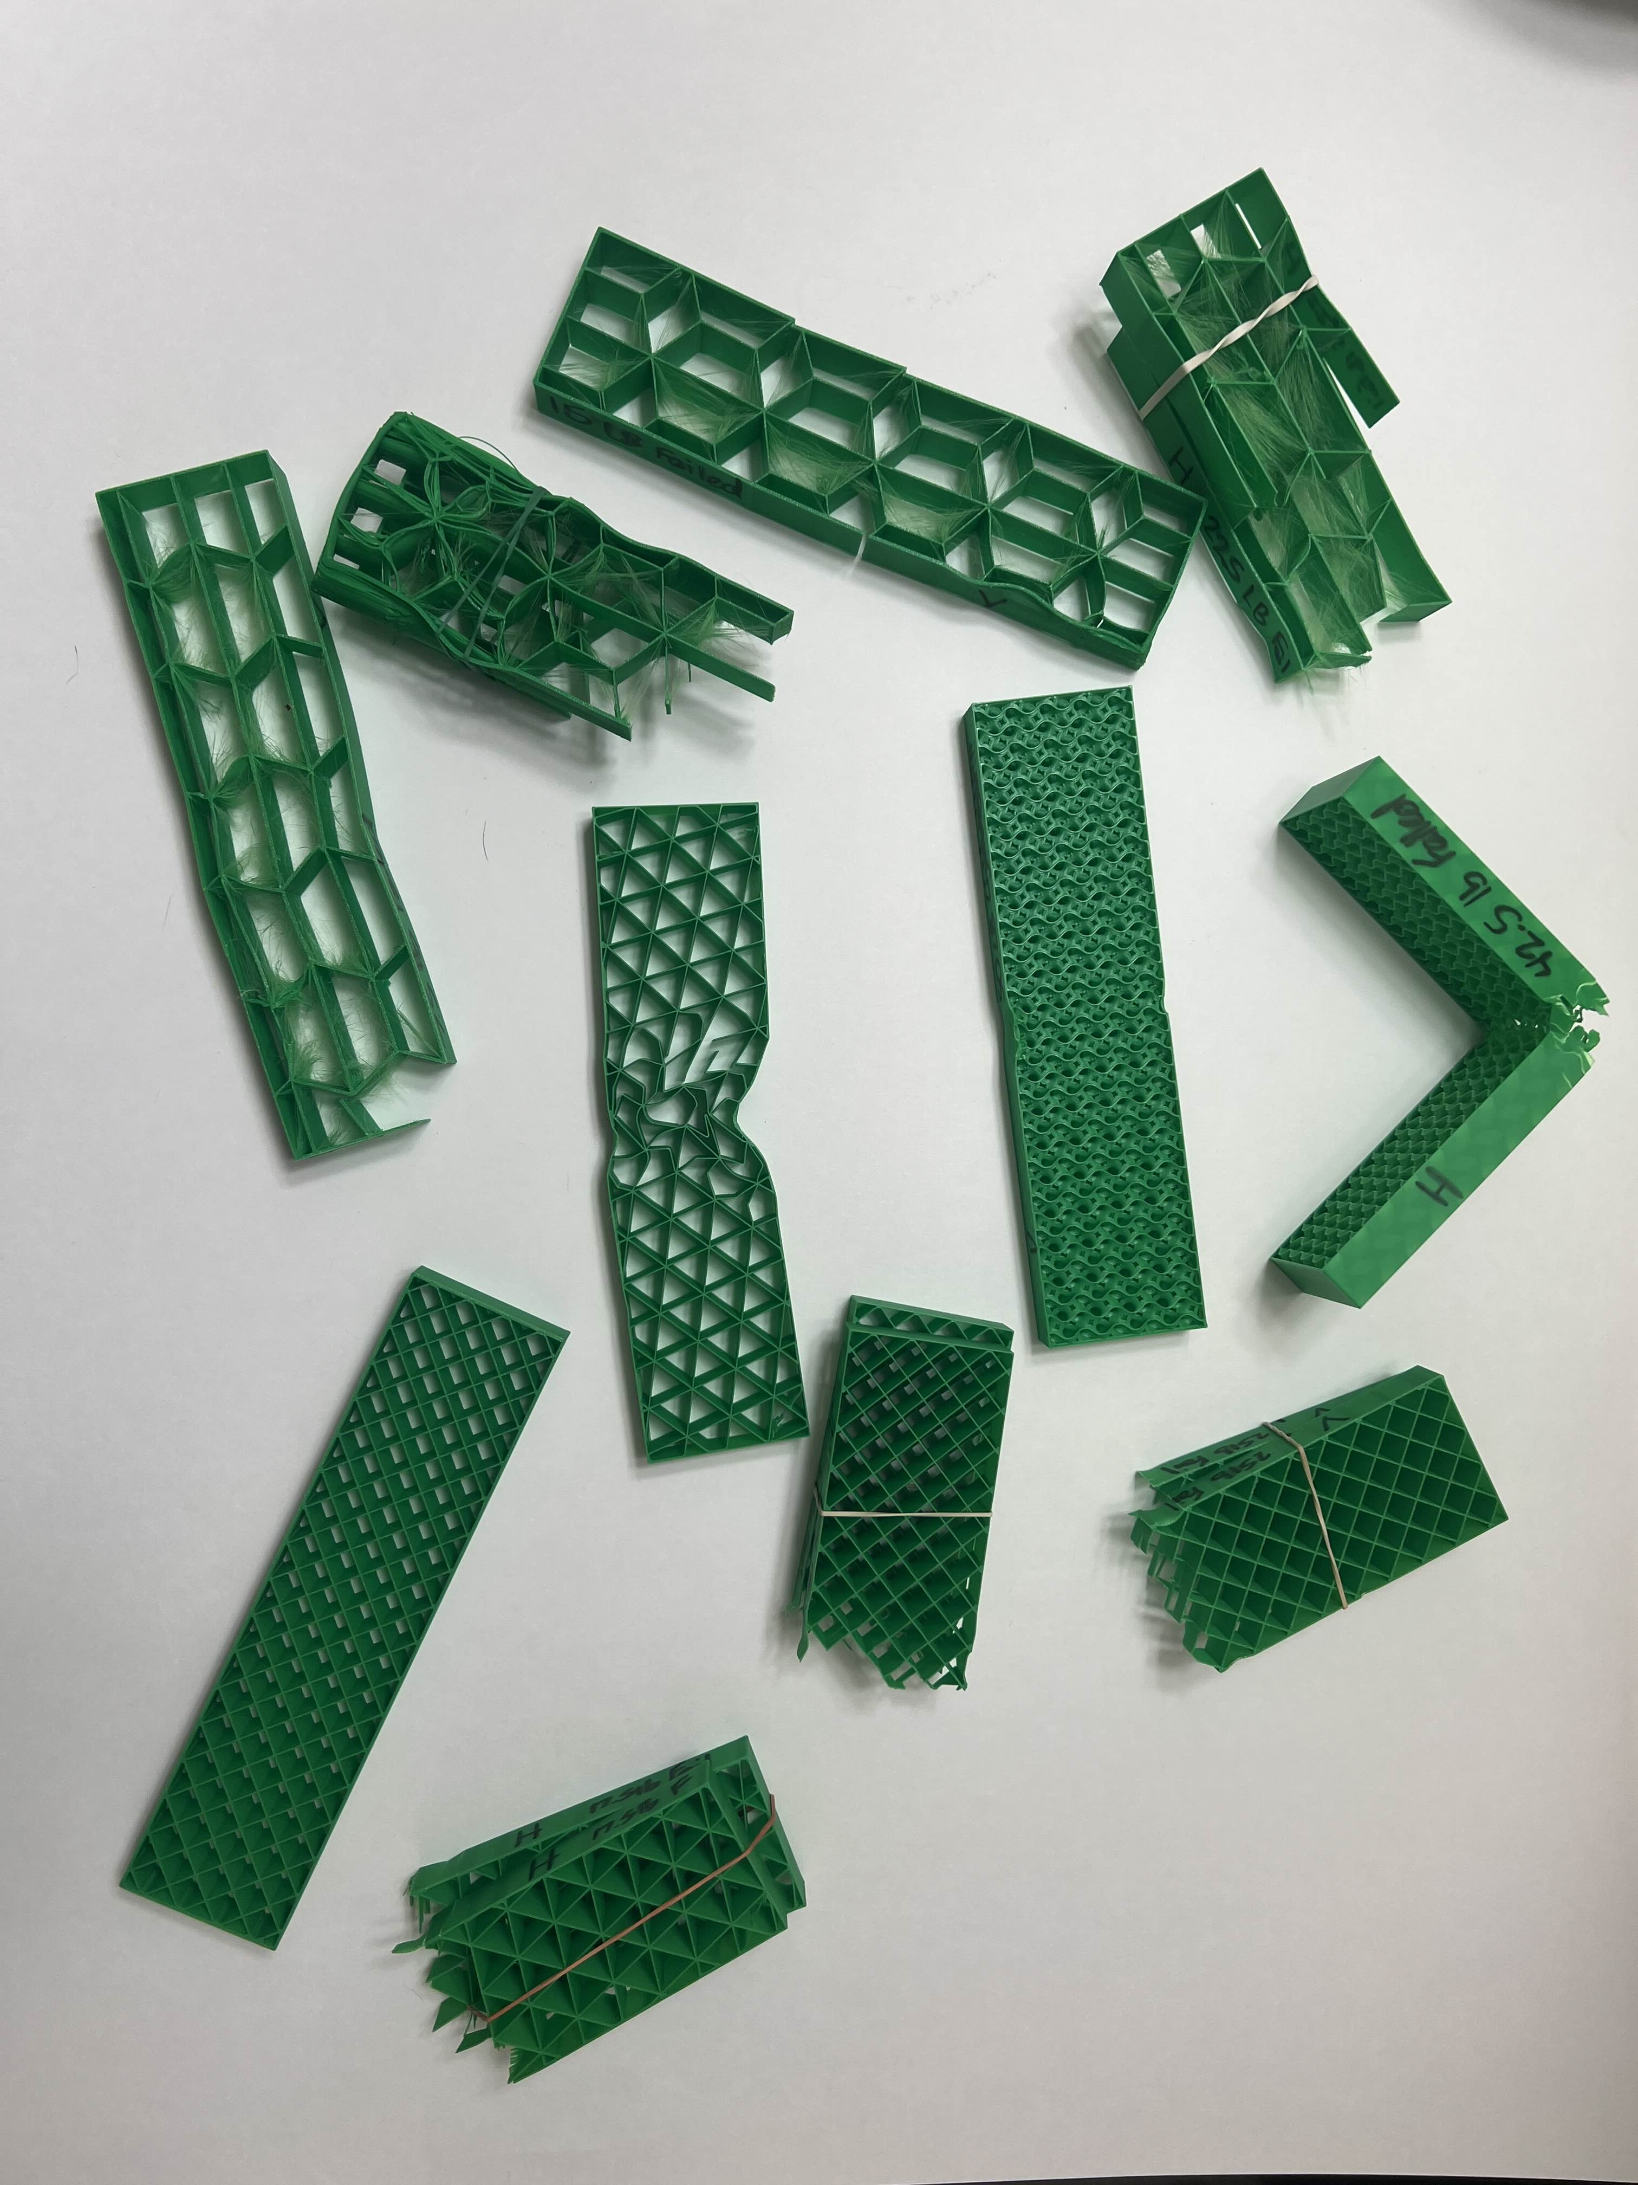
Outcome
Two new infill patterns using trapezoids as the base shape
Can integrate into shapes for printing
Spacing between trapezoids added to structural strength
Gyroid is crazy strong
Rudimentary tool for custom infill patterns

Slide 7
Future Work
Allow slicing for complex models
Optimizing toolpath generation for infill patterns
(Eularian Circuits/Paths)
Create infill patterns that introduce non-linear curves

Slide 8
THANK YOU
Ricardo Ponce
Nathan Rowe
Computer Science

