Slide 1
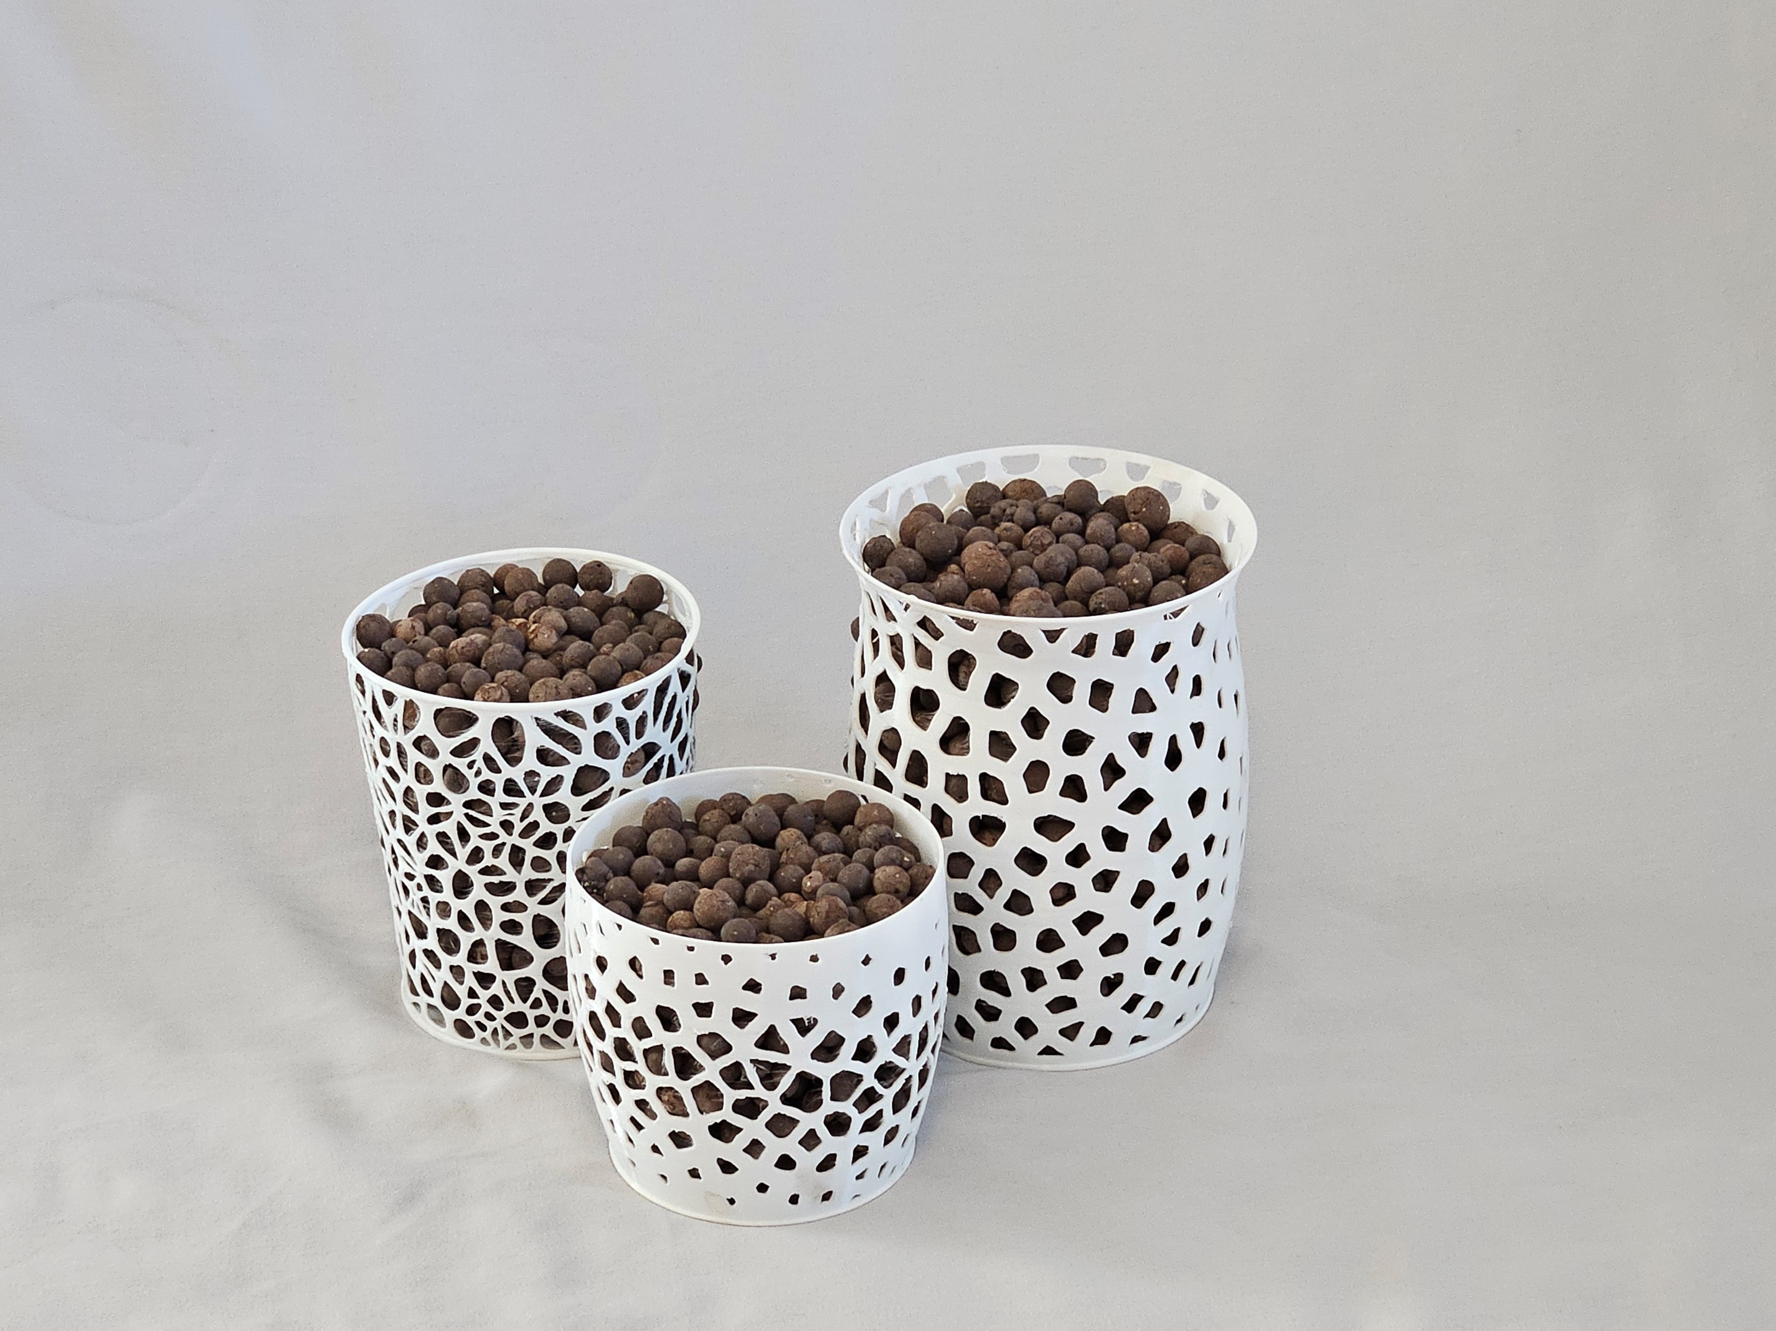
3D Printed Voronoi orchid pots with RFID-based tracking
German Bejarano Cardenas
University of New Mexico
CS491: Computational Fabrication

Slide 2
Overview
This project combines computational design and digital fabrication to create 3D-printed pots with Voronoi patterns. These pot designs promote airflow for orchids and integrate an RFID tracking system for monitoring care.

Slide 3
Process: computational design
I started by creating Voronoi patterns in Python, and later switched to using Grasshopper for better integration with Rhino.
I used Grasshopper elements like Populate 2D, Voronoi, and Surface Morph with sliders for customization.
Integrating typical Python libraries is challenging within Grasshopper, so to save time, Python scripts were used to generate pot profiles only.

Slide 4
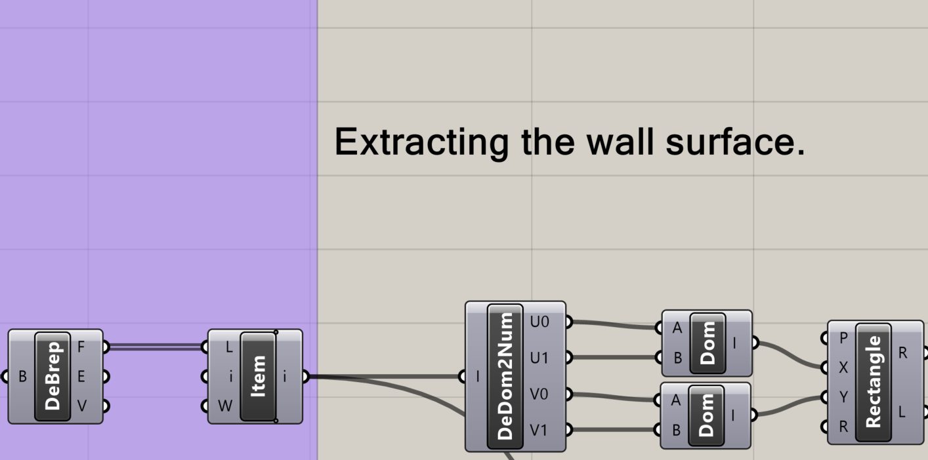
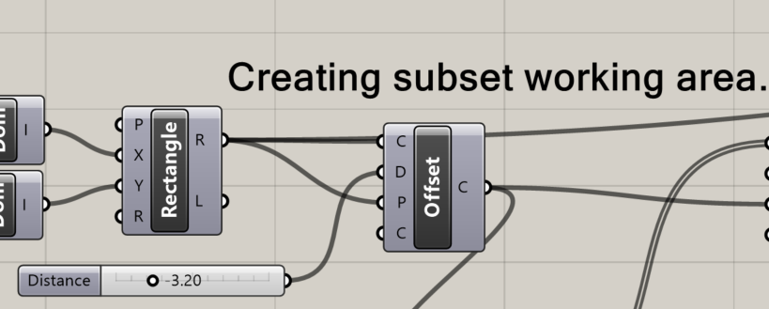
Using Grasshopper tools, I extracted the pot wall surface to apply the pattern.
An offset tool was used to generate the working area. This is to avoid making holes near the edges of the surface.
Random points were used to generate the Voronoi cell centroids.

Slide 5
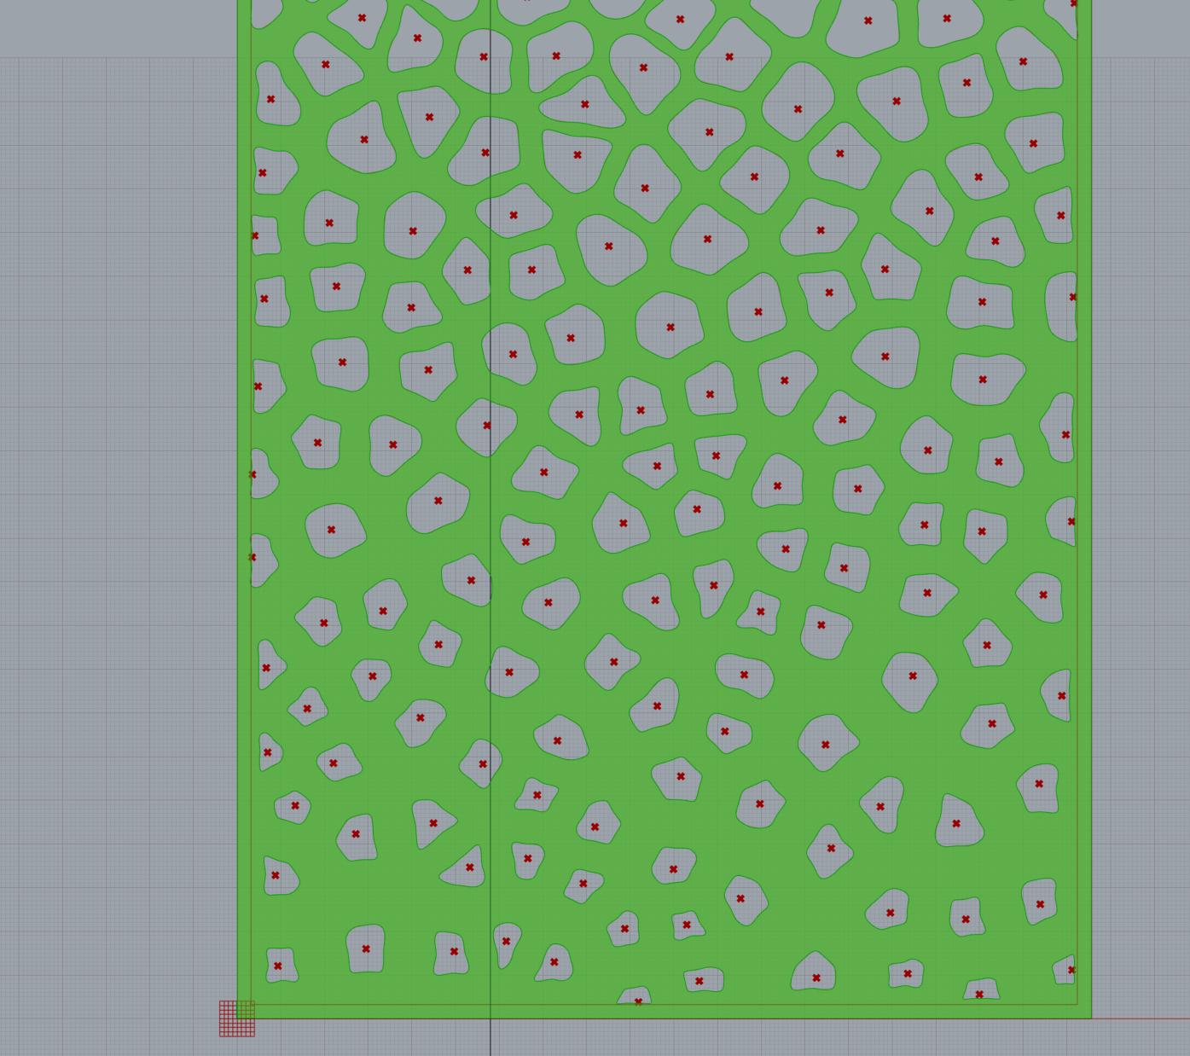
Various tools were used to make the cells and adjust their size. Including the use of “attractors” allows adjusting the cell size based on proximity to it.
I wanted to soften the sharp angles of the cells for a more natural look, so I used the Rebuild Curve tool for this purpose.
I used the Surface Morph tool to add the Voronoi pattern to the actual pot wall surface.

Slide 6
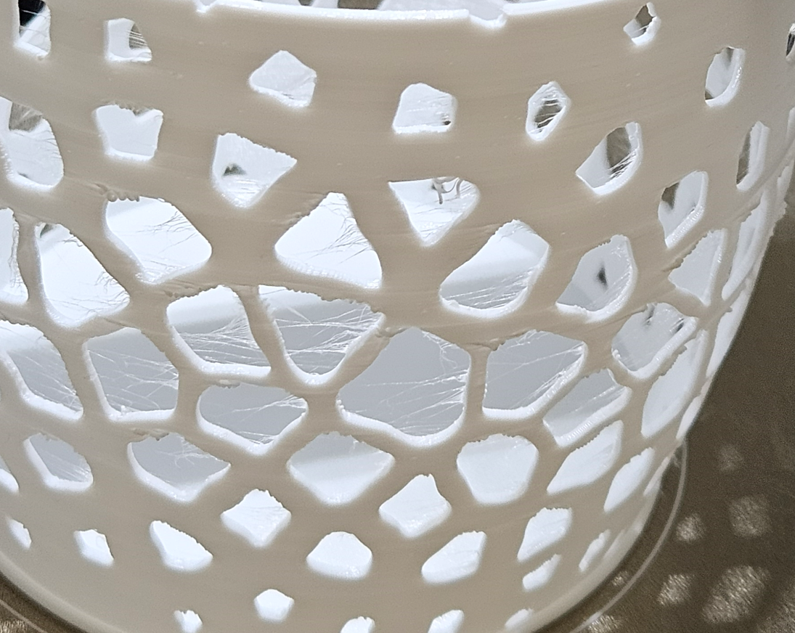
Process: Fabrication
I wanted to use TPU filament for my artifacts. The rationale was, besides experimenting with a new material, that the softness would reduce the chance of damaging the orchids.
Printing TPU requires somewhat different printer settings from PLA filament. Adjustments are required to reduce the defects typical of this material, such as stringing and blobs.

Slide 7
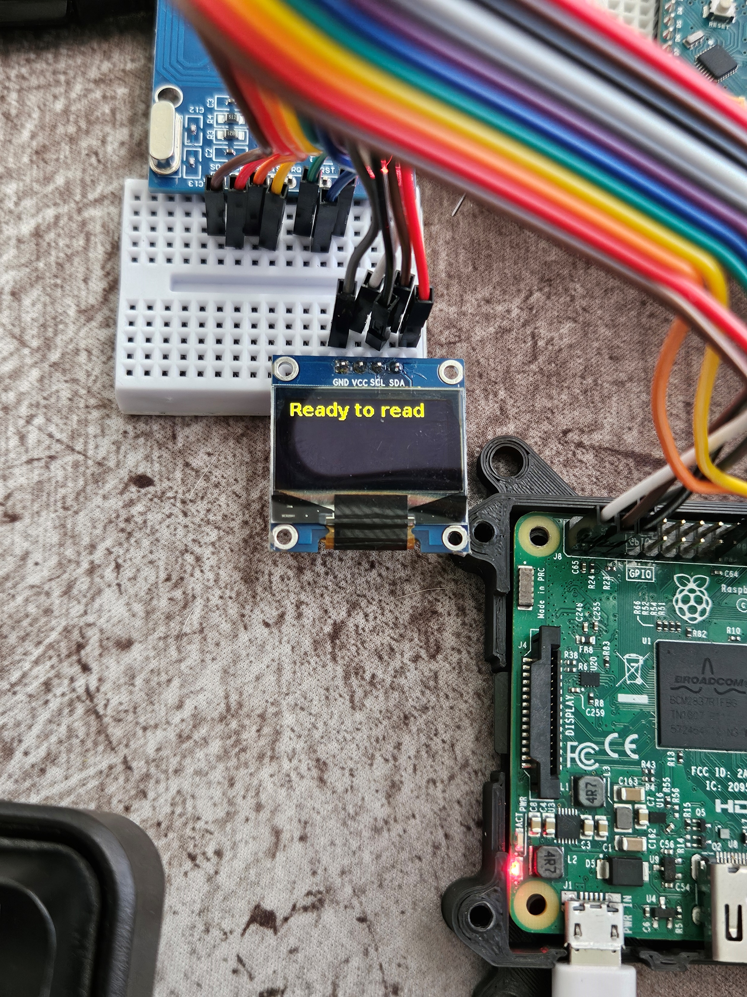
Outcome
The finished artifacts, although far from perfect, achieved all my goals. The pots are soft, lightweight, shatter proof, and they have a visually appealing appearance. The RFID system allows me to log watering events with timestamps, tag IDs, and names.
Admittedly, some of the properties that I desired have not been tested, but I believe the increased airflow and drainage from the patterns will be beneficial to my orchids.

Slide 8
Thank You
German Bejarano Cardenas
University of New Mexico
CS491: Computational Fabrication

