Slide 1
Final Project: Cultural Jewelry
Desiree Forster
Computer Science

Slide 2
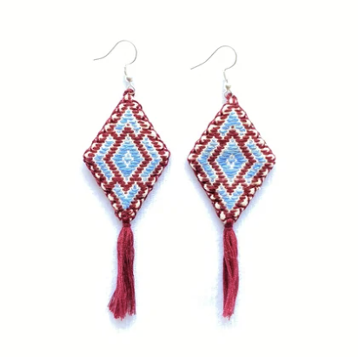
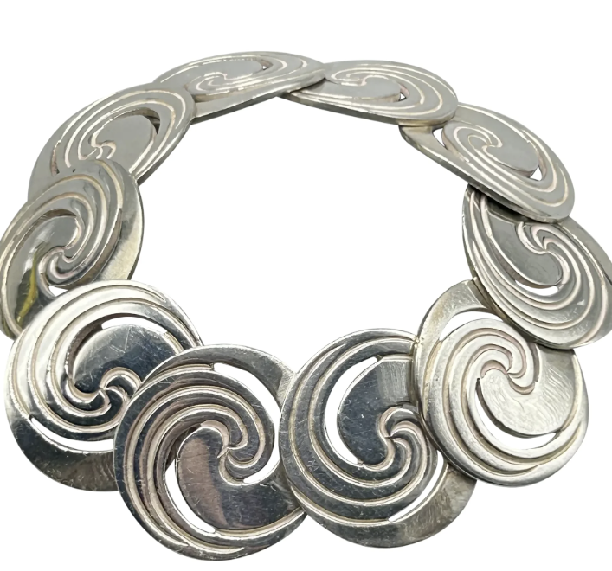
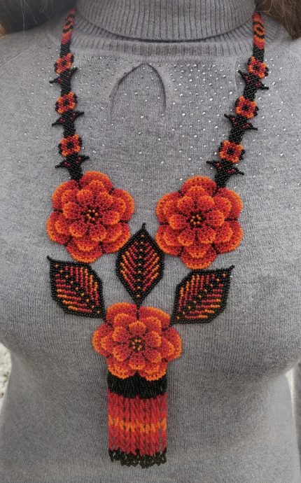
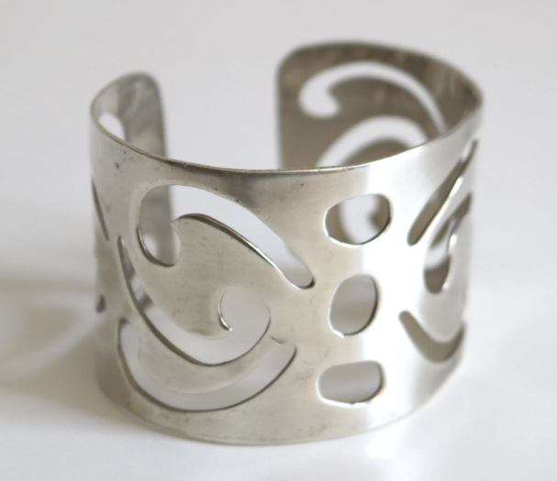
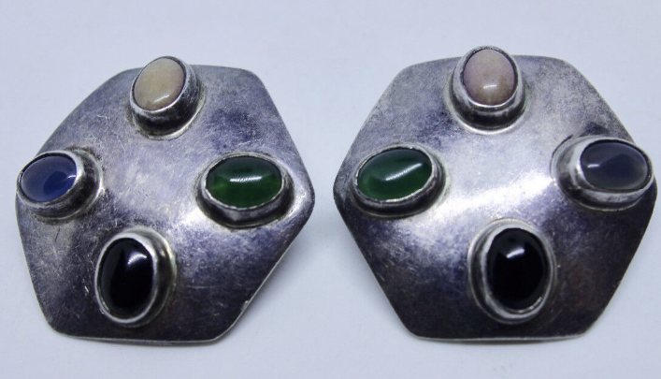
Introduction & Overview
Designing and creating cultural jewelry
Used concepts from Large Projects 4 and 5 (GCODE and Tiling)
Computational focus on jewelry base shape and patterns
Materials
Inspiration Pictures:

Slide 3
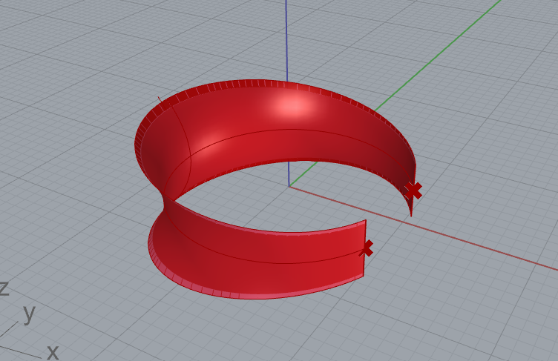
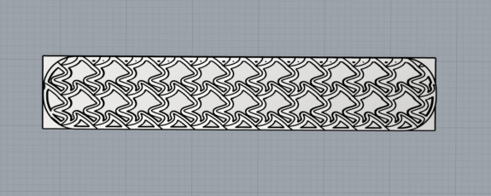
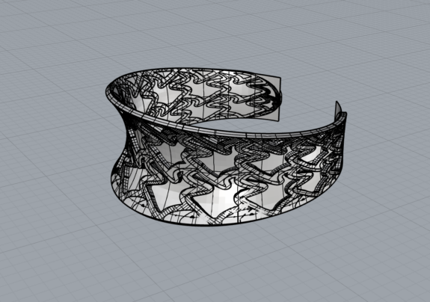
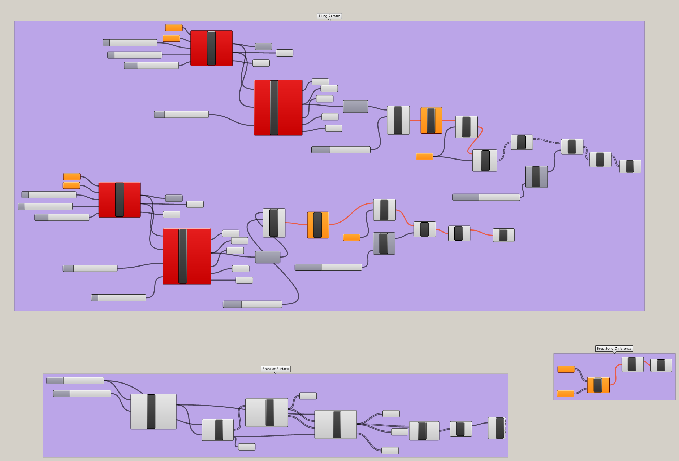
Process
Find ideas for inspiration
Tiling:
Bracelet
Programmed bracelet surface from Rhino modeling video
Using the tiling, create another block, offset and solid difference the two tiling patterns
CreateUVCrv, Fillet Corners, cut curve from tiling, and FlowAlongSrf
Spiral Bracelet
Surface from Bracelet 1
Created spiral, translated across rows and columns
CreateUVCrv, fillet corners, extruded it, aligned, solid difference with pattern
FlowAlongSrf
Hexagon Earrings
Created hexagonal surface and twisted
Hexagonal tiling with different extrusions
CreateUVCrv, cut shape from tiling, and FLowAlongSrf

Slide 4
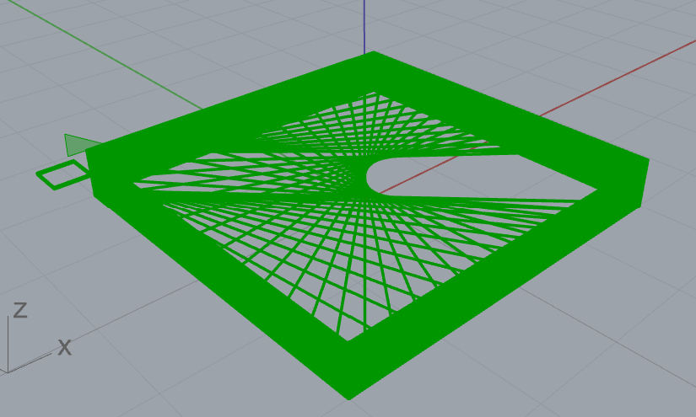
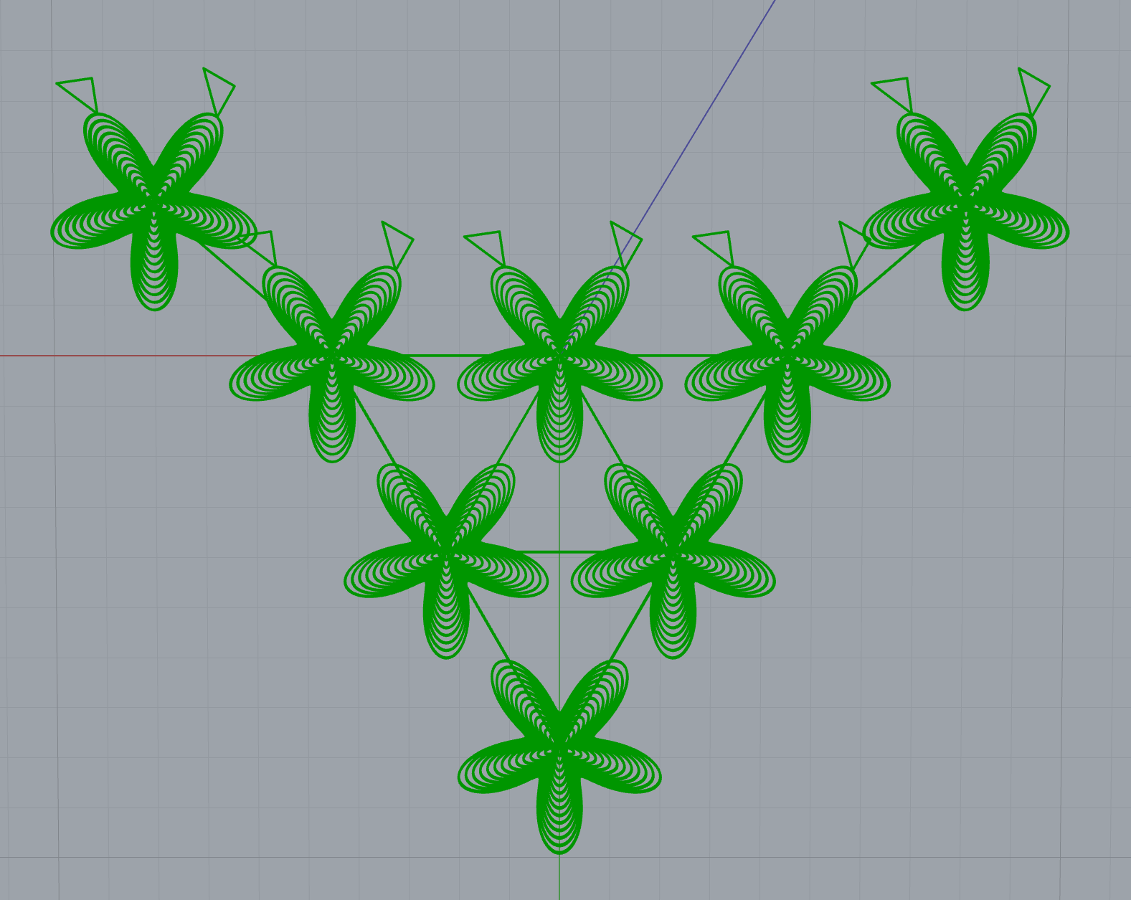
Process Cont…
GCODE
Diamond Earrings
Create diamond using points
25 layers, for each layer move nozzle across
Necklace
Function to create flower shape
Placed first five layers of each flower in a pyramid-like structure (offset bottom two corners)
Set the position of the nozzle across all flower centers to connect them together
Five more flower layers on-top with decreased radius
Test print many many many times and adjust appropriately

Slide 5
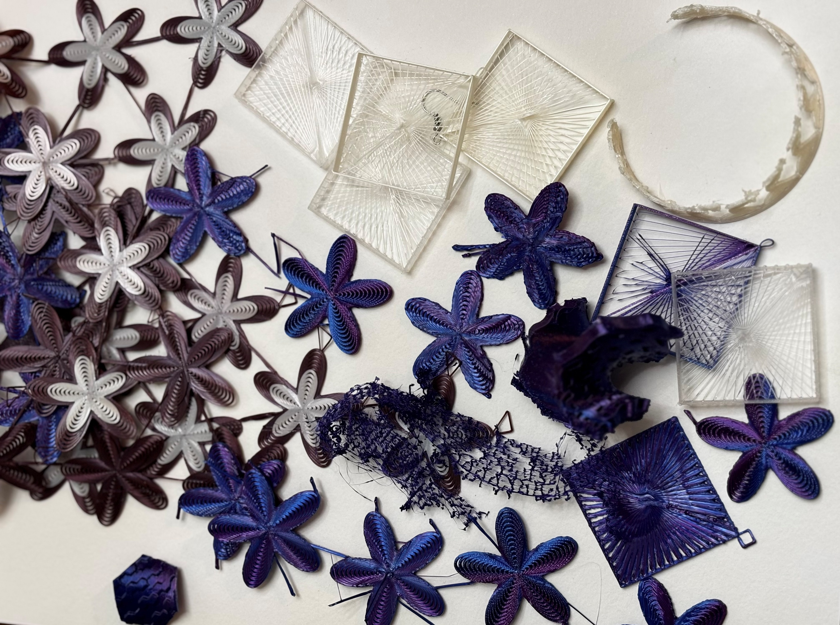
Challenges
Time consuming – couldn’t send out to printing services
Rhino crashing several times - computationally expensive
Lots of trial and error
3D printing problems – TPU is very difficult to work with given its soft nature

Slide 6
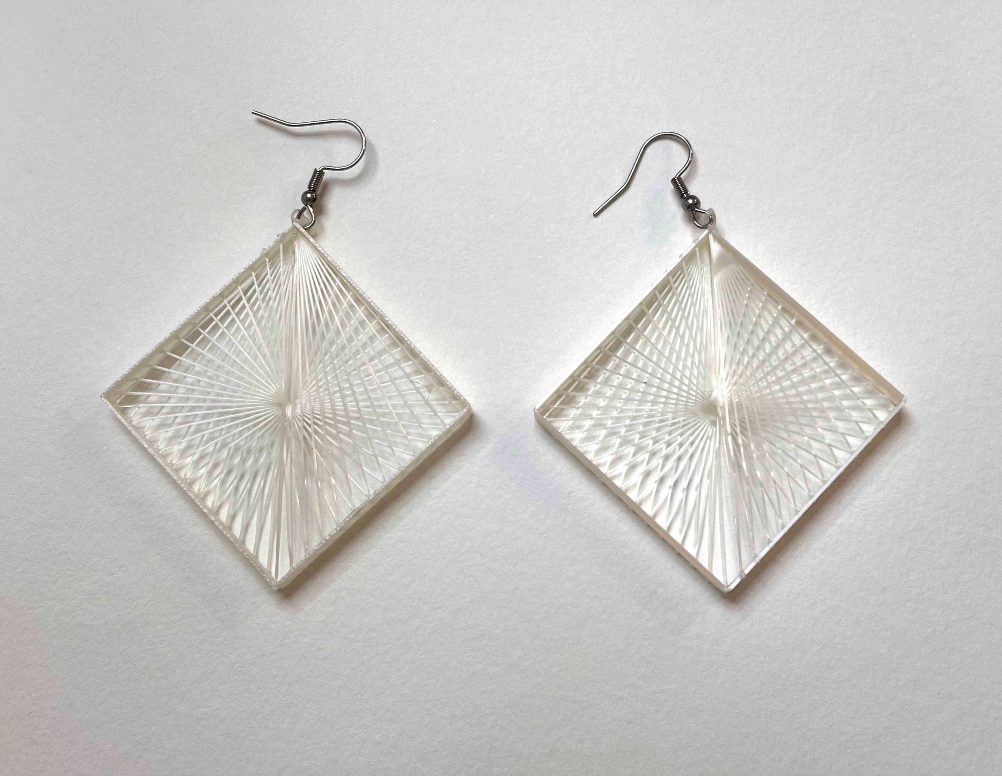
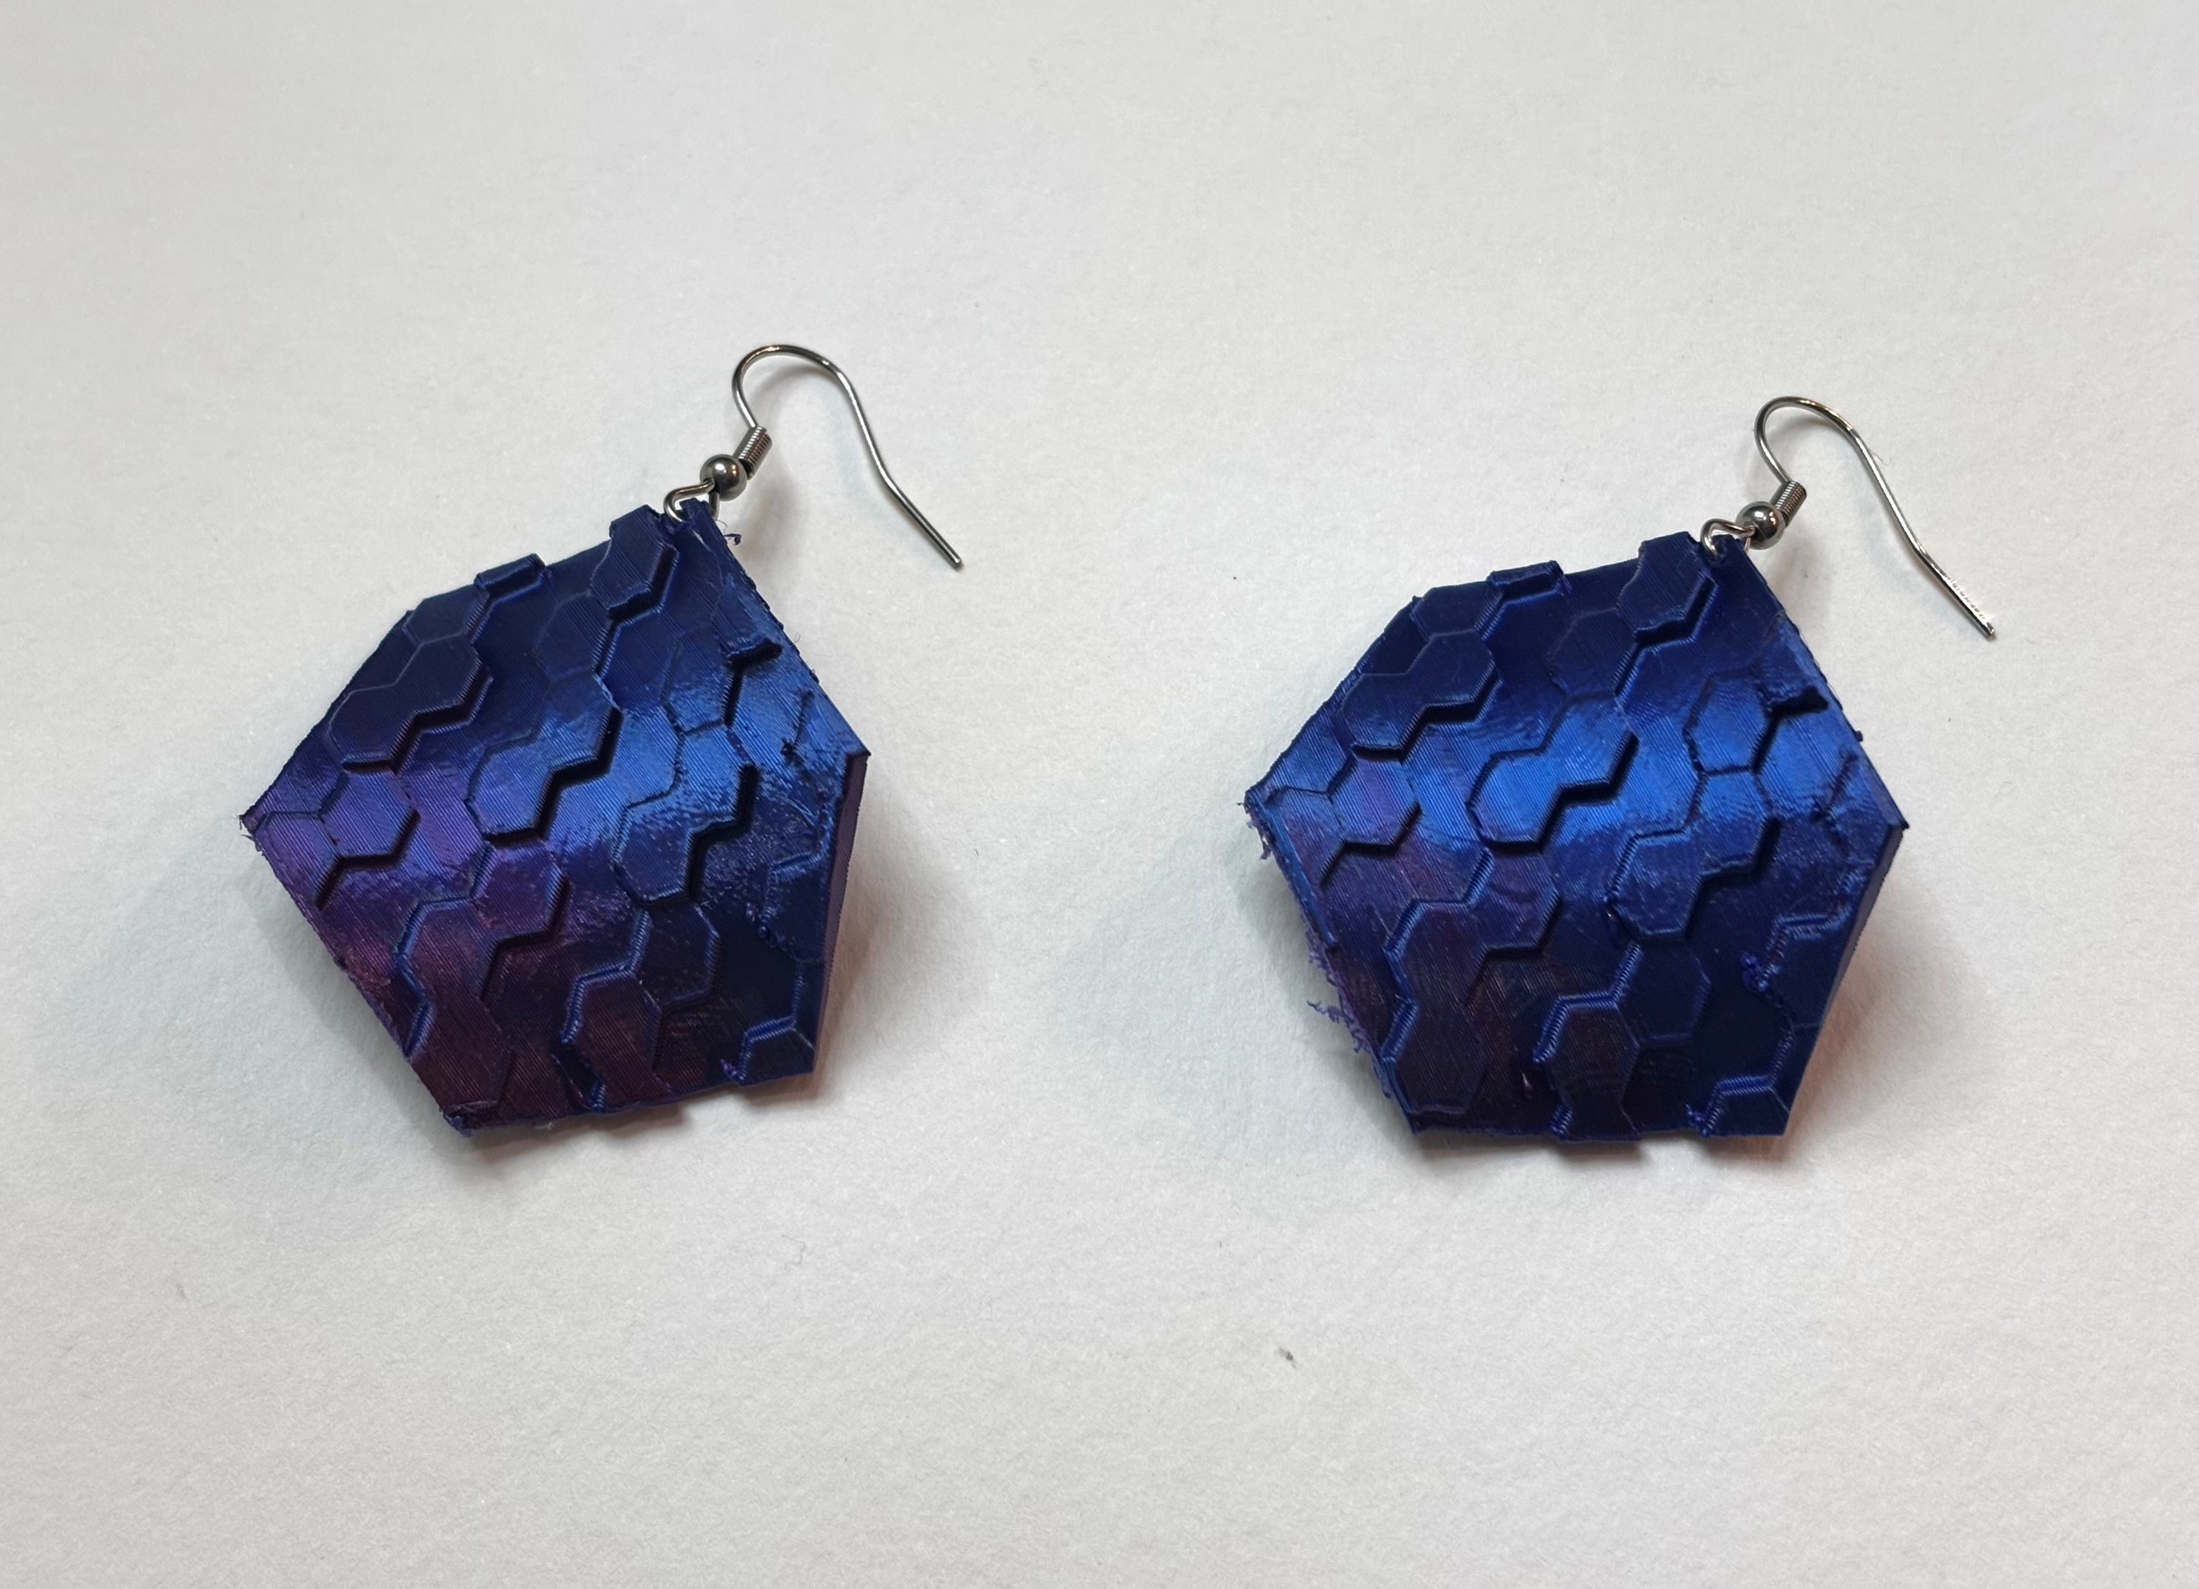
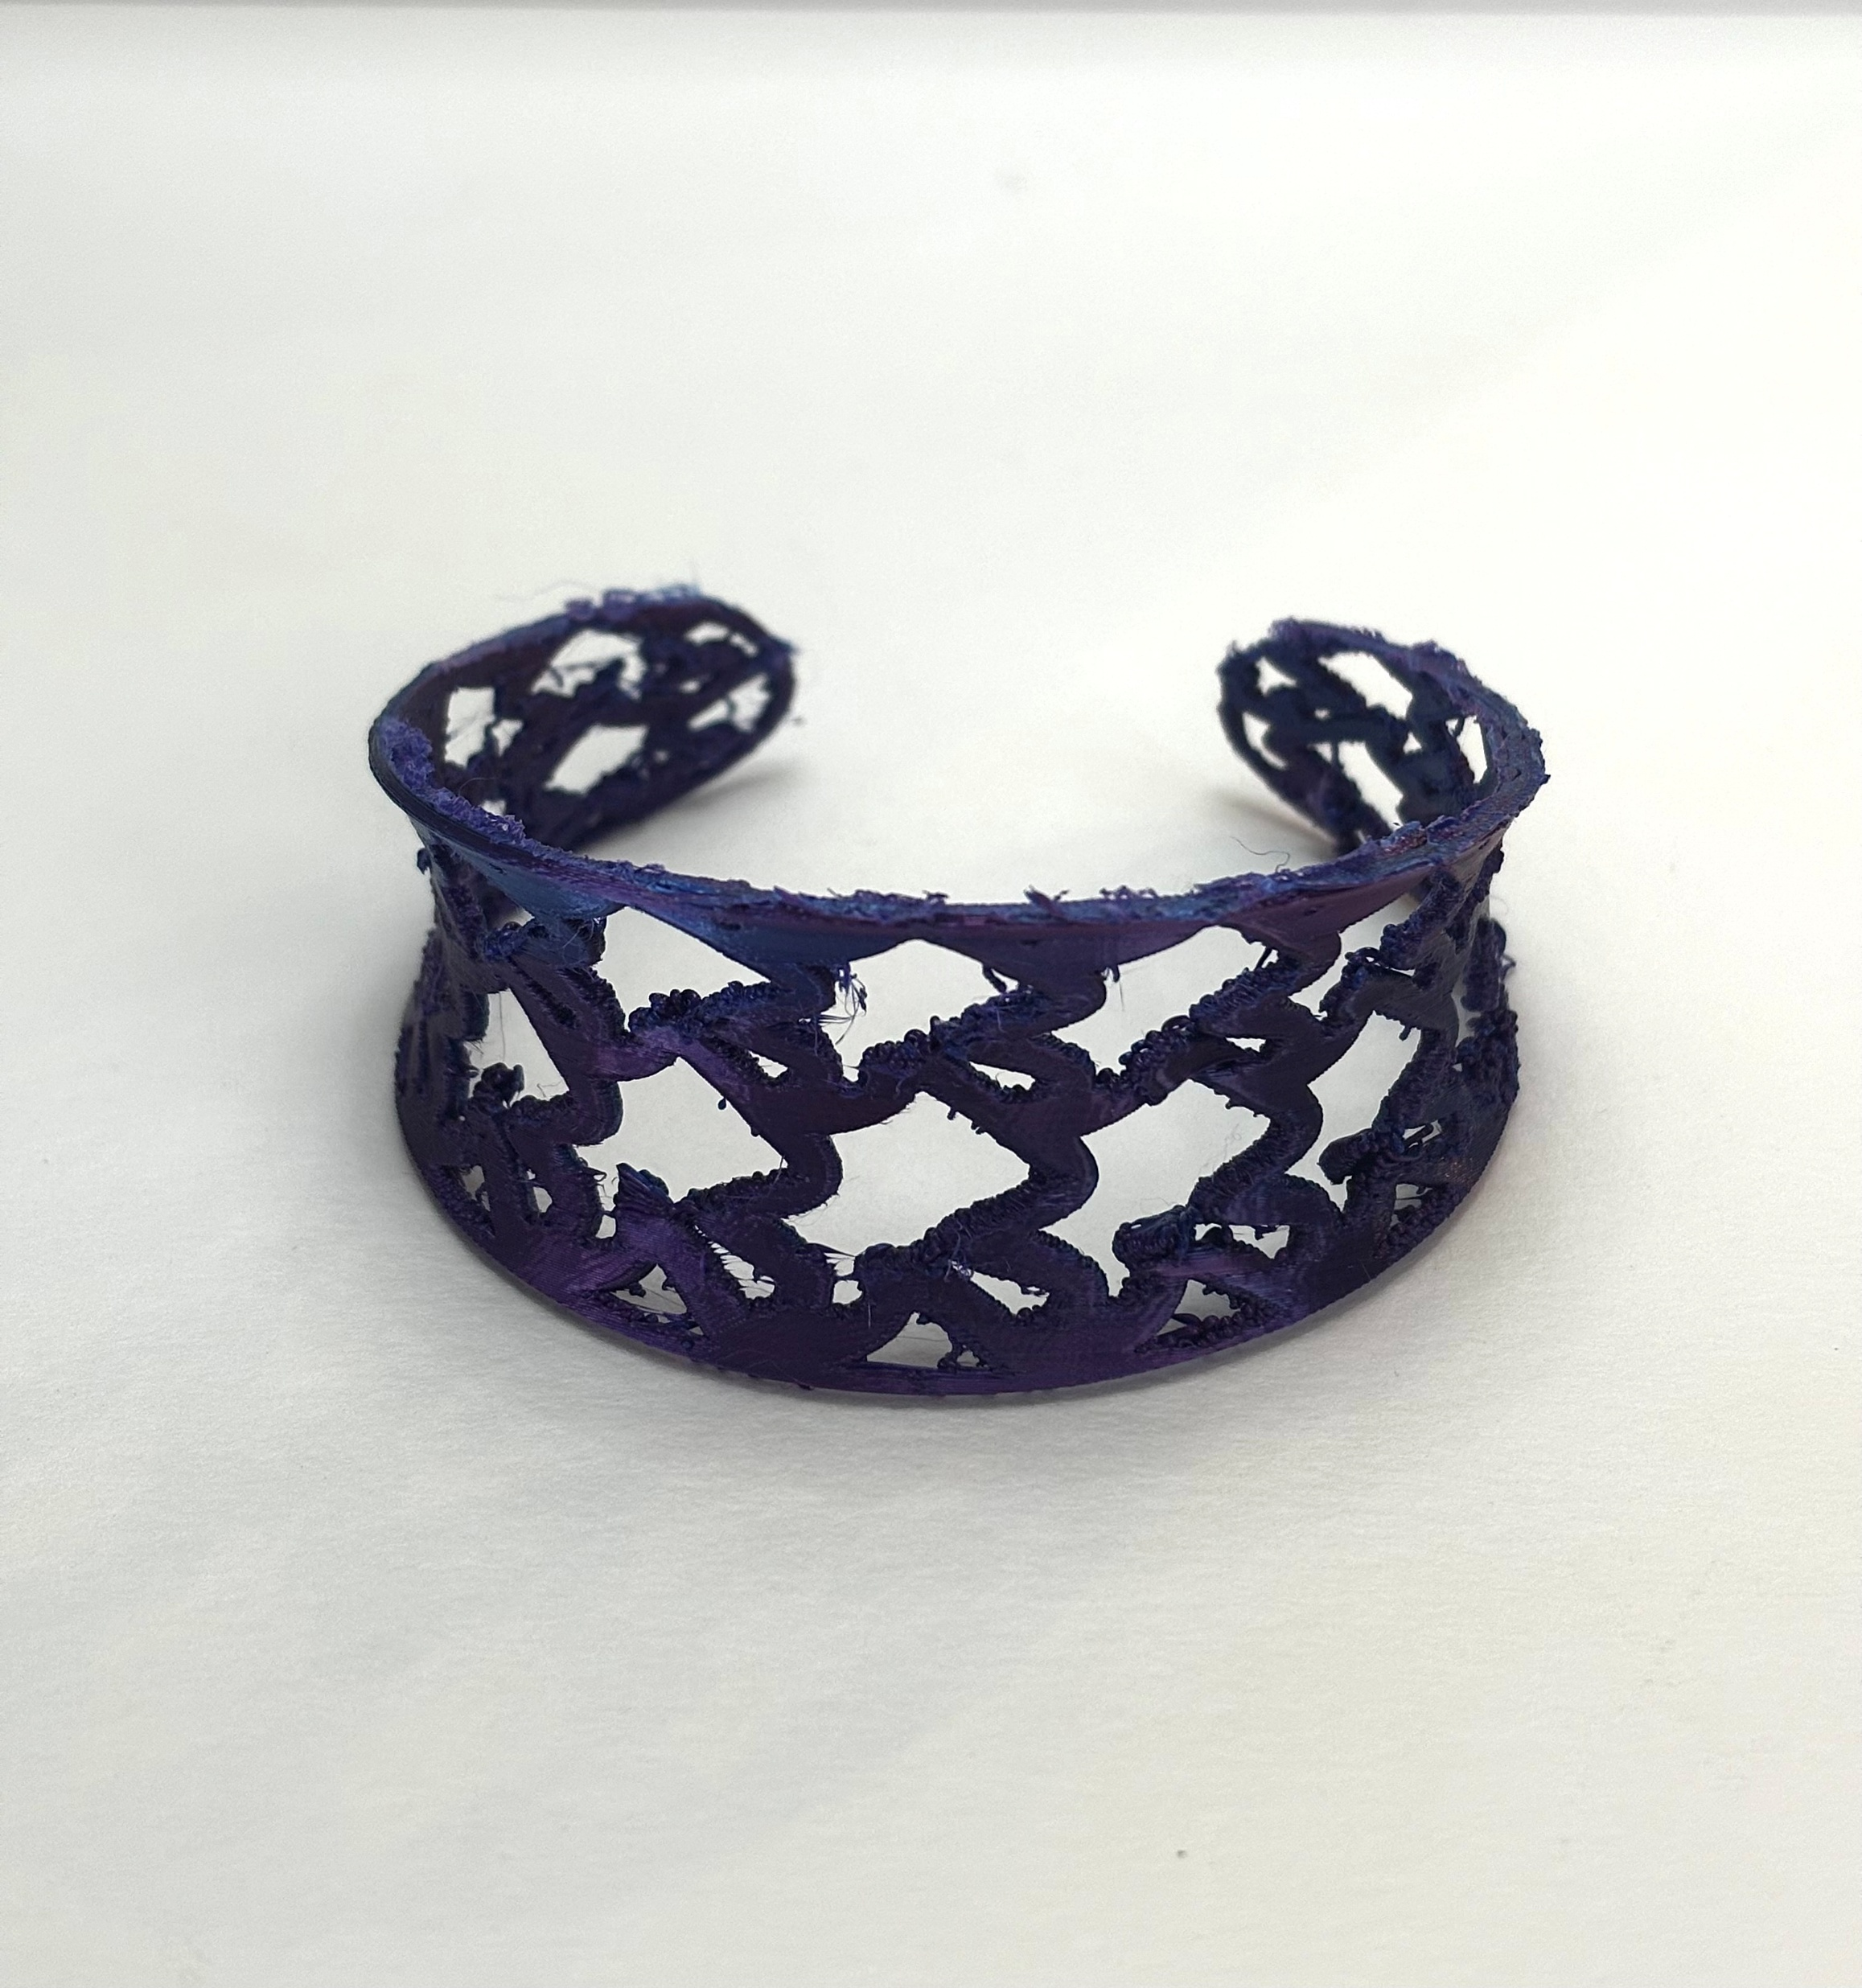
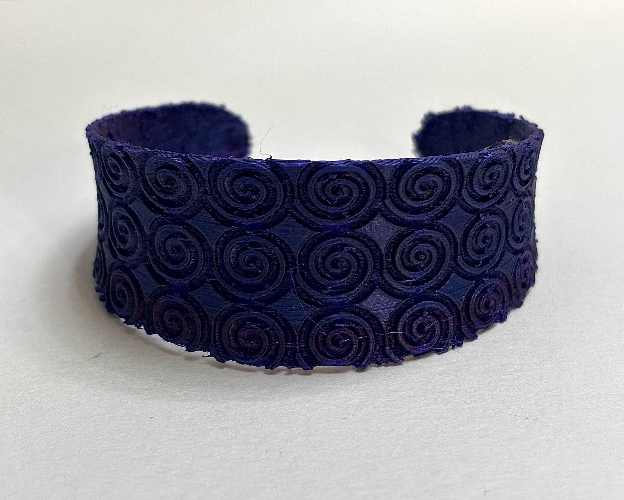
Outcome

Slide 7
Future Work & Reflection
Experiment with different materials (especially with metals and fabrics)
More complex design patterns
Go beyond the pattern – shapes
Learned a lot about geometry
Very time consuming, but pleased with outcome
3D printer and TPU filament nuances
Everyone is now asking me to design them jewelry

Slide 8
Thank you!
Desiree Forster

