Slide 1
Flexible Claw
C. Beau Gilbert

Slide 2
Intro
Inspired by PneuMesh, one of the research projects shown off in class.
Decided to create a claw.
Constructed out of modular joints and pillars.
Flexible structure: Closes without using moving parts like hinges or gears.
Capable of holding small household objects.

Slide 3
Process
prototyping
Lessons from Prototyping
- Focused on iterative design
- Experimented with materials and properties of such
- Figured it out as I went developing the structure as I built it.
- Mix of stiff material and flexible material made the strongest claw
- Need lots of handholds for claw to actually grab stuff
- Modular design is great. Quick turn around, less crippling misprints.

Slide 4
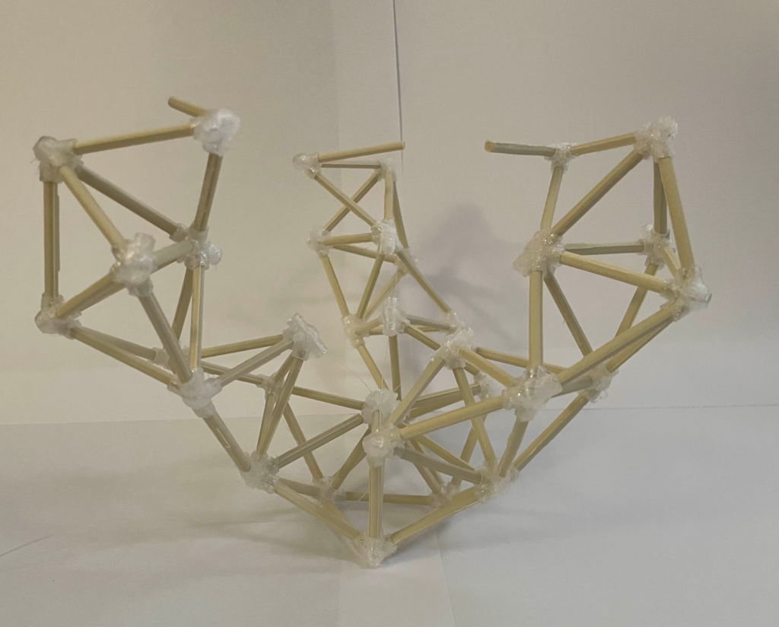
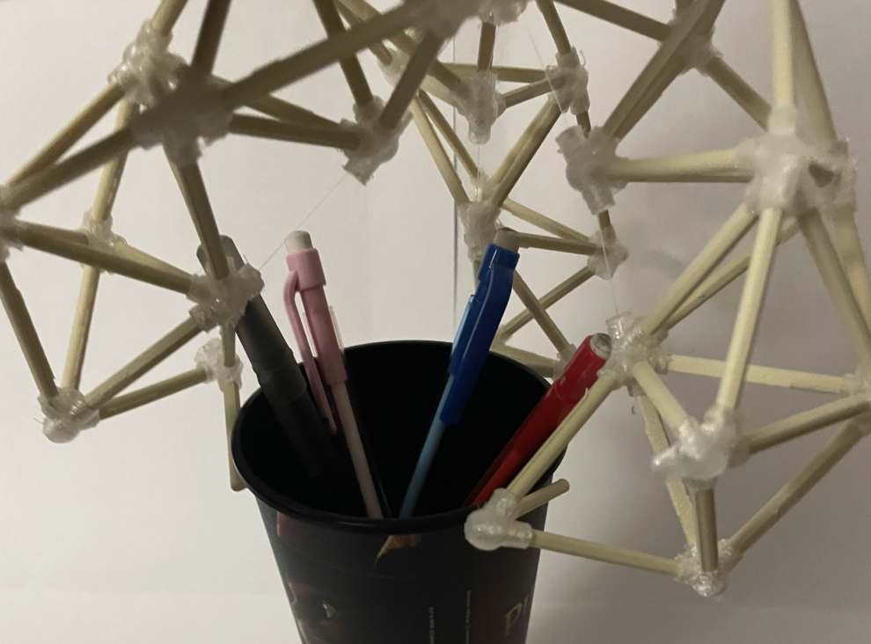
Final Outcome
- Final piece count was 115 individually printed components.
- Closing mechanism uses fishing line.
- Can hold cup full of pencils
- Verdict: Success

Slide 5
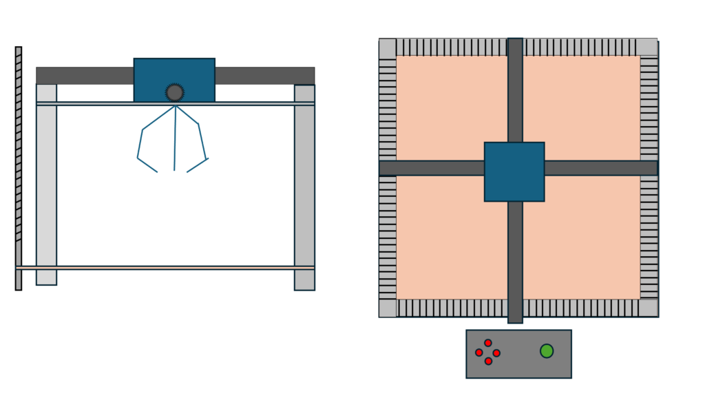
Future
- Expansions?
- Add electric motors so it closes on its own
- Add claw machine framework and turn it into a game.

Slide 6
Thank You

