Slide 1
Computationally Fabricated Skyscrapers
Wayne Rudnick

Slide 2
Introduction to Skyscraper Design and Fabrication
Overview:
Created 5 Skyscrapers
Explored how computational fabrication can be used to design new skyscrapers
Drew inspiration from real-world skyscrapers as well as prototypes
Using algorithmic methods, built skyscrapers from the ground up
Key Goals:
Investigate feasibility and aesthetics in skyscraper design
Combine structural practicality with innovative, eye-catching forms
Create never before seen building designs

Slide 3
Designing and Printing
Computational Design
Designed using Grasshopper and Rhino
Built skyscrapers layer by layer. Shapes manipulated along the Z-axis (e.g., twisting, reshaping)
Used functions like sine waves
Combined layers using Loft
Fabrication
Models 3D-printed on an Ender 3 printer using Cura for slicing
Printing times ranged from 2.5 to 5.5 hours
Overcame challenges with bed leveling to ensure proper filament adhesion
Challenges Encountered
Balancing structural feasibility with innovative designs
Slight loss of precision at spire tops during printing
Ensuring unique designs without compromising stability

Slide 4
Final Product

Slide 5
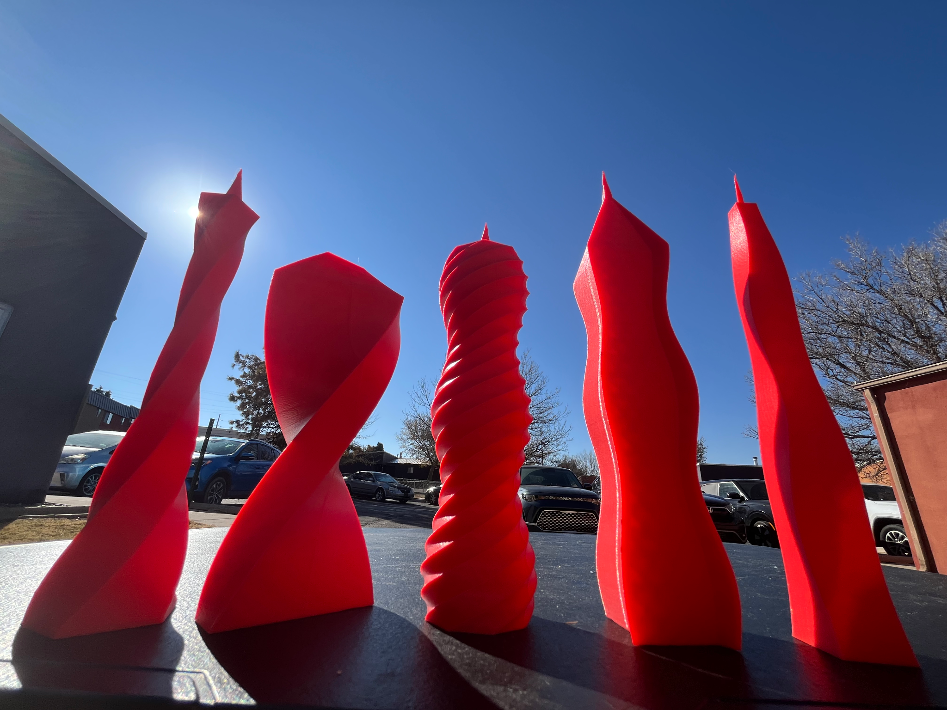

Slide 6
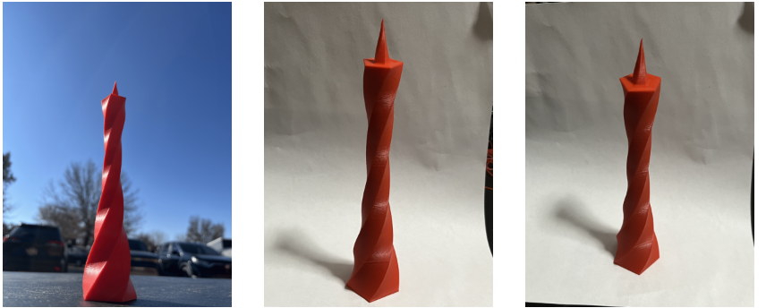

Slide 7
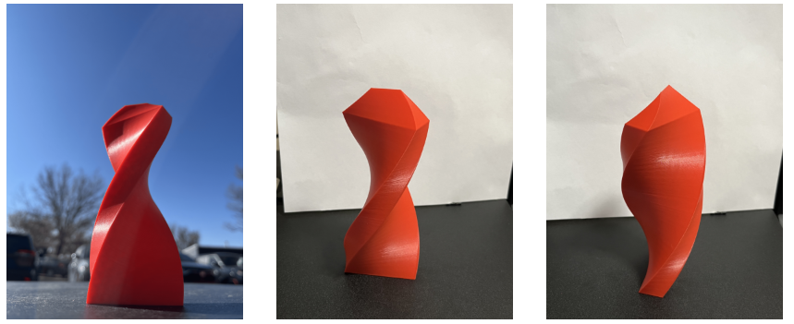

Slide 8
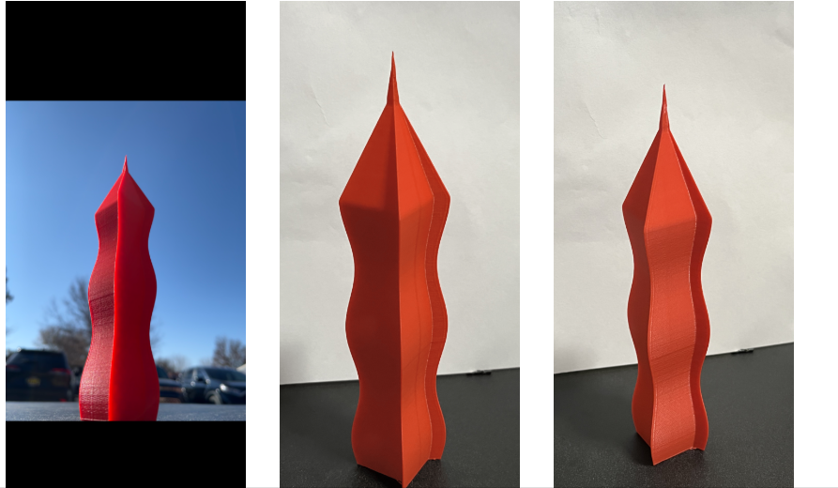

Slide 9
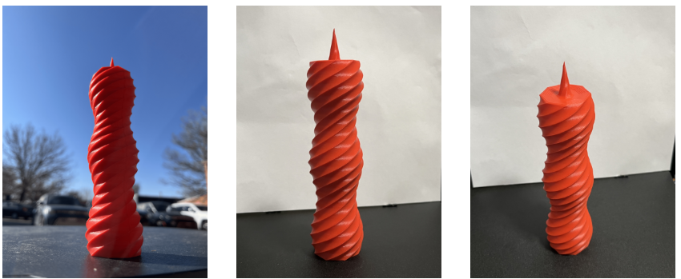

Slide 10
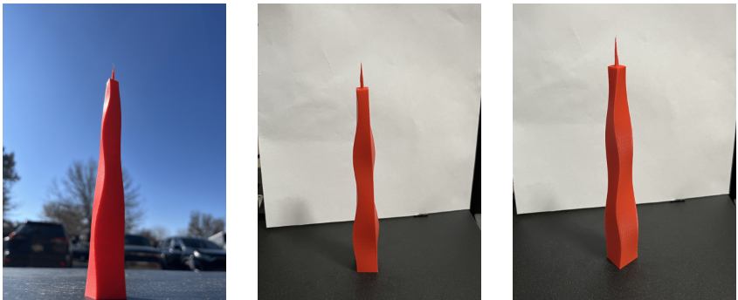

Slide 11
Thank You!
Wayne Rudnick - Master’s Student at UNM

