Slide 1
Fiducial FEZ
Logan Sullivan

Slide 2
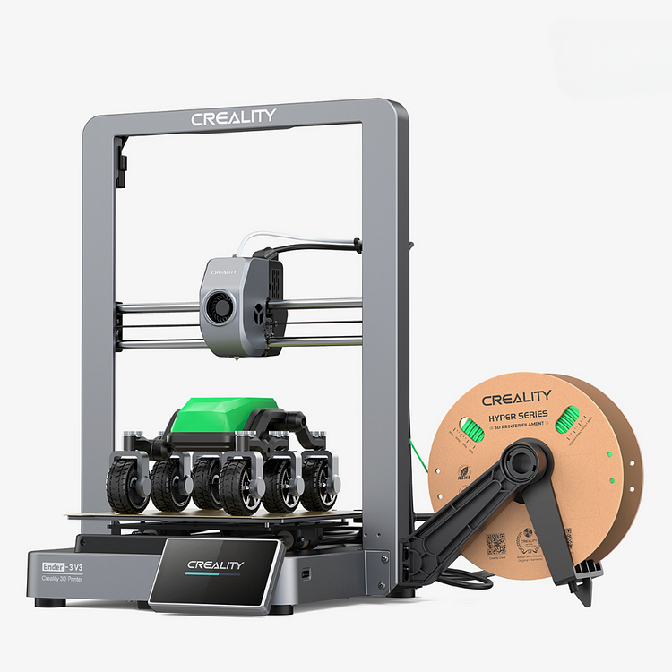
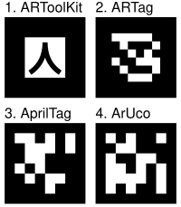
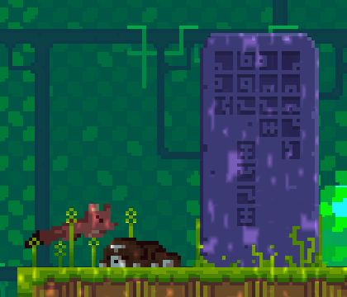
Fiducial FEZ
FEZ is a puzzle game with a made-up language called Zuish
English, but with a vastly different set of symbols
Rotation is important, for both the symbols and reading in general
Zuish letters look a lot like fiducial markers
Why not make them into actual fiducial markers?

Slide 3
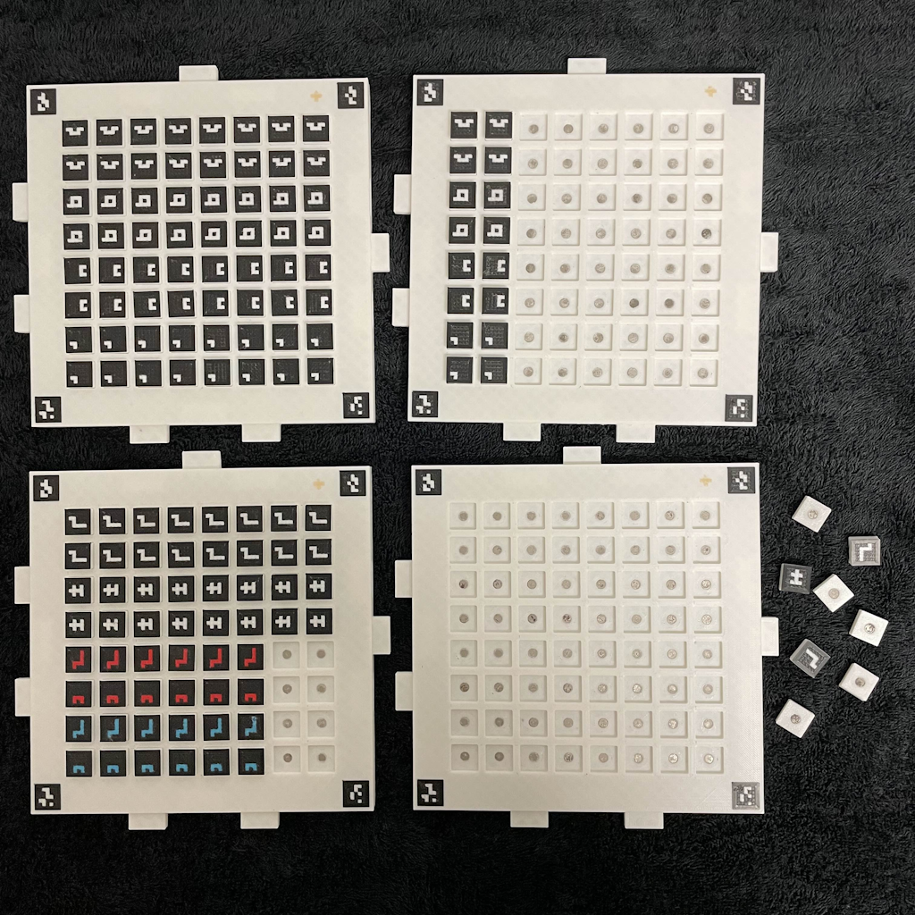
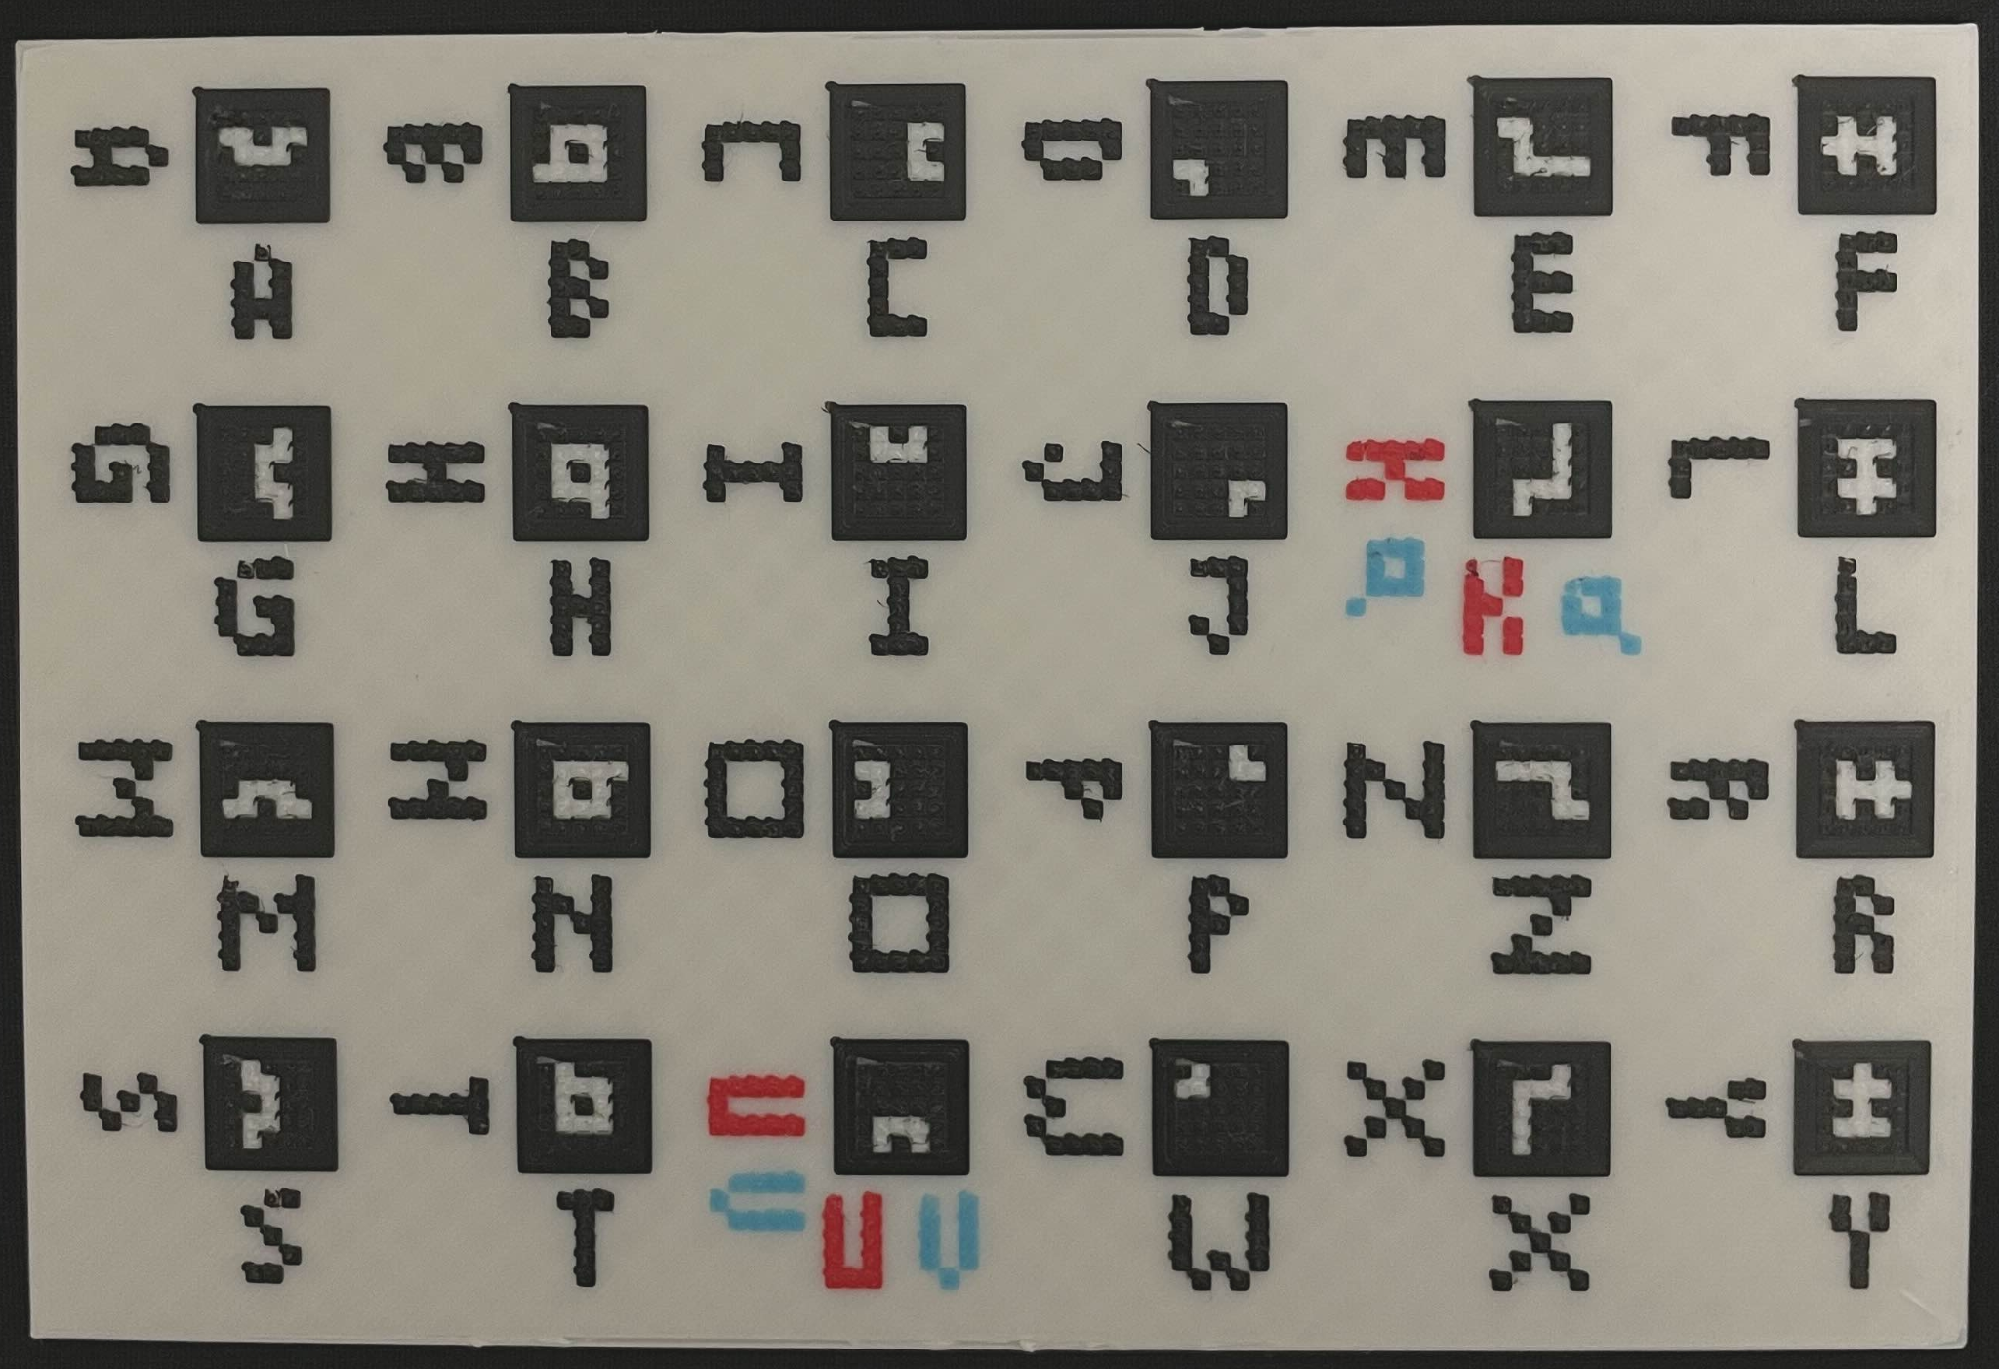
The Stuff
Baseplates that provide a grid for tiles
Able to connect together
Tiles with Zuish letters
Some use red or blue instead of white
Physical translation keys
Zuish and English rotations
Scanner / Translator
A whole dang website

Slide 4
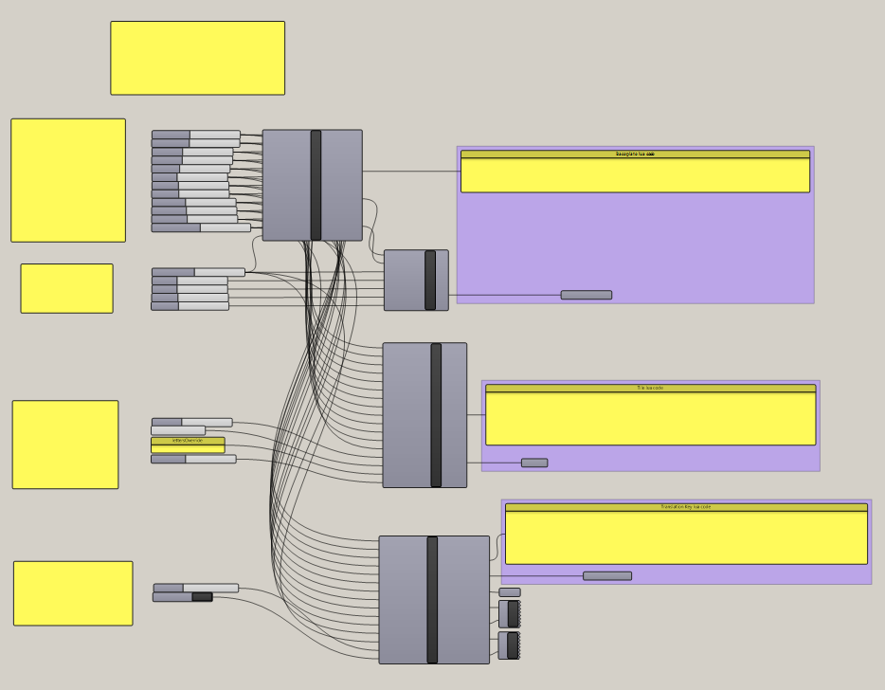
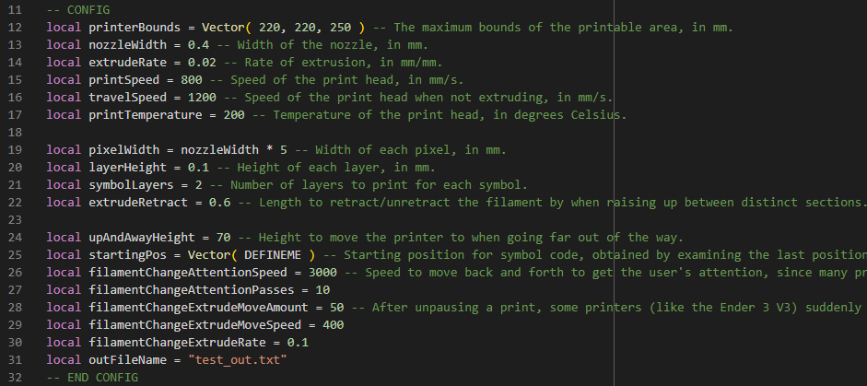
Design Process
Make models in Grasshopper -> slice with Cura -> add custom gcode with Lua
Maximize number of tiles per baseplate without making them too small
Make baseplates easy to connect, and easy to orient for the scanner
The devil’s in the details
Straightforward ideas, involved solutions

Slide 5
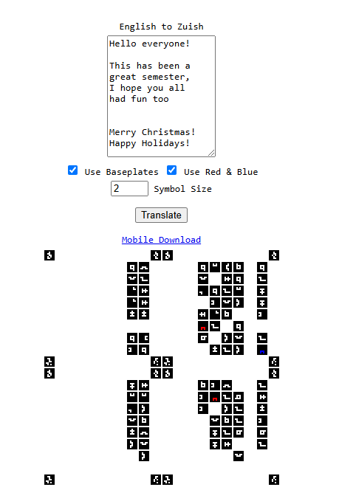
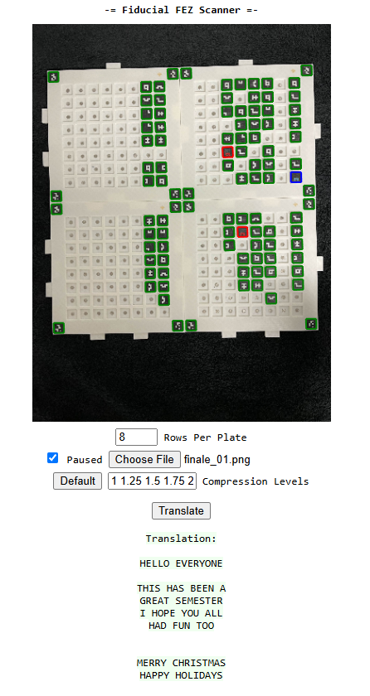
Live Demo
Scanner Website!

Slide 6
Thank You!
- Logan Sullivan

