Slide 1
Robotic Hand
First Year CS Master’s Student
12/10/24
Andrew Holmes

Slide 2
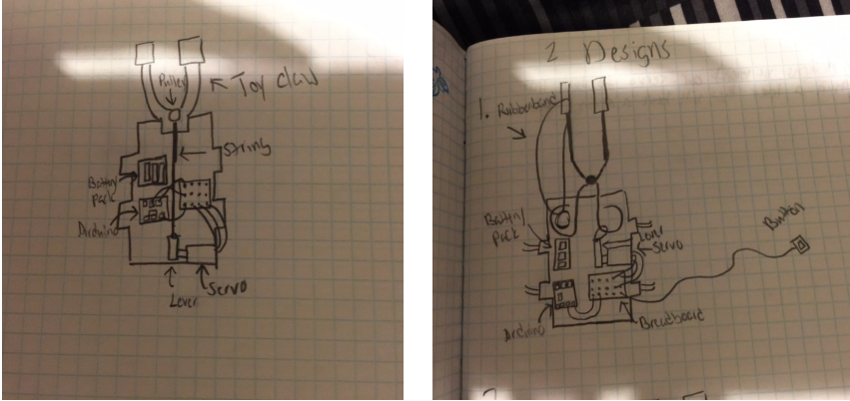
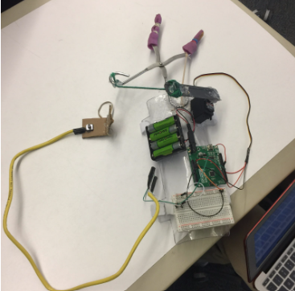
Revitalizing a Past Project

Slide 3
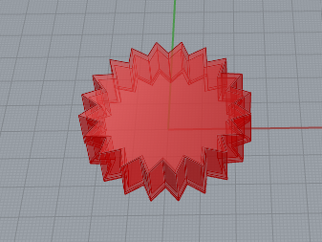
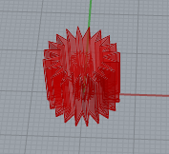
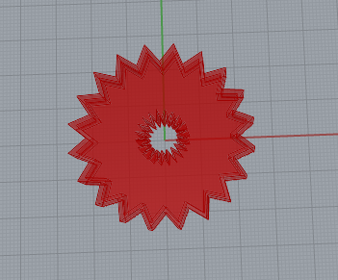
Process and Struggles
Focused on integrating gears to elevate design functionality.
Prioritized efficient placement for synchronized rotation.
Tested and refined gear design for compatibility with servos.

Slide 4
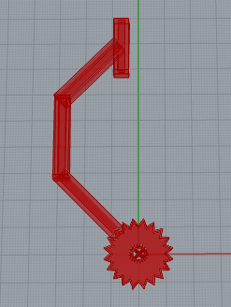
Process and Struggles
Computational Design Process
Used Python to create parametric designs for finger components.
Rotated finger segments at 45° to achieve a curved claw look.

Slide 5
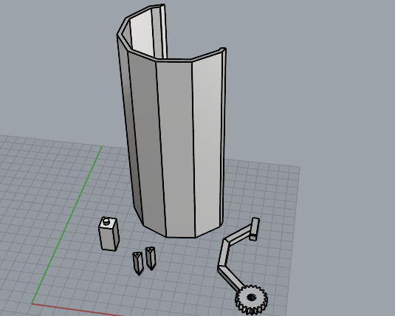
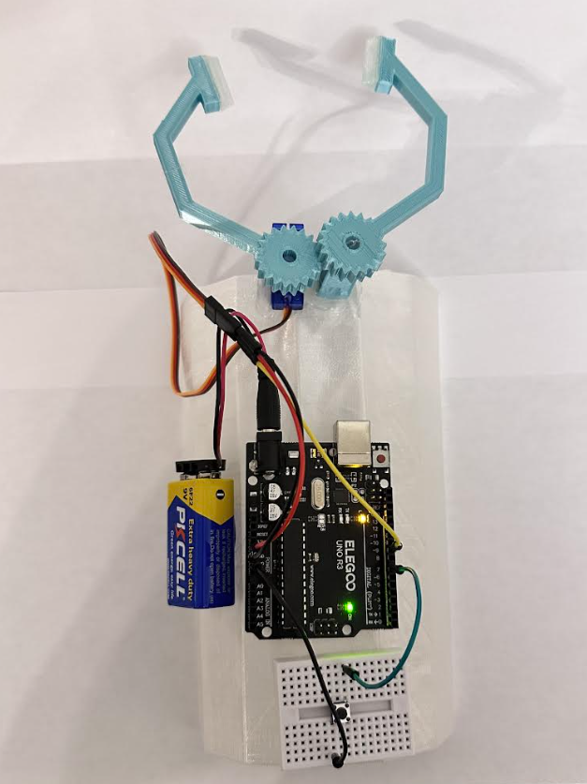
Process and Struggles
Adjusted parts for precise fit by trial and error without calipers.
TPU clogging caused 8 hours worth of lost time
Changed arm base to a hexagon for better component layout.
Introduced a tapered arm base to match wrist dimensions.
Created modular sleeves for components to avoid direct hot-glue application.

Slide 6
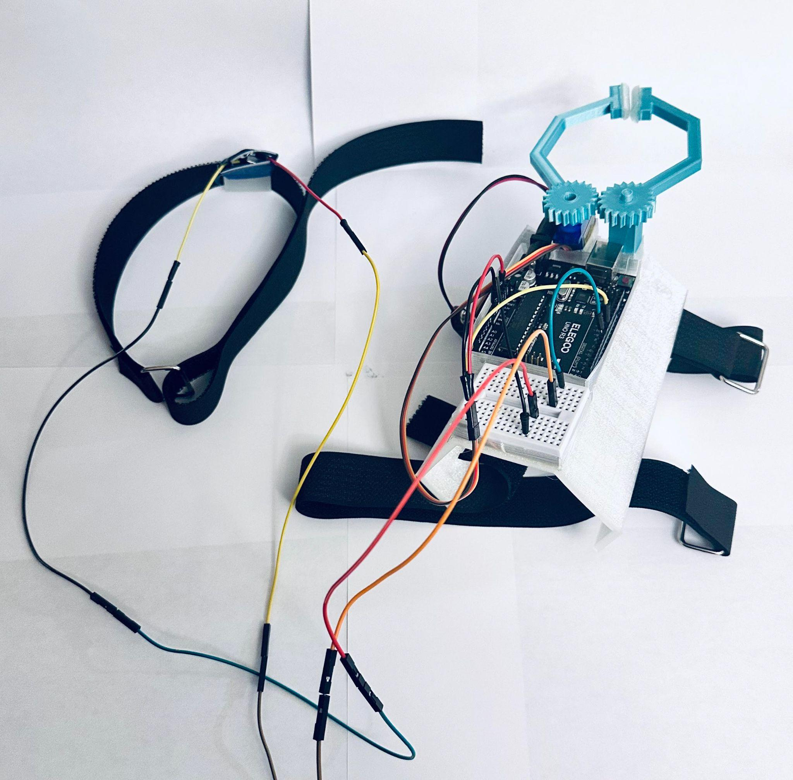
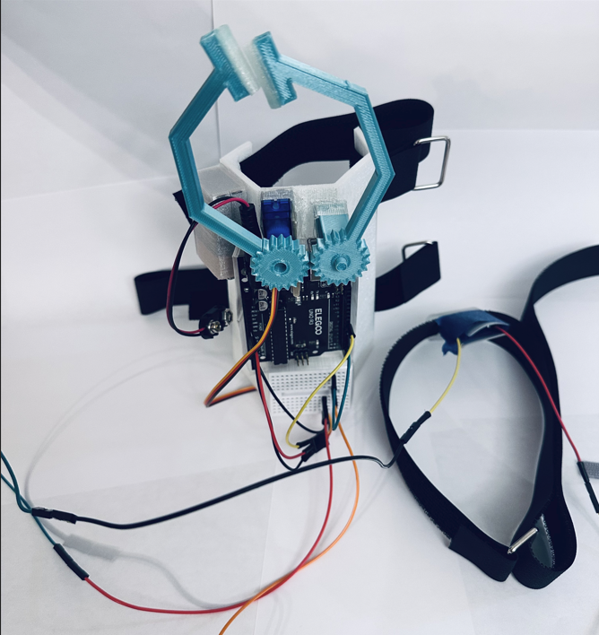
Final Outcome

Slide 7
Thank You
&
Quick Q&A
Andrew Holmes
First Year CS Master’s Student

