Slide 1
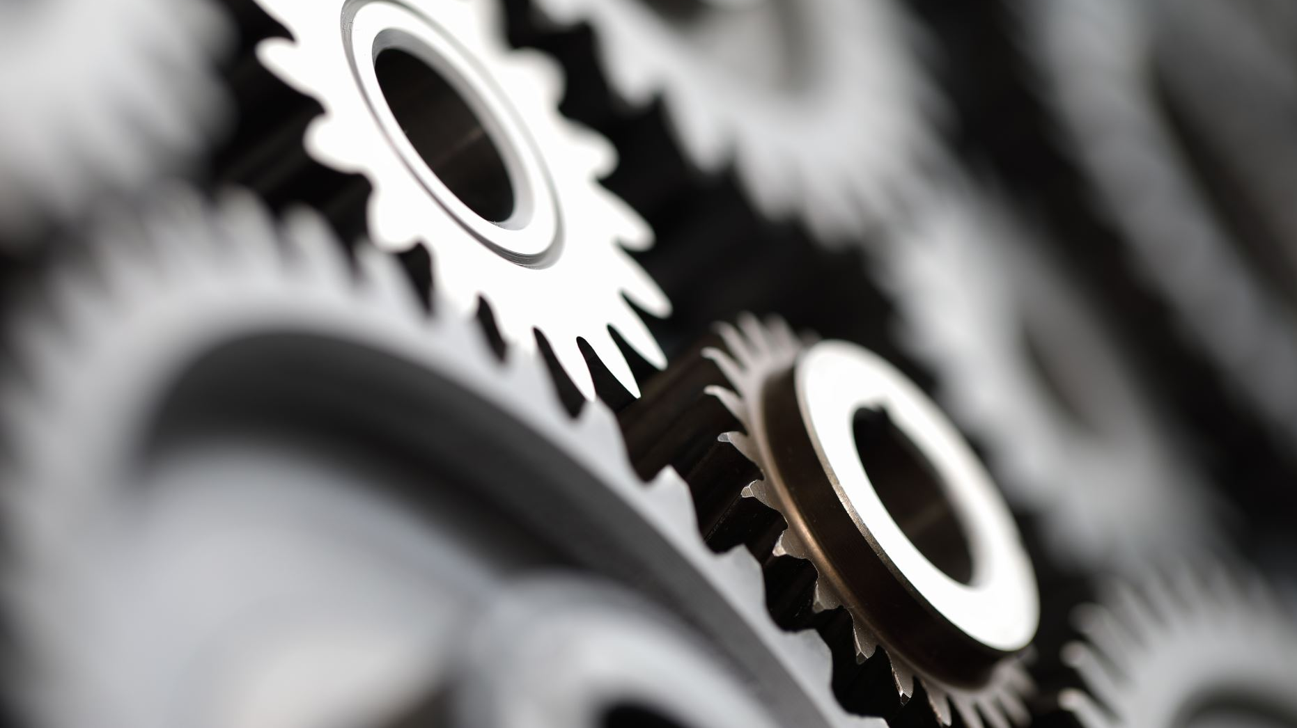
Designing Motion: Gears & Vessel Transitions
CS 491/591 – Computational Fabrication
Andrei Phelps | Undergraduate – Computer Science

Slide 2
Introduction
Sine-wave patterns designed for interlocking, dynamic movement.
Generated computationally using Python scripts and Grasshopper.
Exploring functionality through motion and visual appeal.

Slide 3
First Steps
Started with computationally generated sine-wave gear designs.
Incorporated a central hole for alignment and movement using pins.
Experimented with Cura slicing settings to balance structure and weight.

Slide 4
Prototypes
Printed multiple gear prototypes to refine functionality and structure.
Tested different infill densities and wall thickness for balance between strength and weight.
Adjusted central hole size to improve alignment with pins and ensure smooth rotation.

Slide 5
Infill & Size
Tested multiple infill densities to balance lightweight design and durability.
Settled on 5% infill, which provided sufficient structural integrity while keeping the gears lightweight.
Adjusted gear size to ensure compatibility with pins and cork board, optimizing functionality and visual appeal.

Slide 6
Computational Vessels
Initial designs included intricate lattice structures, but slicing issues prevented successful prints.
Shifted focus to a twisted sine-wave form that transitions from a gear-inspired base to a circular hourglass shape.
Parametric generation in Python and Grasshopper allowed fine control over wave patterns, transitions, and geometry.

Slide 7
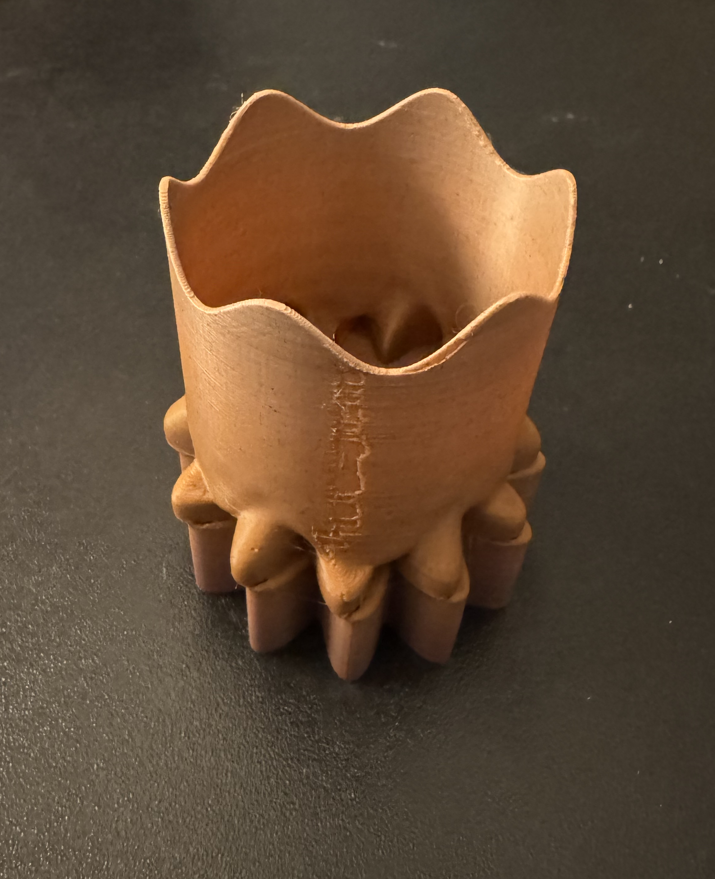
Centerpiece(s)
Initially, I planned to create a lattice-like design for the centerpiece, but slicing issues in Cura made it impractical to print.
Instead, I opted to print two of the hourglass-like designs, which feature a smooth transition from a gear-inspired base to a twisted sine-wave form.
These hourglass shapes not only enhance the visual appeal but also rotate beautifully, adding a dynamic element to the final display.

Slide 8
Final Outcome
The final vessel transitions from a gear-inspired base to a twisted sine-wave hourglass form.
This design balances aesthetic appeal with structural integrity, showcasing computational precision.
Printed with a 5% infill for lightweight durability, the vessel highlights the functional potential of sine-wave patterns for movement and interlocking gears.

Slide 9
Thank You!
CS 491/591 – Computational Fabrication
Andrei Phelps | Undergraduate – Computer Science

