Slide 1
Beat•le
Erin McClure
Computational Fabrication
Department of Computer Science - University of New Mexico

Slide 2
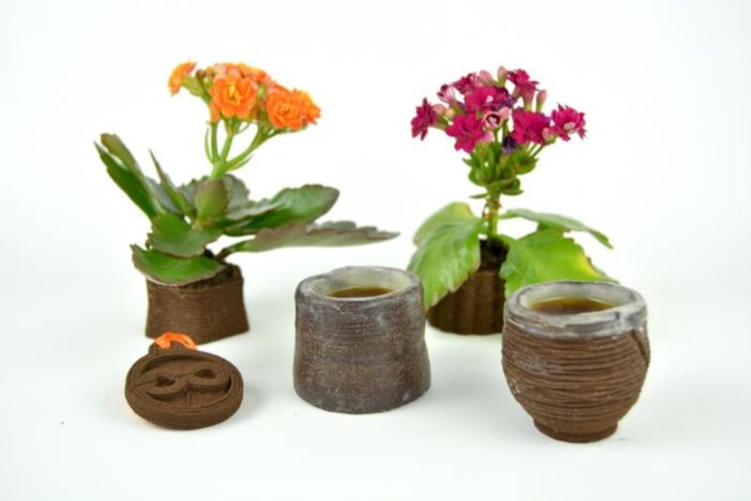
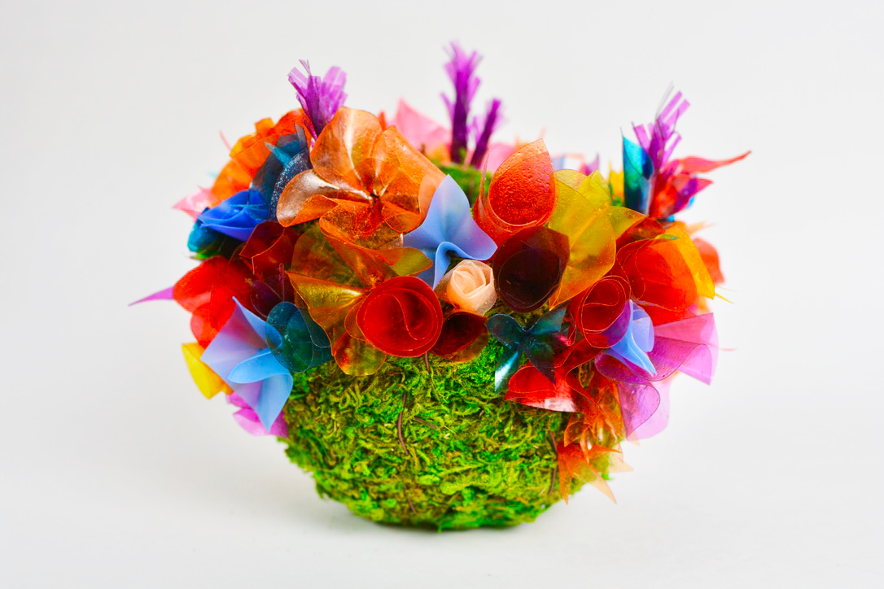

Slide 3
Questions
How can software remove barriers for people to use more sustainable options?
Circuit
Load an image and slice it
What colors of dyes are possible?
Turmeric
Beats
Walnut Husks
How versatile is a clay that transfers color?
Make up
Clothing

Slide 4
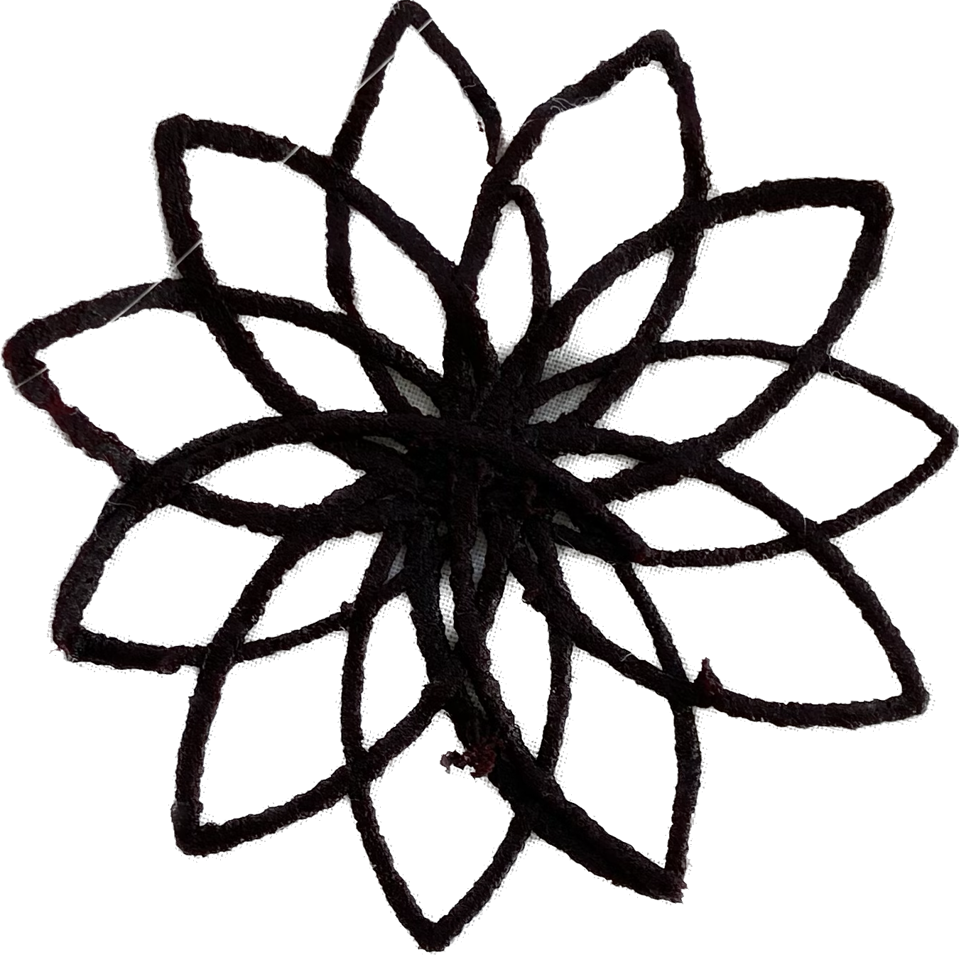
Materials
Beat powder
Methyl Cellulose
Xanthium Gum
Water
Beat powder
Sodium Alginate
Salt
Water

Slide 5
Materials

Slide 6
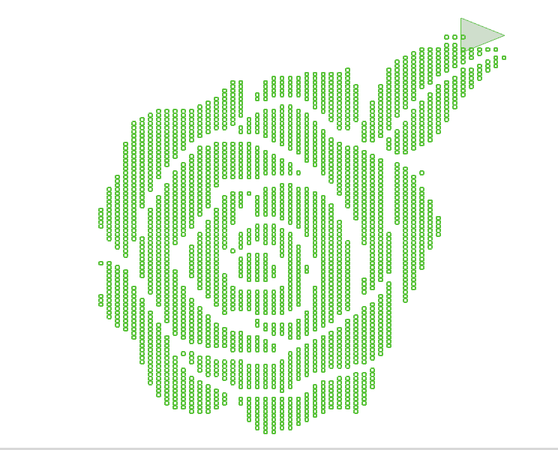
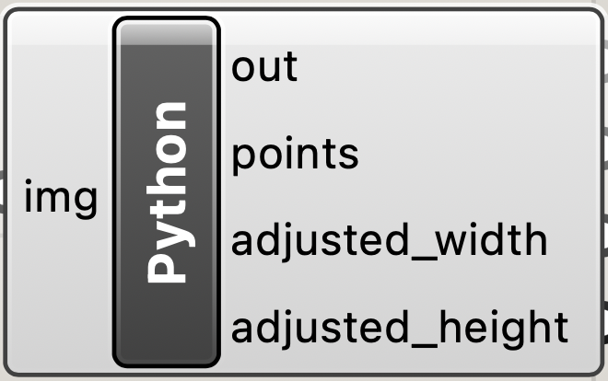
Code

Slide 7
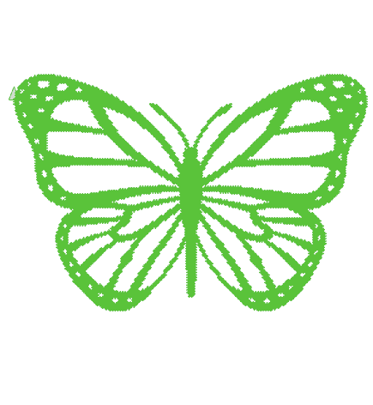
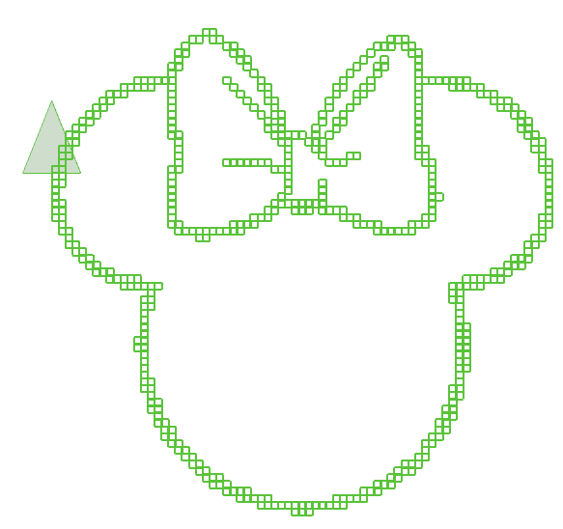

Slide 8
Toolpath Path problems

Slide 9
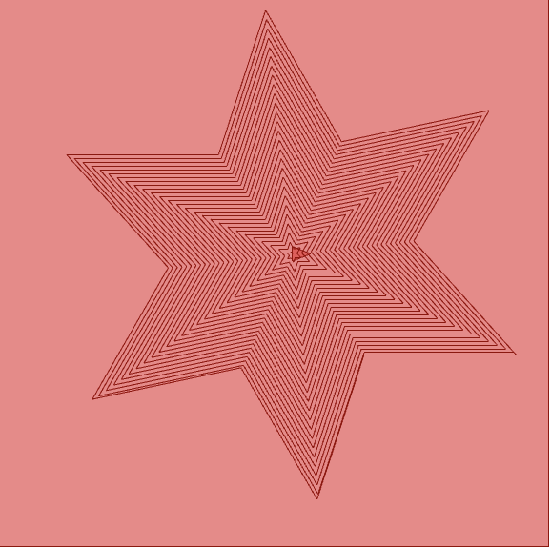
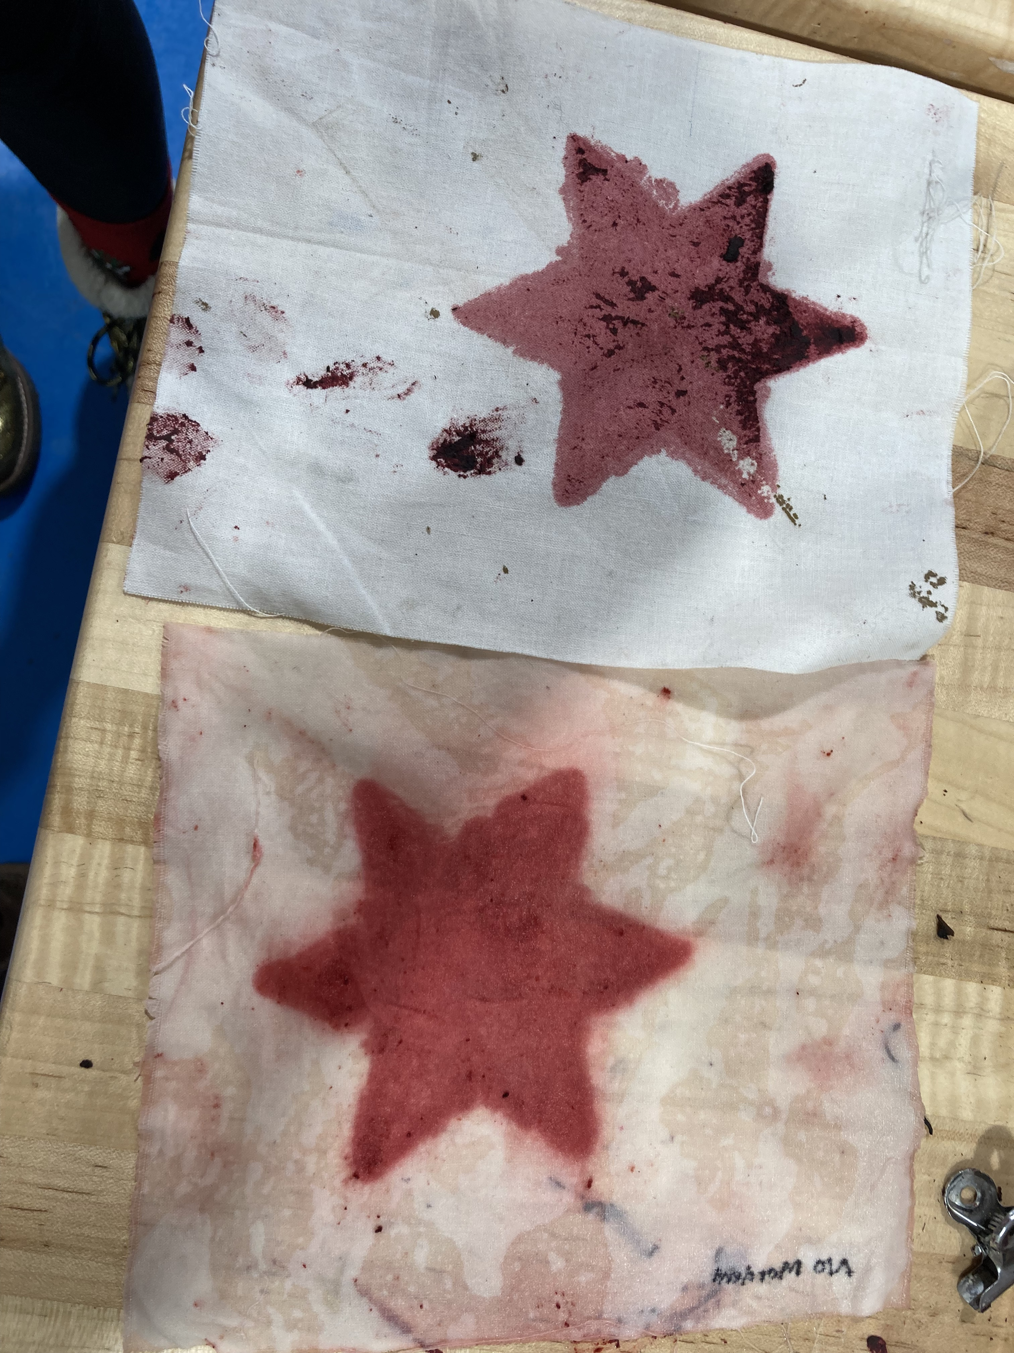
Solid Color

Slide 10
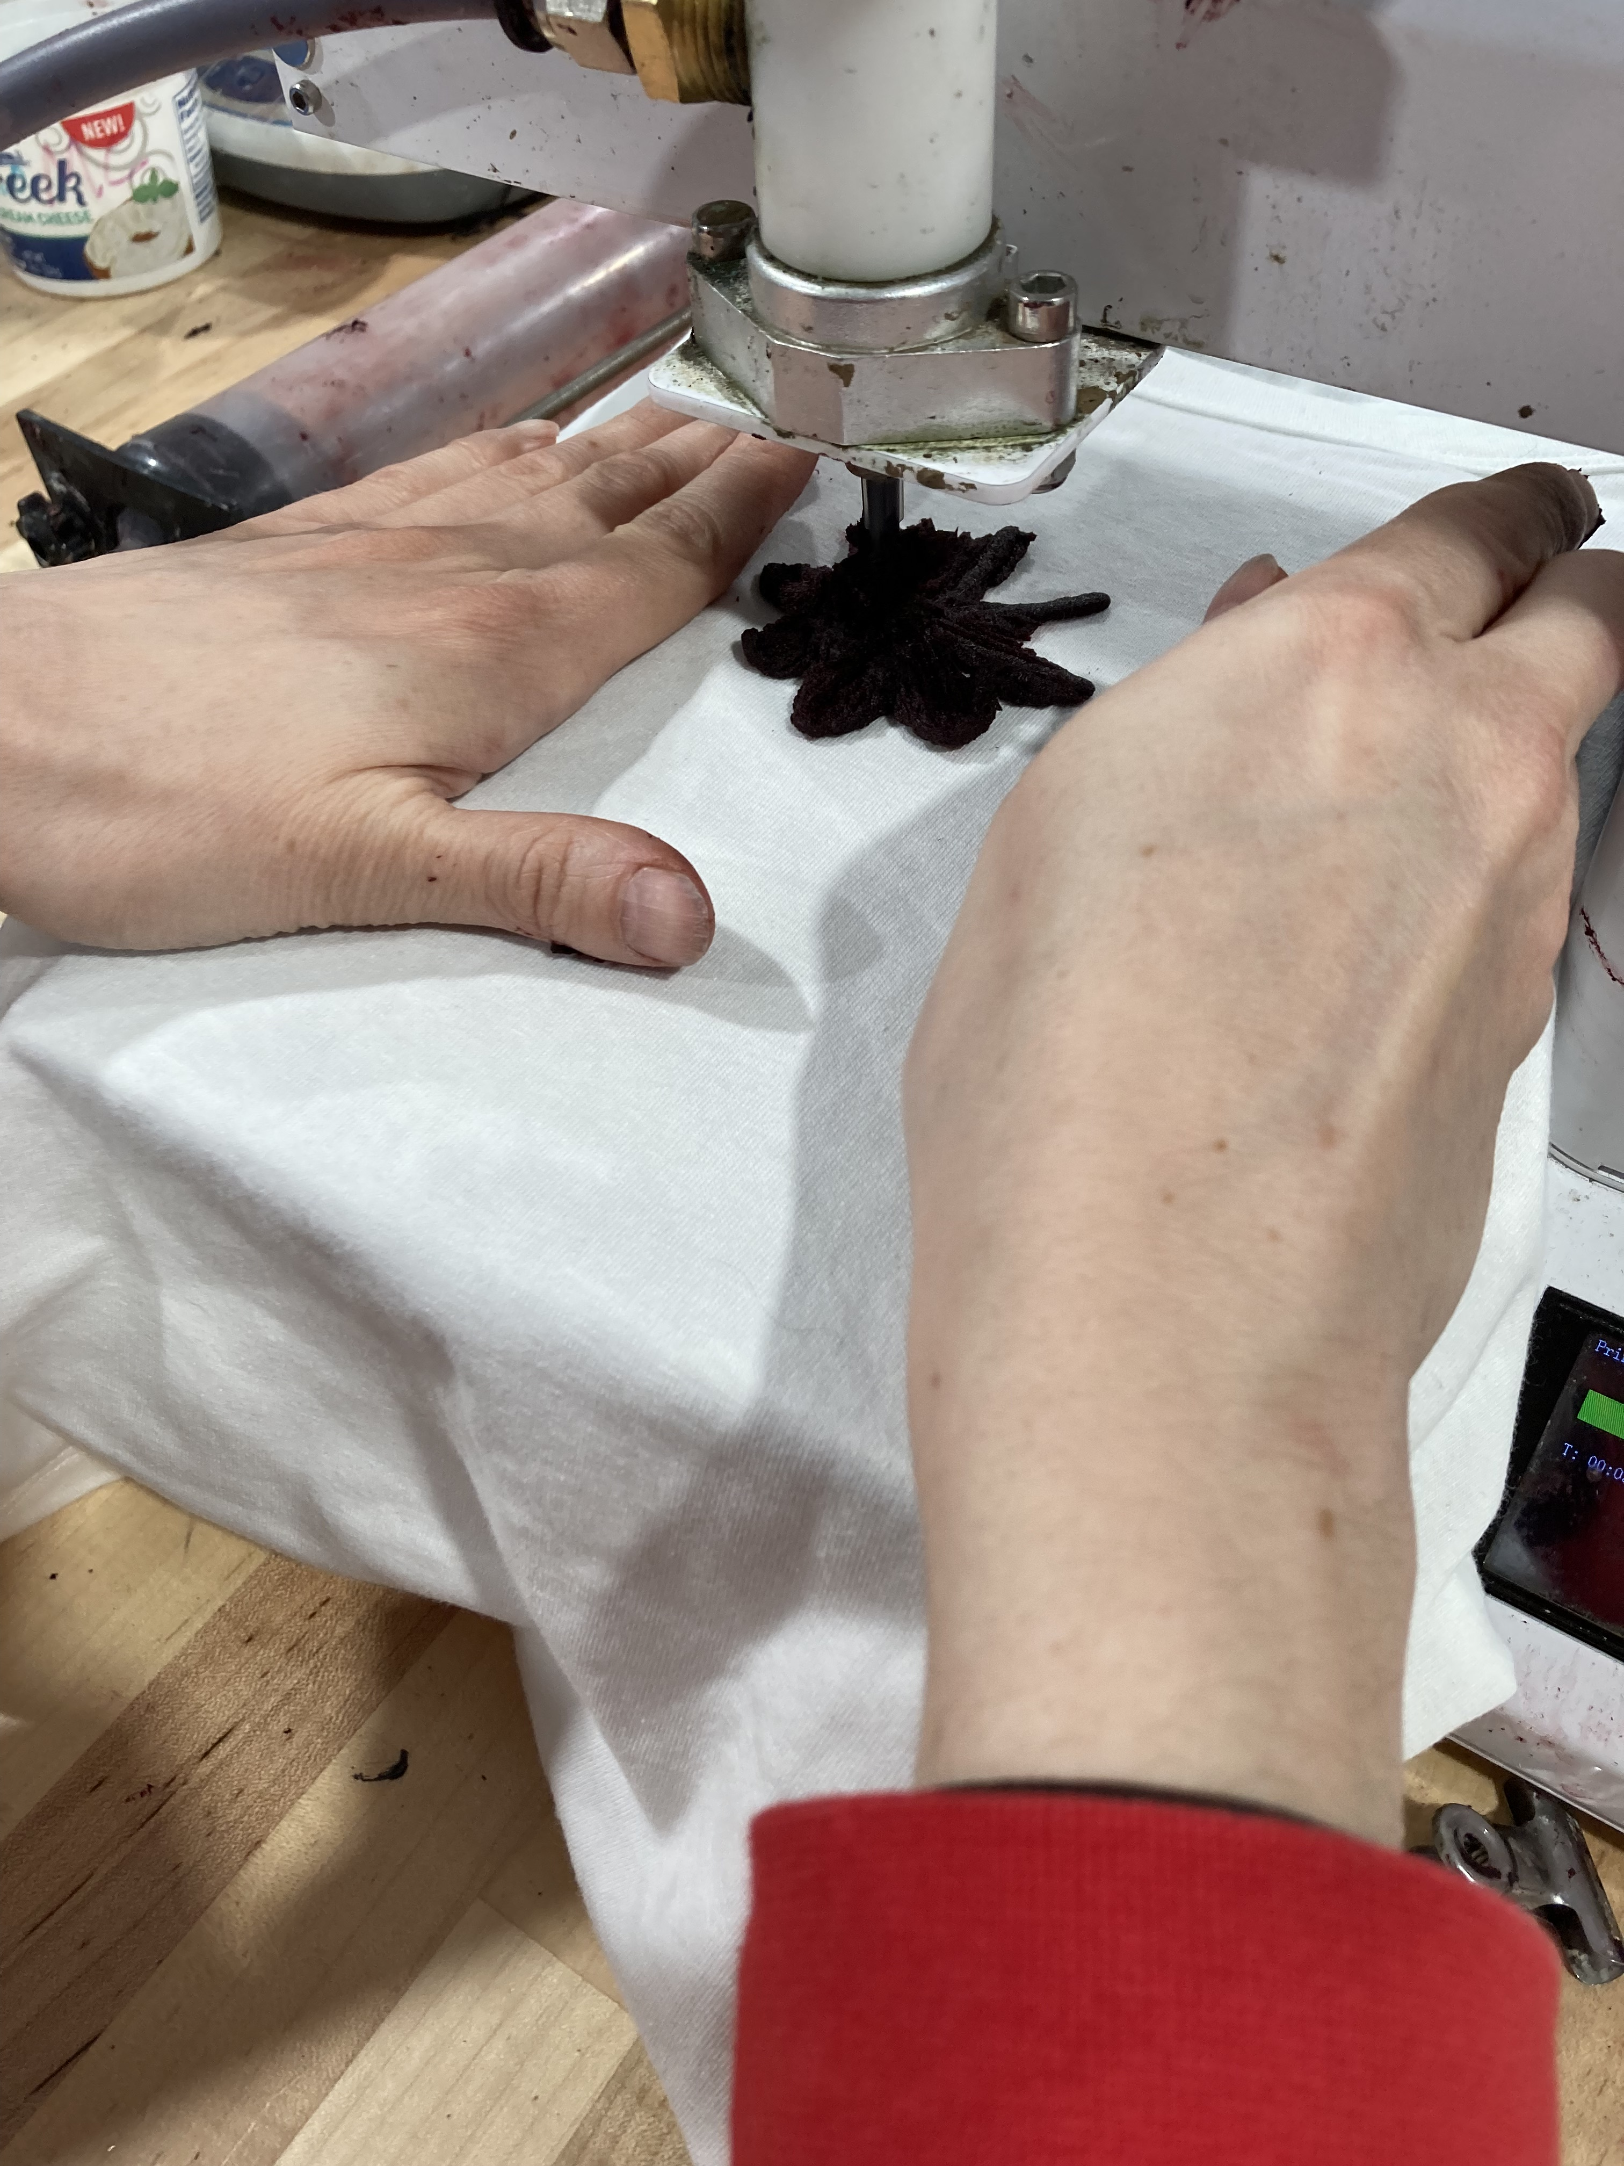
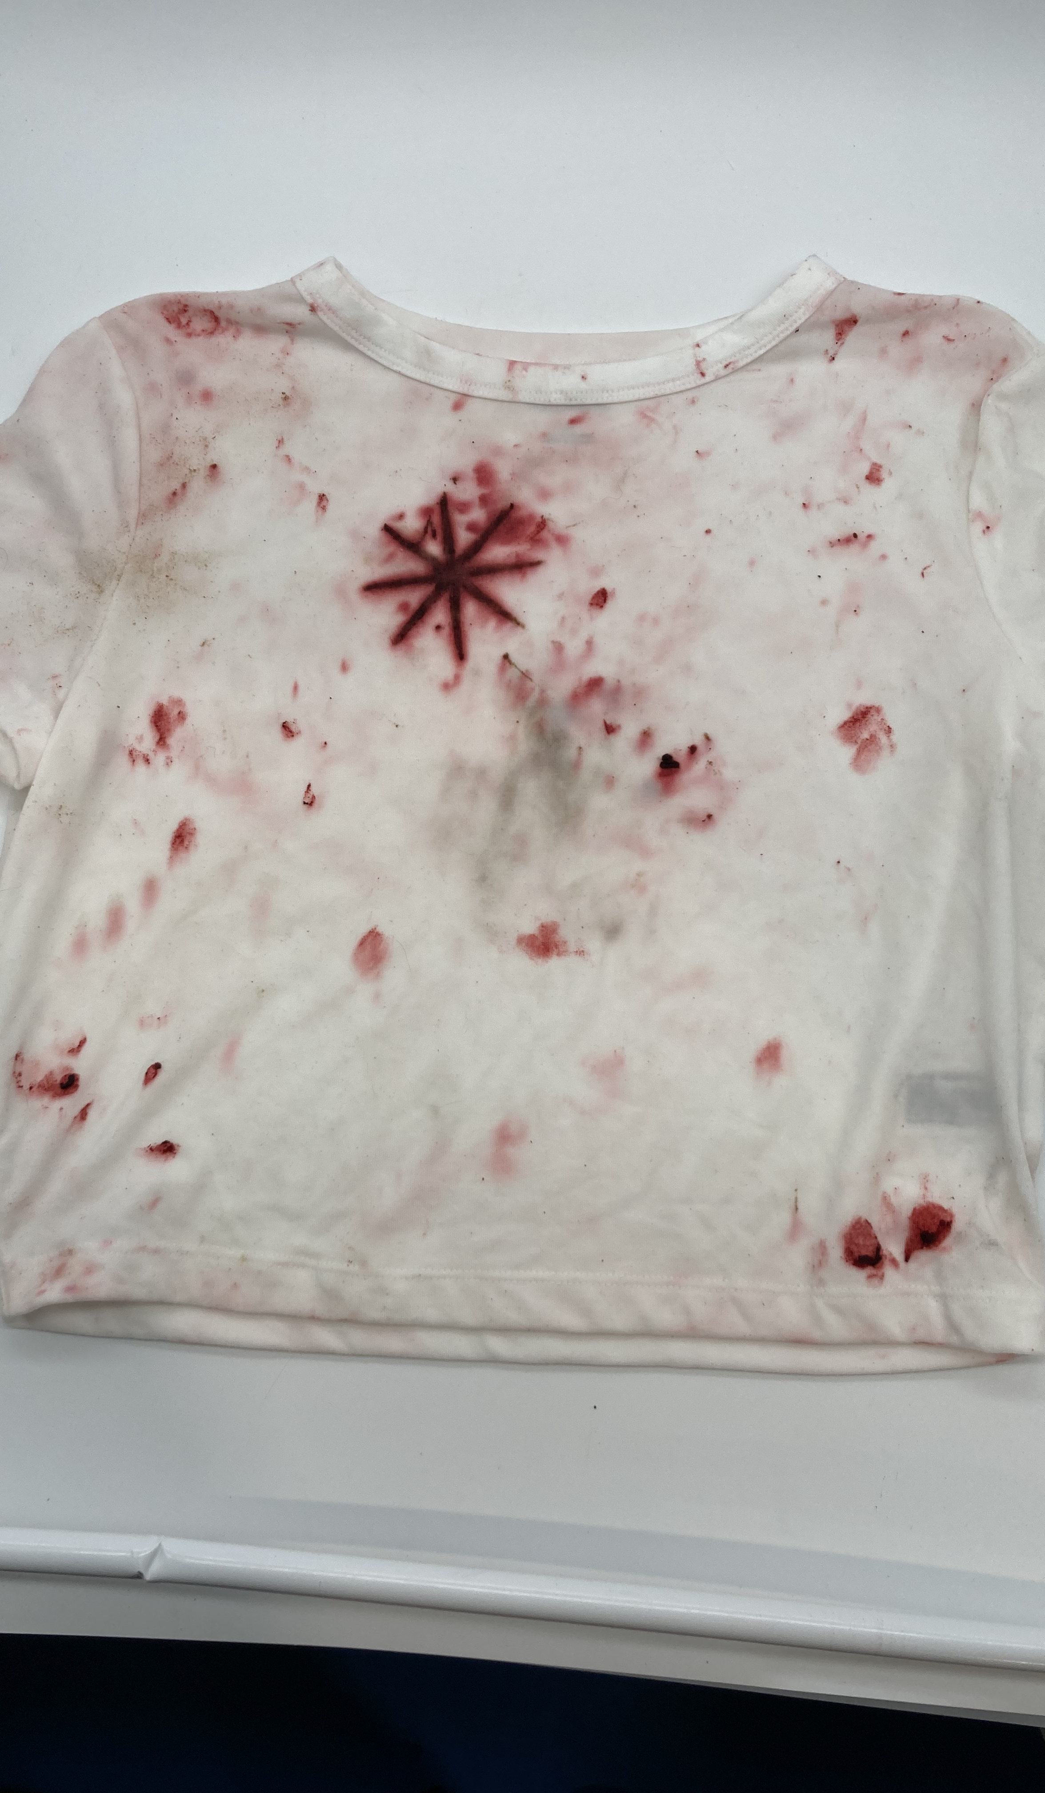
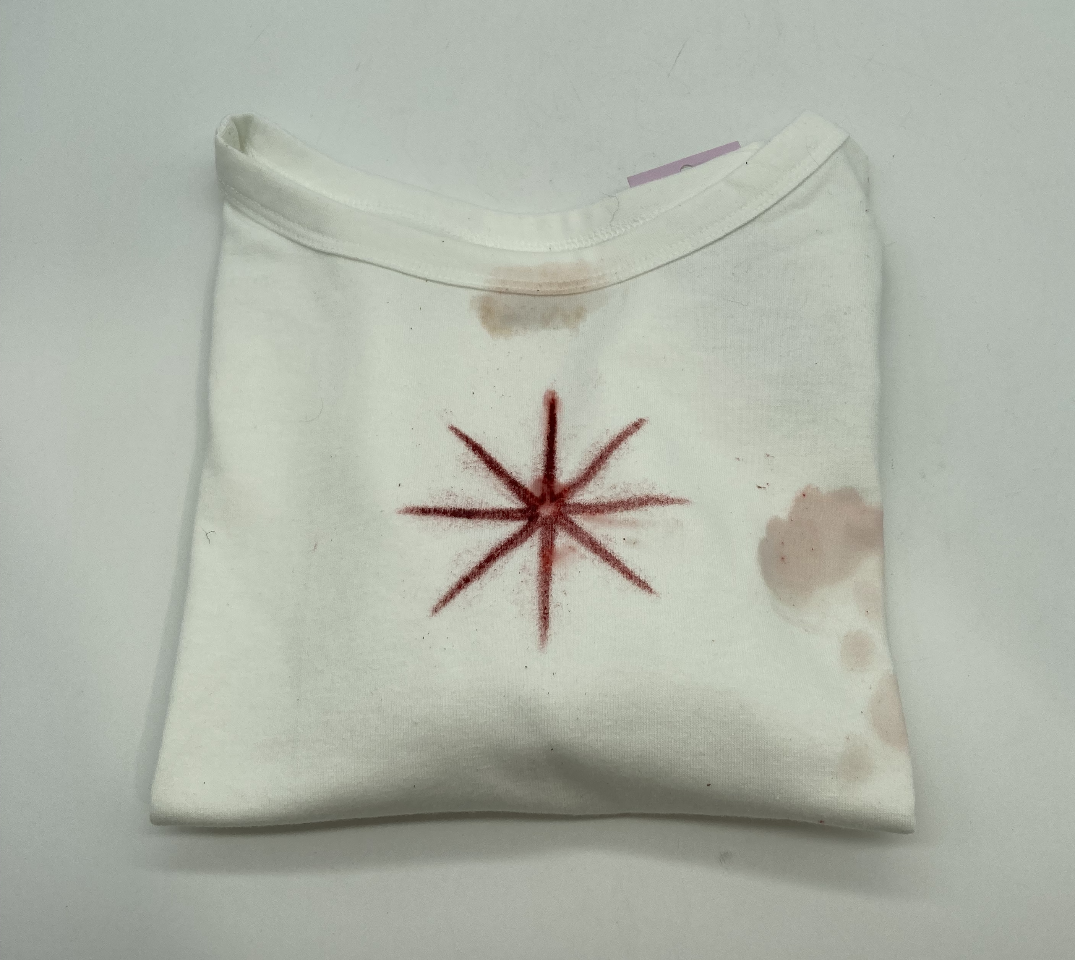
Semi-Permeant Color

Slide 11
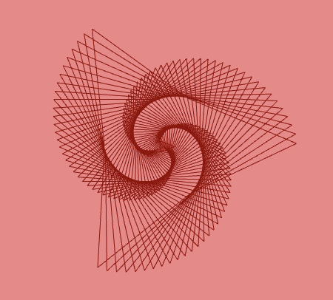
Crisp Details

Slide 12
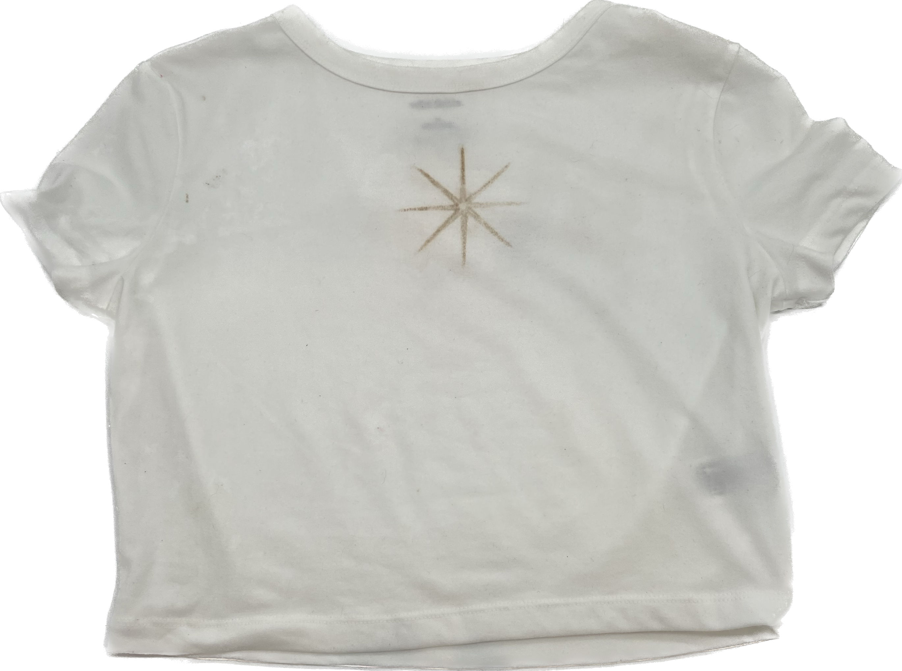
Beat•le

Slide 13
How can software remove barriers for people to use more sustainable options?
Load an image and slice it with a continuous path
Square Tracing Algorithm
What colors of dyes are possible?
Turmeric
Walnut husks
Different mordents
How versatile is a clay that transfers colors?
Focus on making circular fashion
Let the material guide research not the ingredients.

Slide 14
Thank You!
Erin McClure
Digital Fabrication
Department of Computer Science - University of New Mexico

