Slide 1
PRINTING FLOWERS
Lasair Servilla
UNM Undergraduate

Slide 2
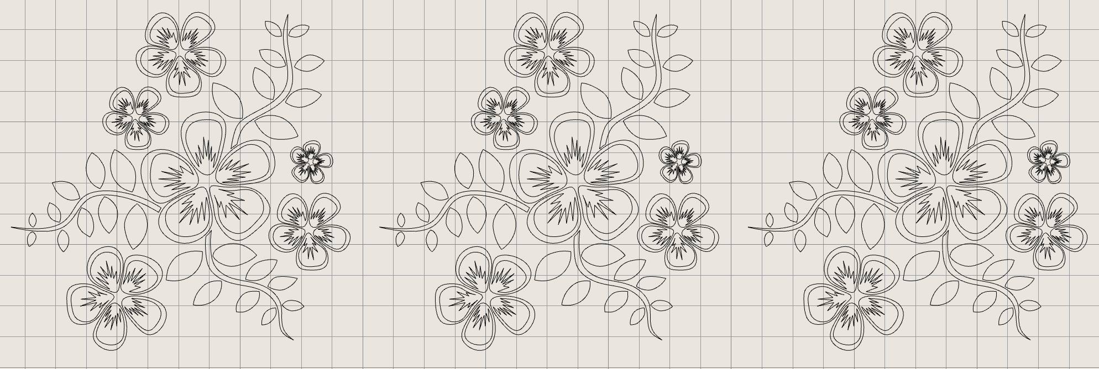
DESIGN

Slide 3
1.) Hand draw curves
2.) Connect curves
3.) Duplicate

Slide 4
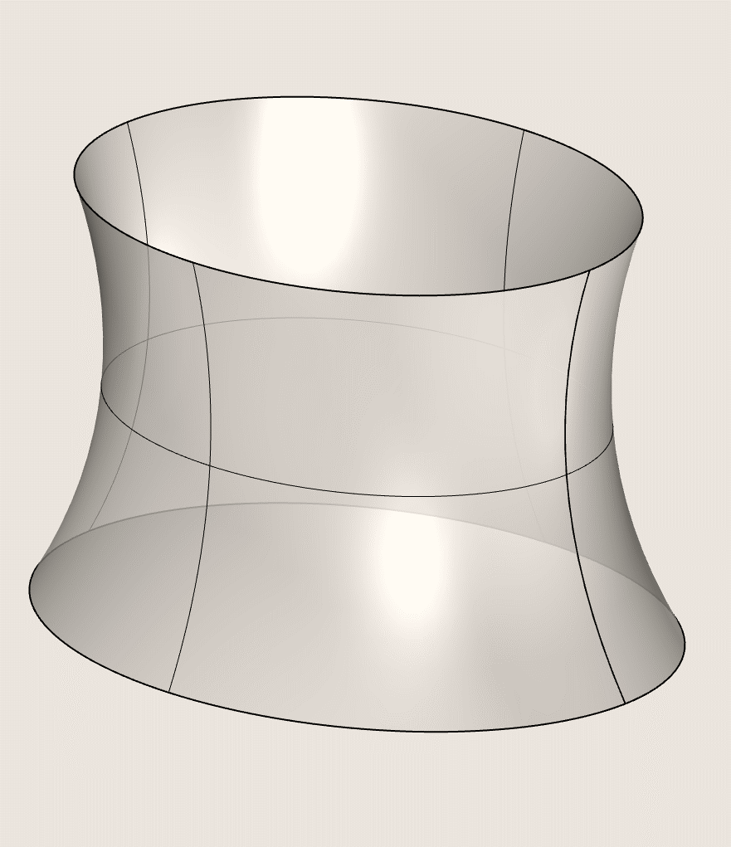
Created a surface to match measurements
Tiled squares across the surface to get panels
Created new surfaces from each of the panels that the flower pattern could then get tiled on top of

Slide 5
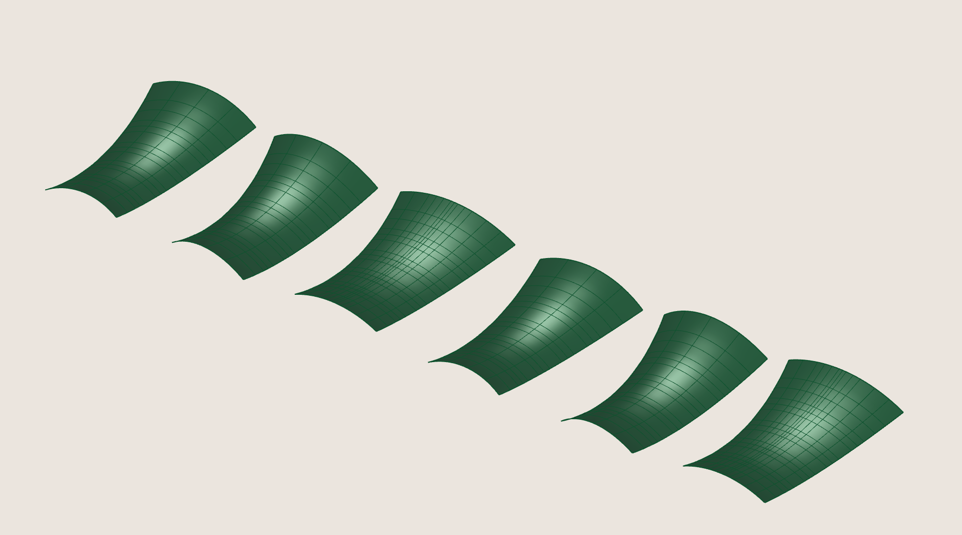

Slide 6
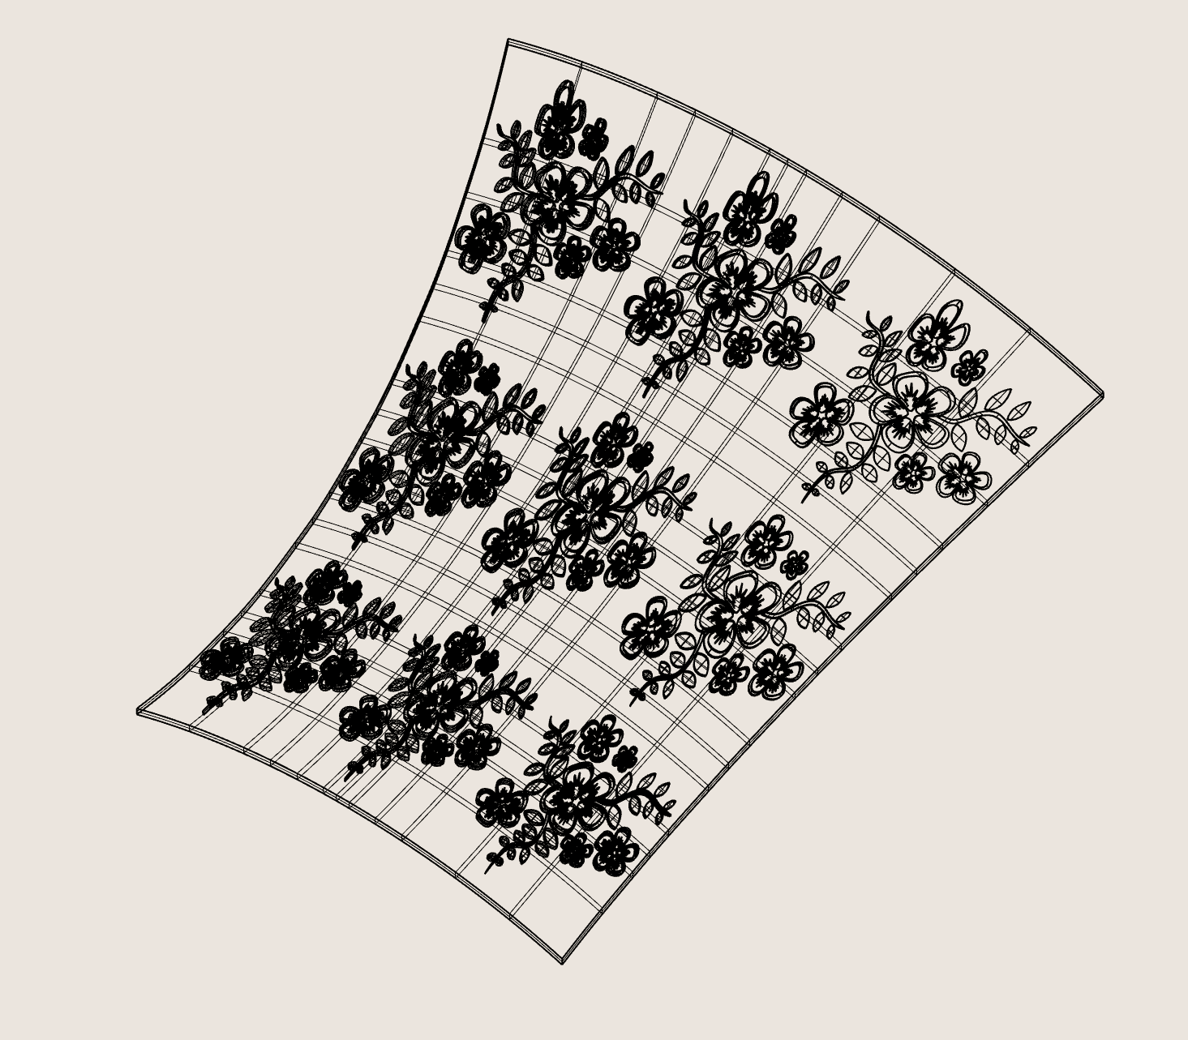
Key Steps:
Get boundaries prior to extruding
Make sure input to solid union are all closed breps
Be patient (even if it looks frozen)

Slide 7
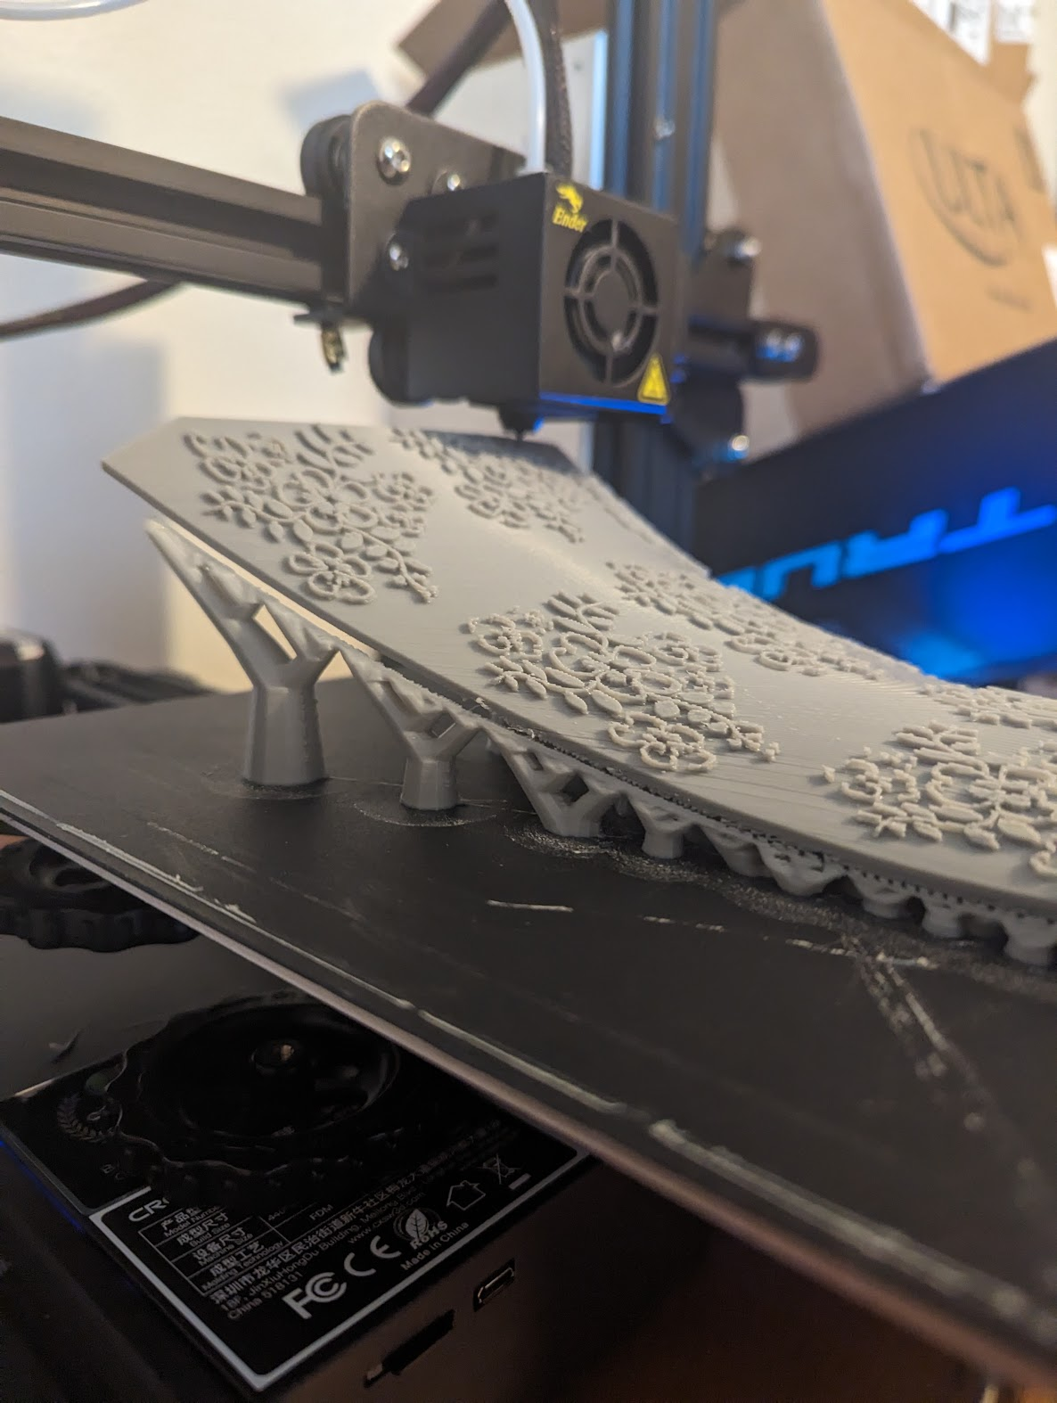
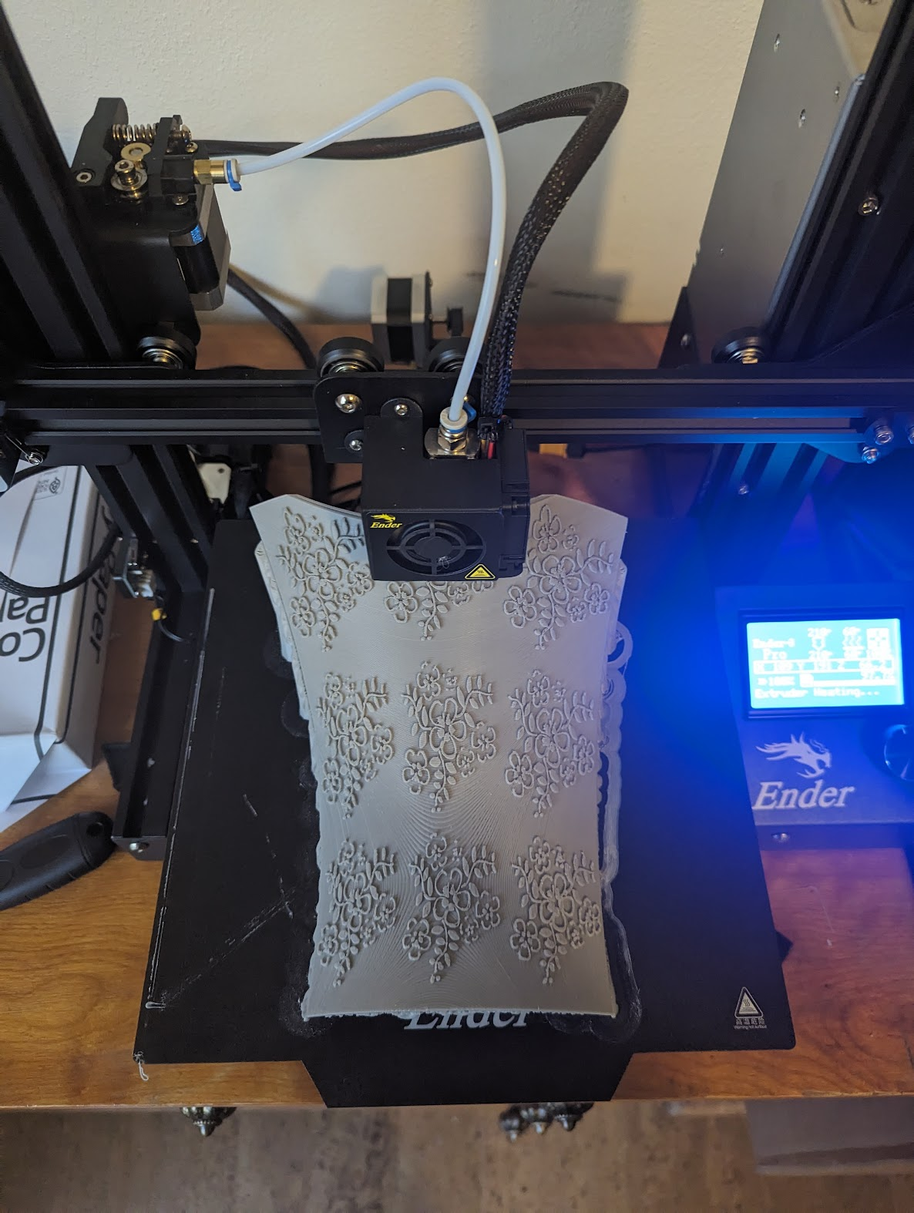
PRINTING
…this took days.

Slide 8
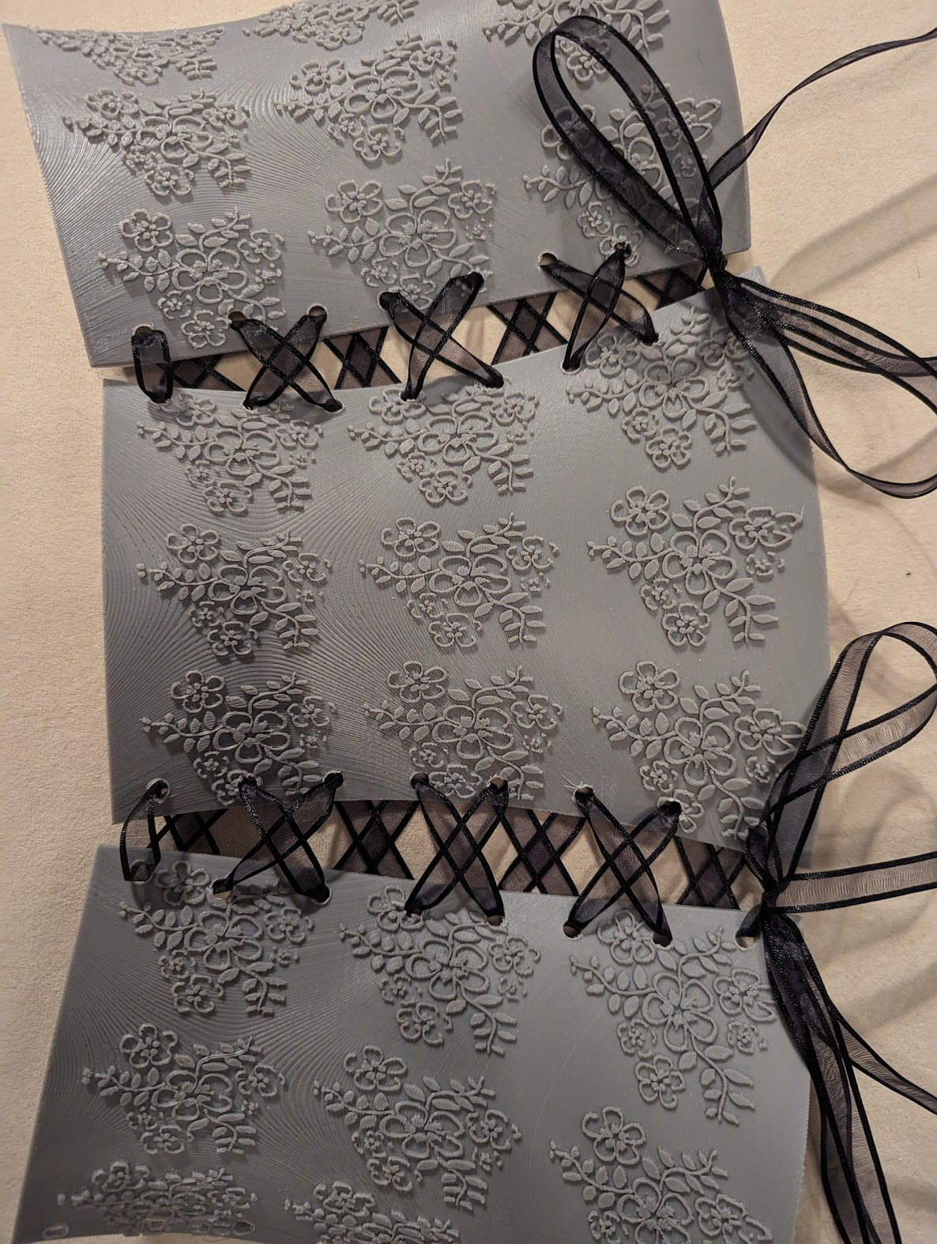
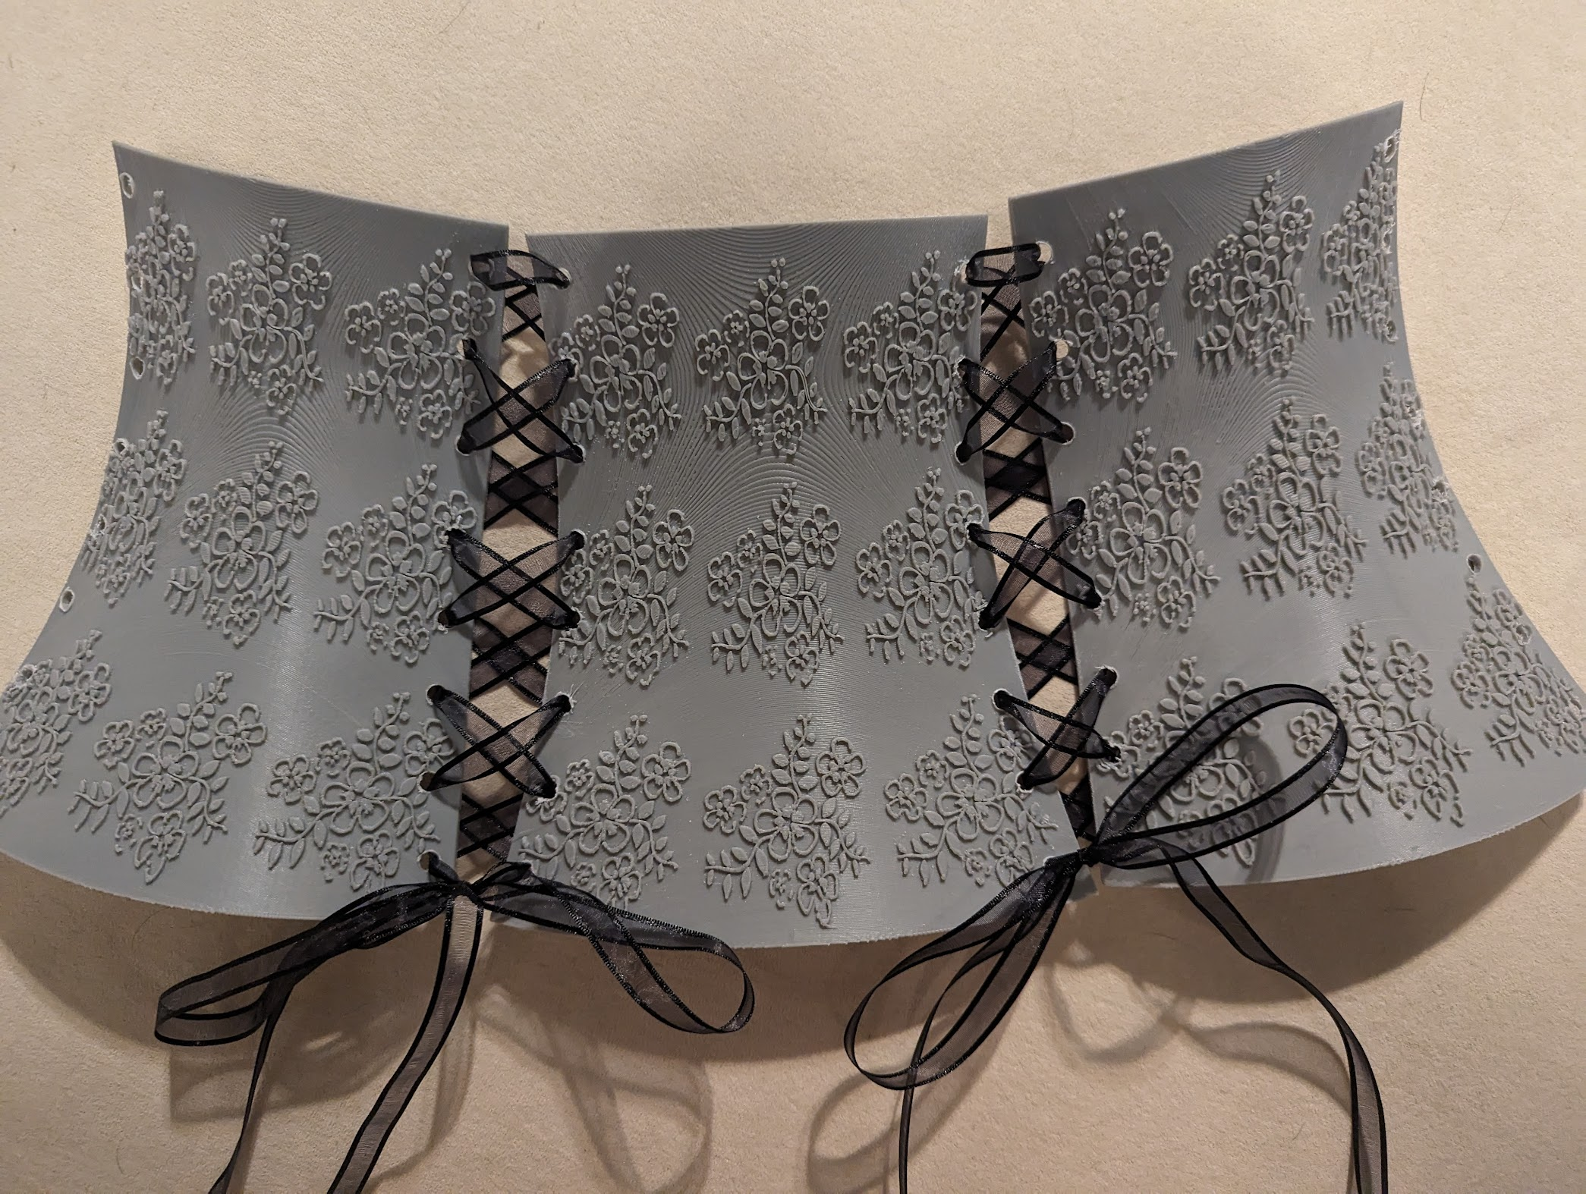
FINAL PRODUCT

Slide 9
THANK YOU
Lasair Servilla
UNM Undergraduate

