Slide 1
Lattice Structures
Atah Omar

Slide 2
Introduction
Creating Lattice structures of various designs
Experimenting with a different material

Slide 3
Researching Materials
I researched different types of lattice structures. At first, I want to create lattice structures using SMP filament.
Went to RoadRunner3D to find some filament.
Bamboo TPU Filament

Slide 4
Creating the Designs
I created a cube mesh and populated the mesh with points for the lines to connect too.
I then used the lines and joined them to create a curve, and used inspiration from the tiling assignment and created a bounding box and a box array.
Discovered the Dendro grasshopper plug-in.

Slide 5
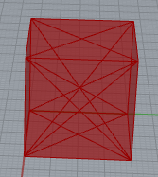
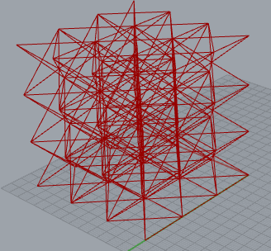
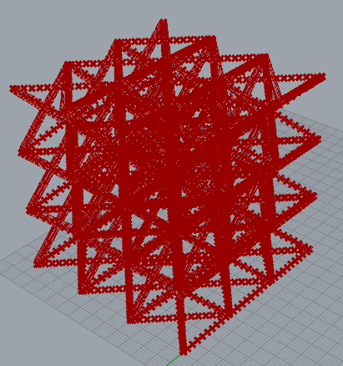
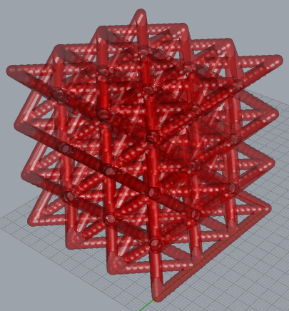
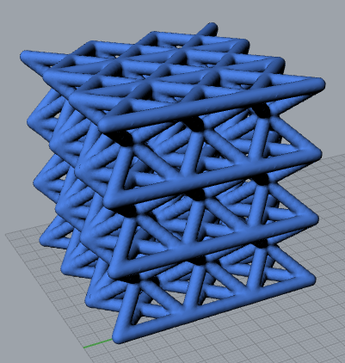

Slide 6
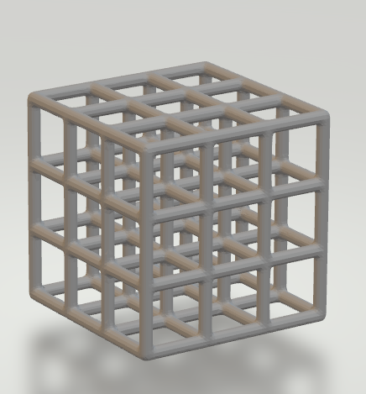
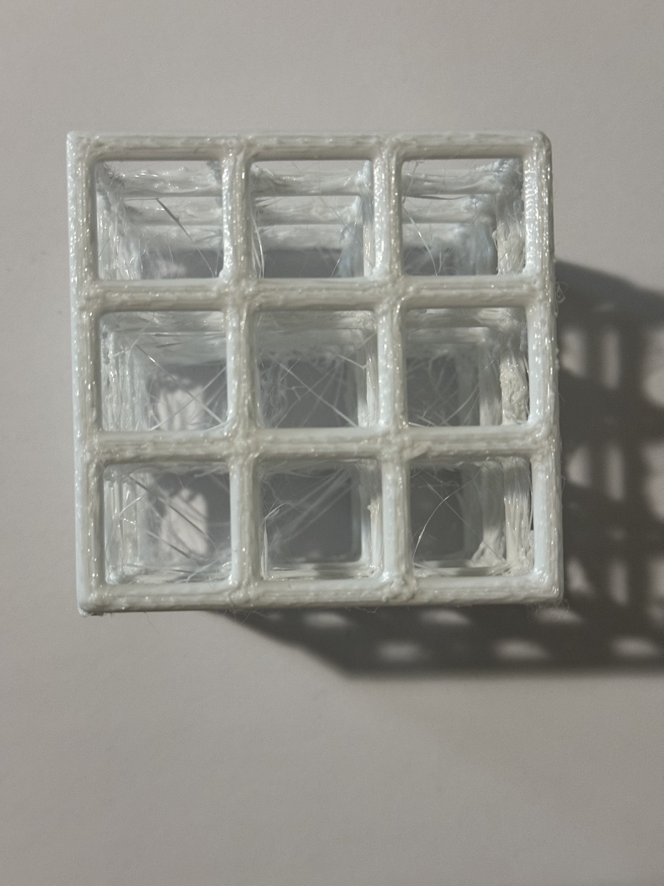
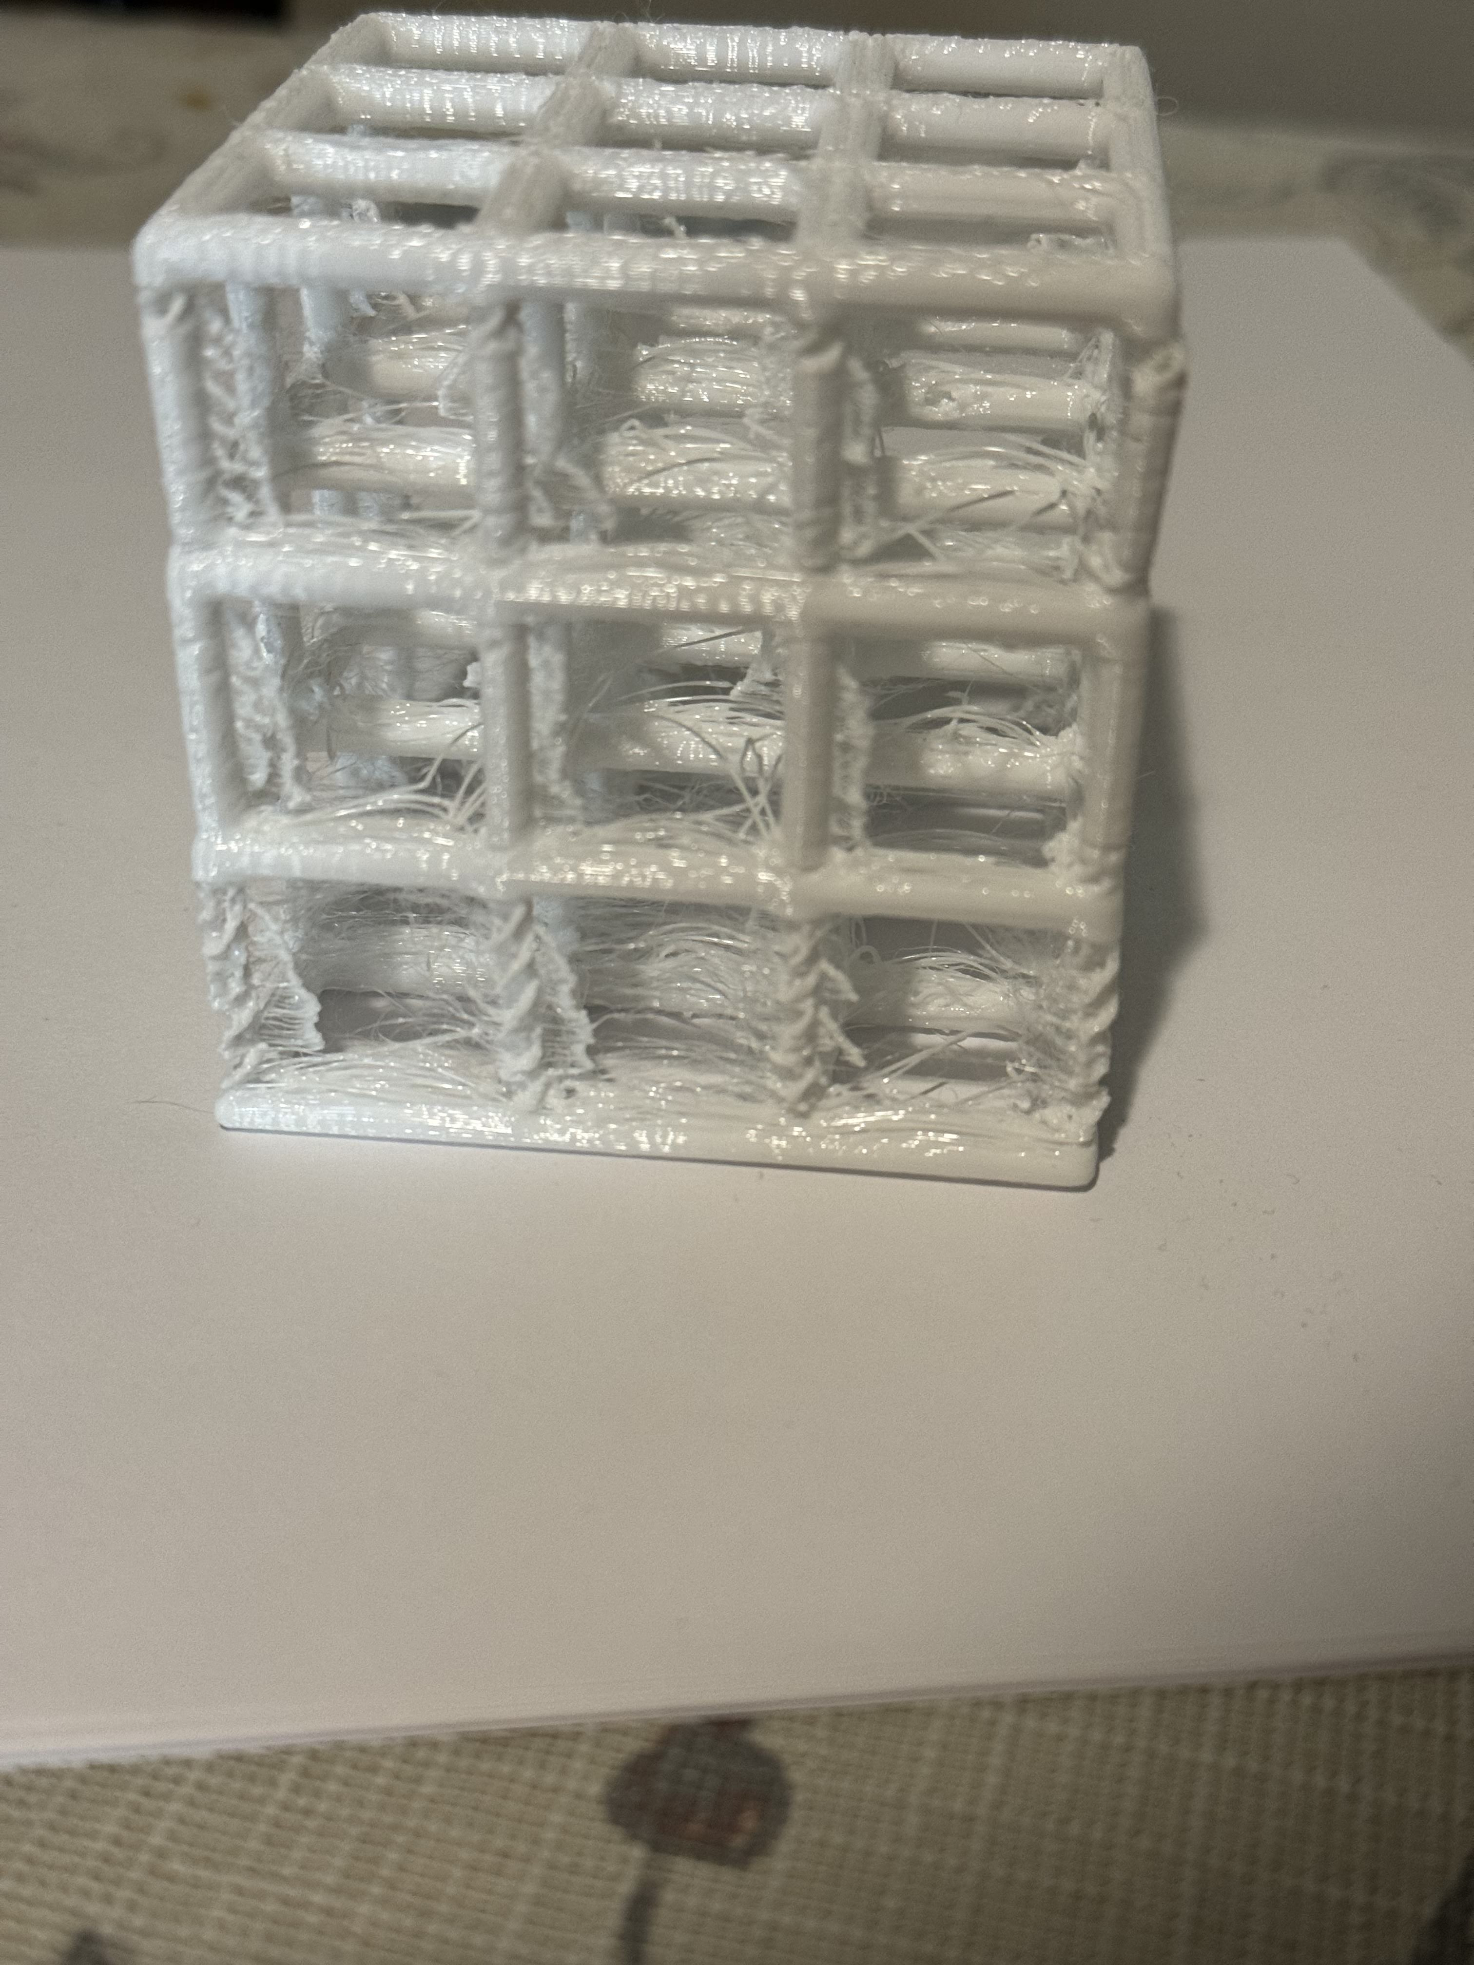
Design 1
I created a basic lattice structure that has a cube pattern for actual lattices

Slide 7
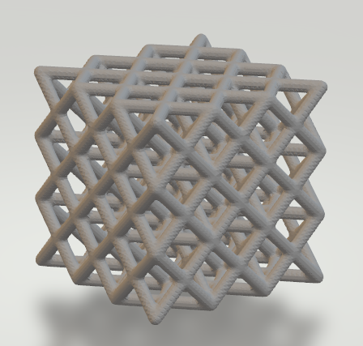
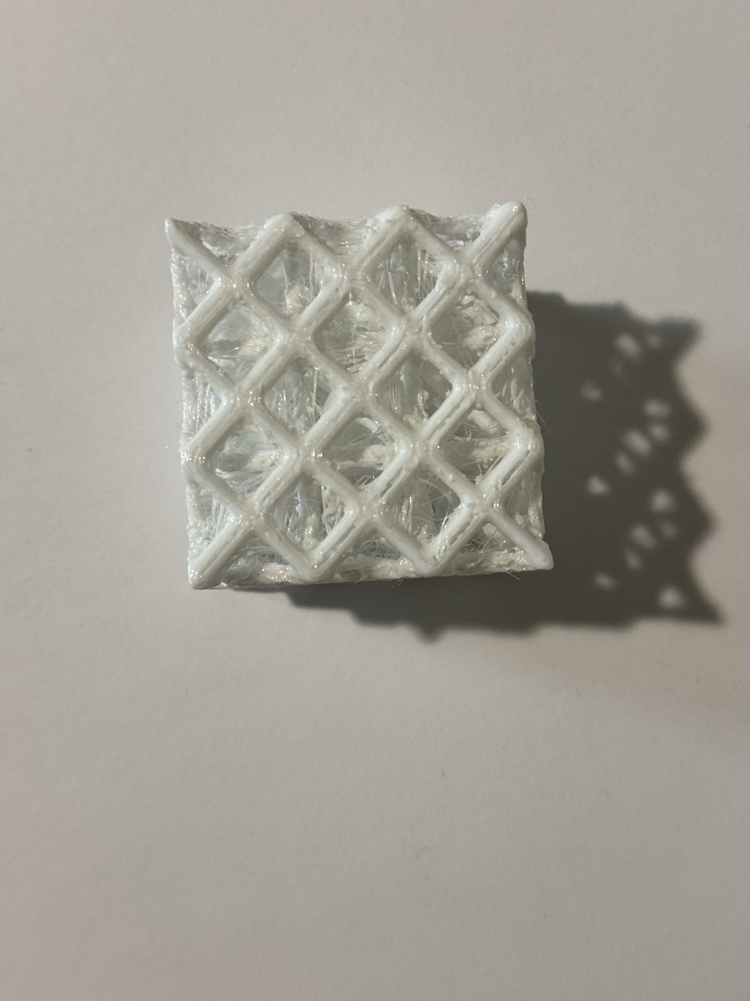
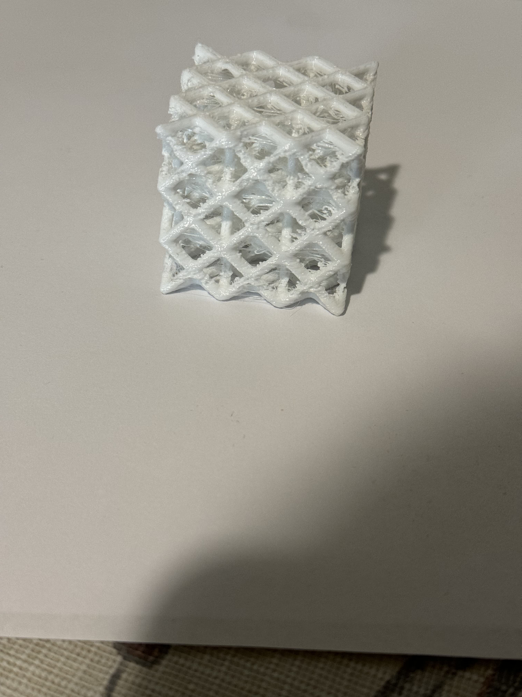
Design 2
I created a diamond lattice structure.

Slide 8
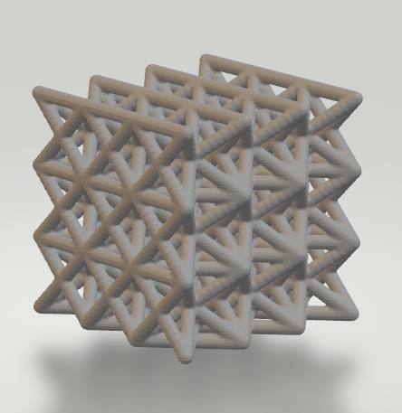
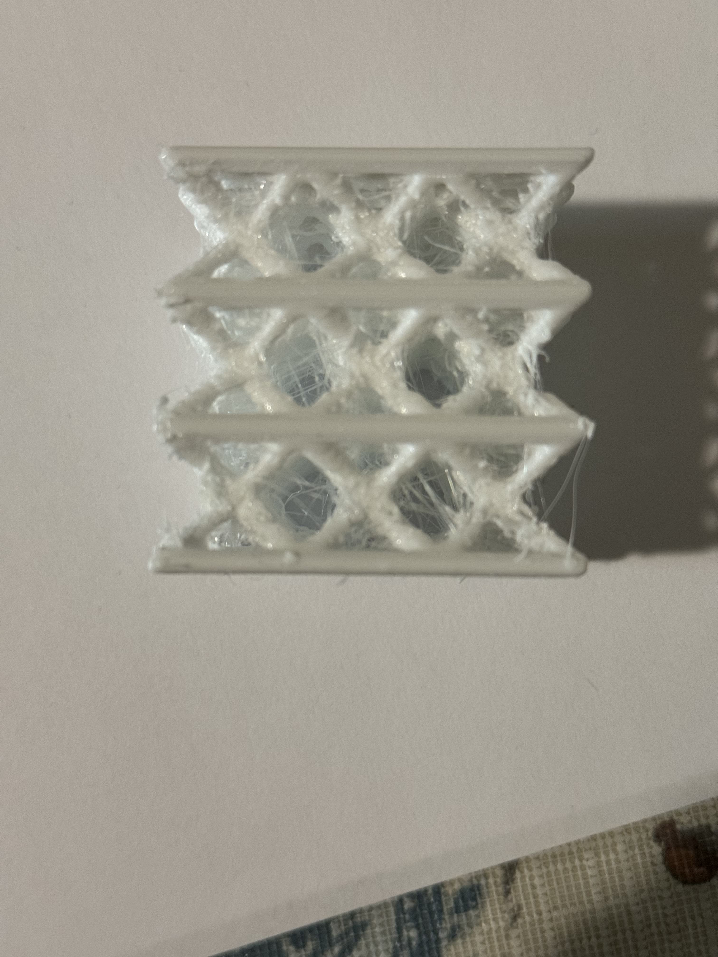
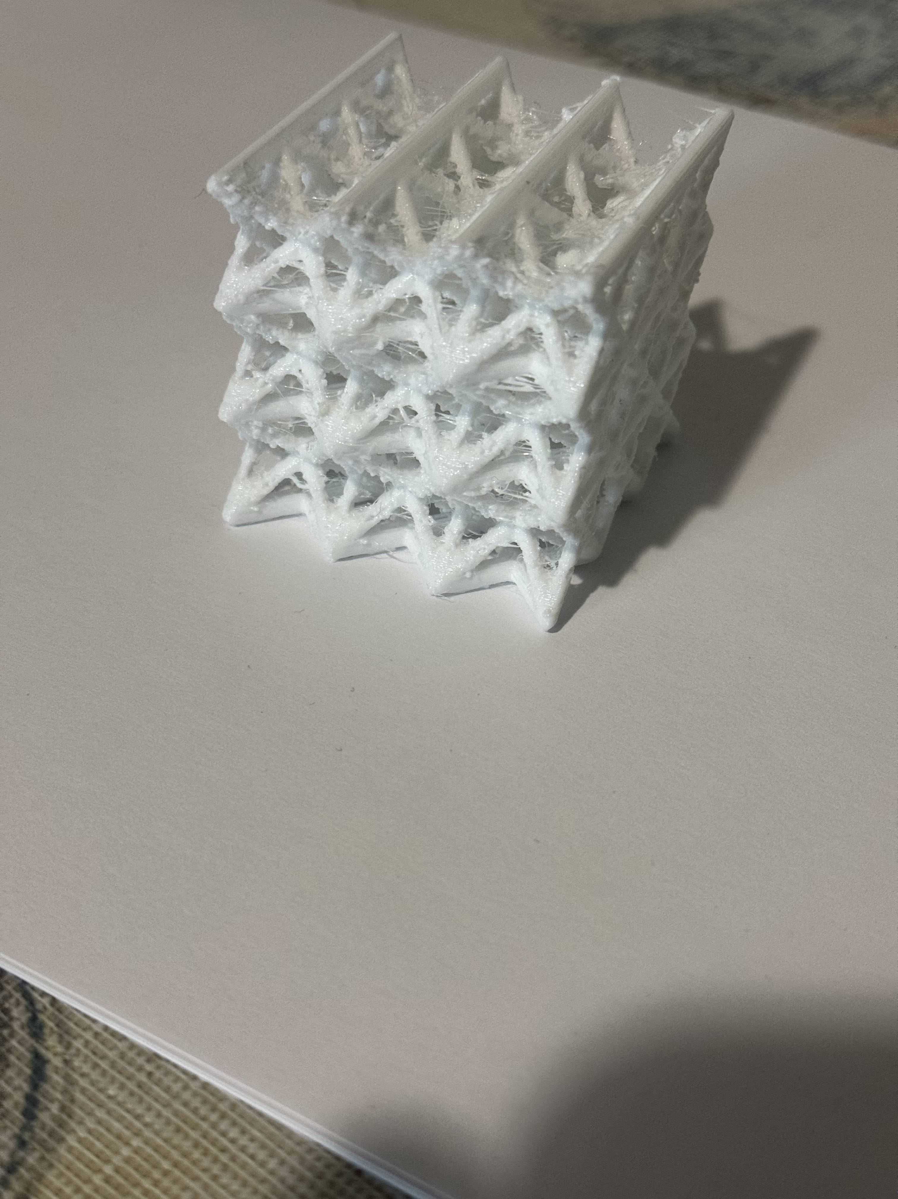
Design 3
I created a triangular pattern

Slide 9
Challenges
Problems with using TPU and figuring out the speed.
At first, I had a problem with having to print the initial design before I found the dendro plug in.

Slide 10
THANK YOU
Atah Omar

