Slide 1
Computational Fabrication
Christopher O’Neill
Dec, 5th 2023
School of Architecture and Planning

Slide 2
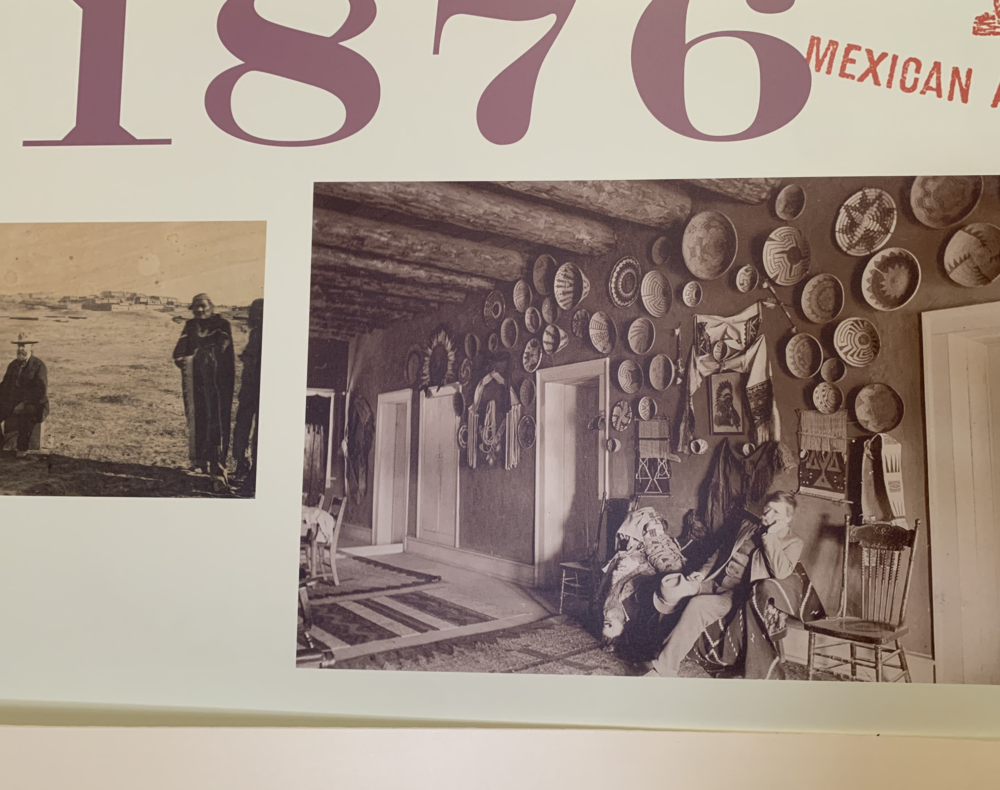
New Mexico and it’s indigenous past creatations
Inspiration from indigenous design.
More importantly old and dated ceramic and woven pots.
Math shown in a beautiful design.

Slide 3
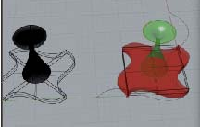
Past issues are no longer a problem.
Reaching out for help with the coding portion I was finally able to manipulate the tiling to move into the z axis and create a 3D tile.
The tiling program is what was needed to finish my project.

Slide 4
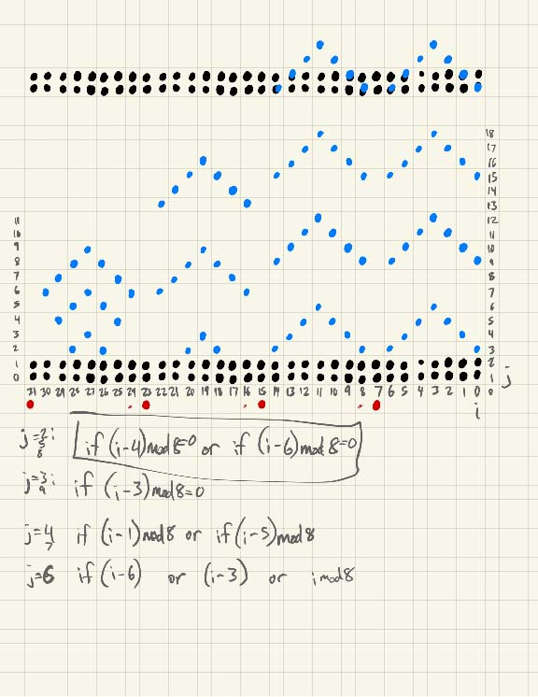
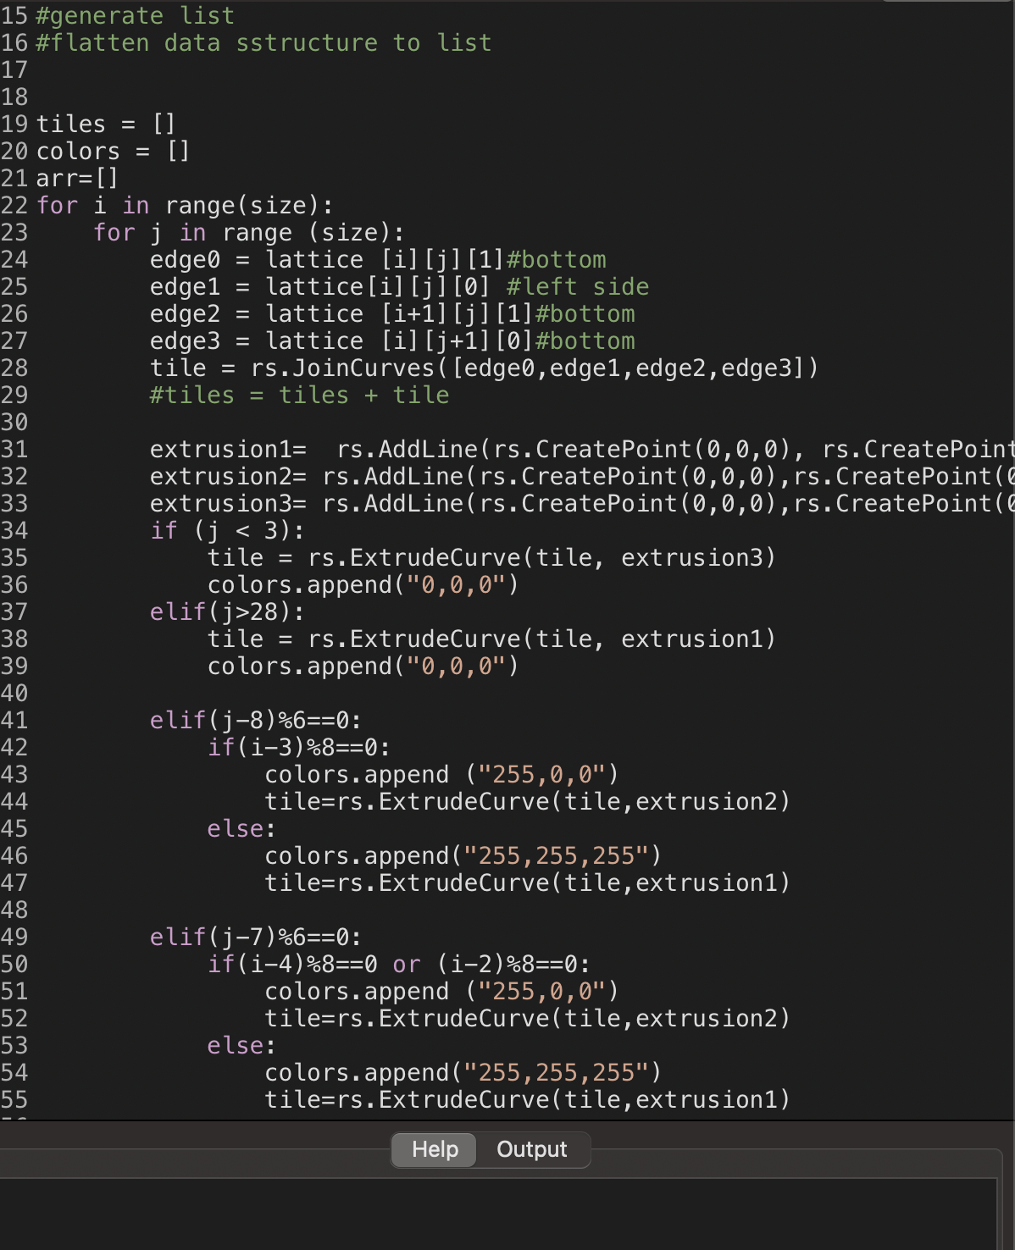
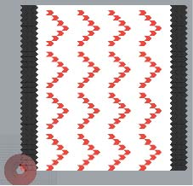
Applying a little math to create the shapes I was looking for.

Slide 5
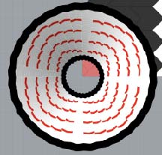
The results…

Slide 6
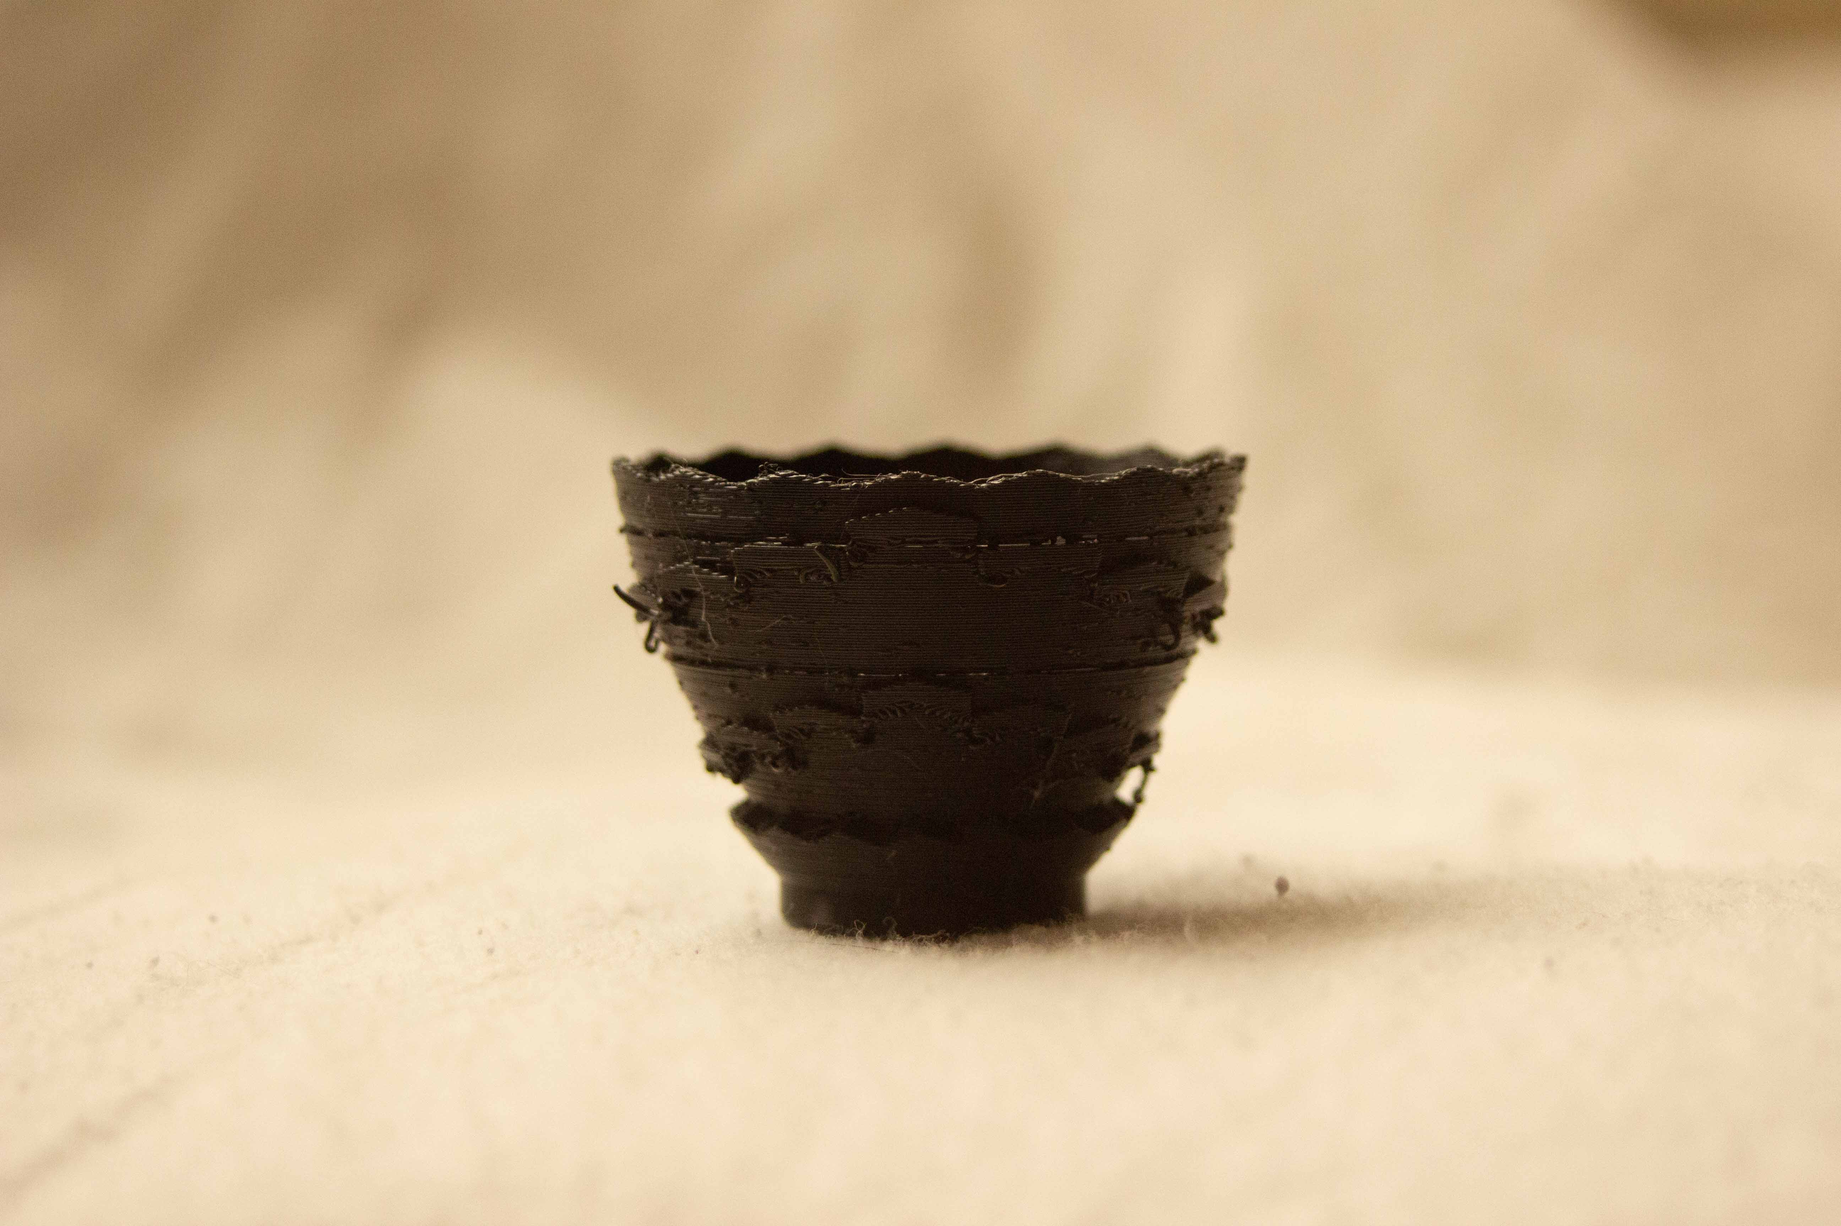
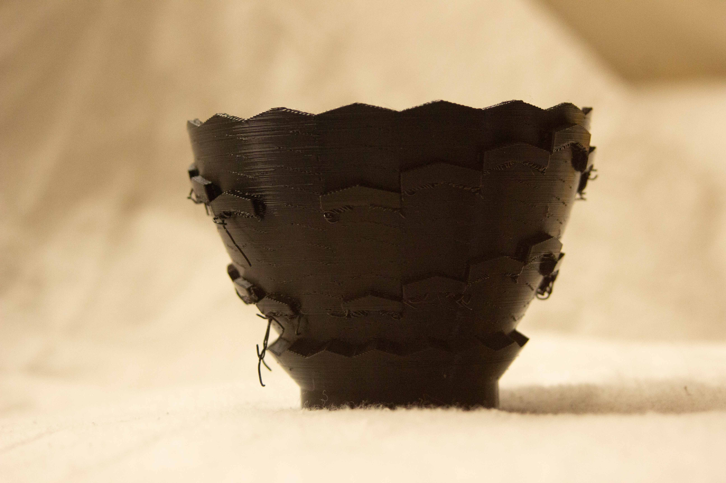
1st test run: -Printed with no issues other than loose filament. -1.5 inches max size. -Took over 2 hours to print. 2nd test run: -Doubled the size allowing for cleaner print but still loose filament. -Just over 3.5 inches -Took over 17 hours to print
3D printing

Slide 7
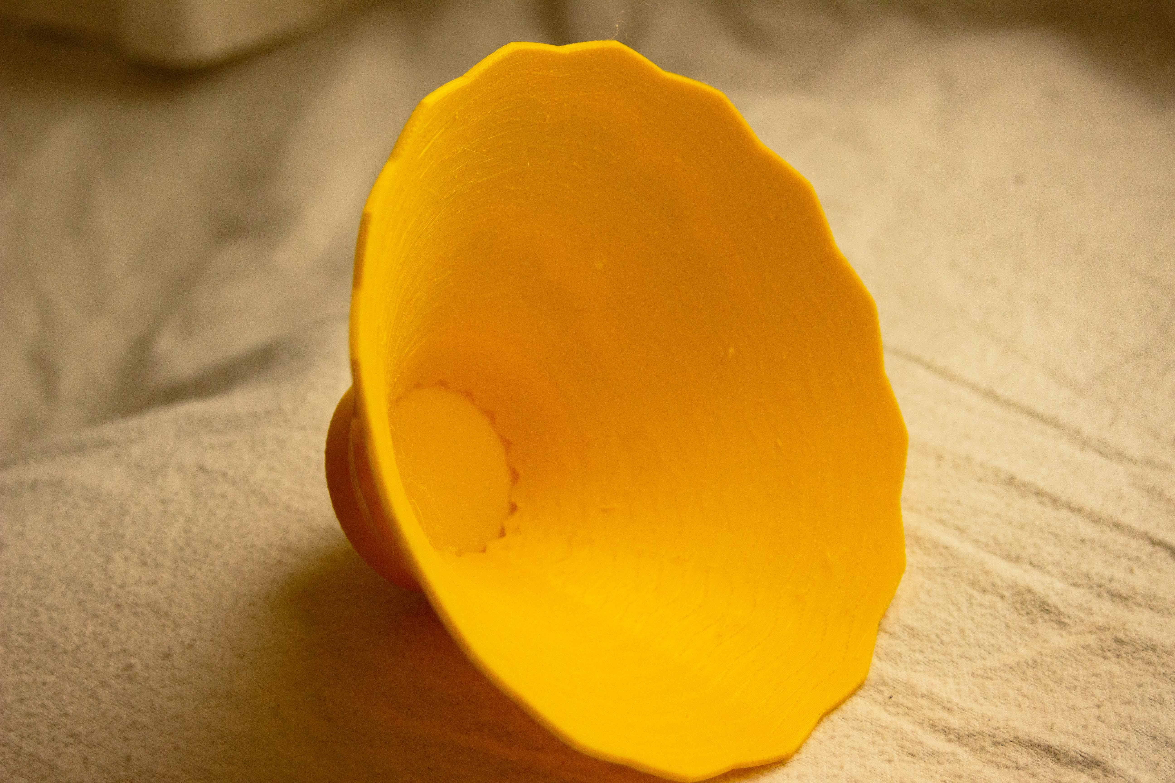
Final design.
Changes:
- A 45-degree angle was made
- Filament was changed
- Size was doubled.
Issues:
- The tiling had to be reduced
- Still some filament issues.

Slide 8
Thank you all for your inspiration
By
Christopher O’Neill
School of Architecture and Planning
University of New Mexico

