Slide 1
Designing A Ukulele Using Computational Fabrication
By Michel Robert and Daniel Morales
UNM CS-491, Computational Fabrication

Slide 2
3D Printed Ukulele

Slide 3
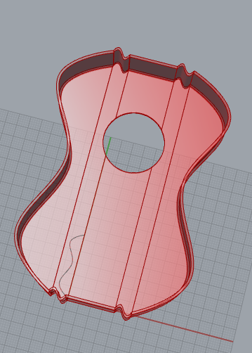
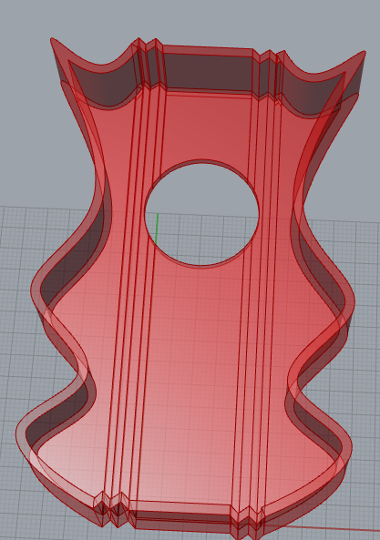
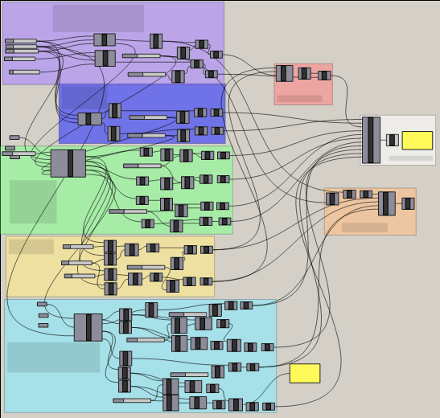
Ukulele Body
Grasshopper Code:
Rhino Bodies

Slide 4
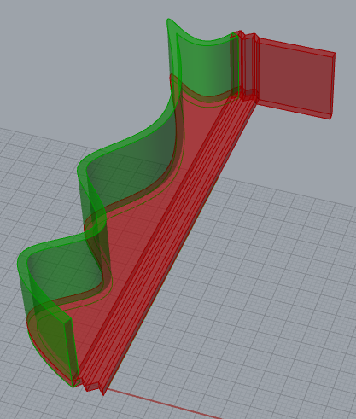
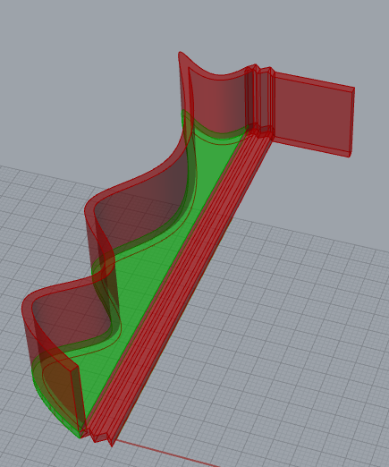
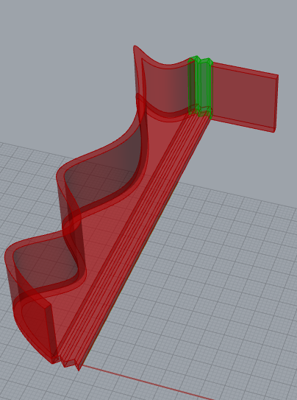
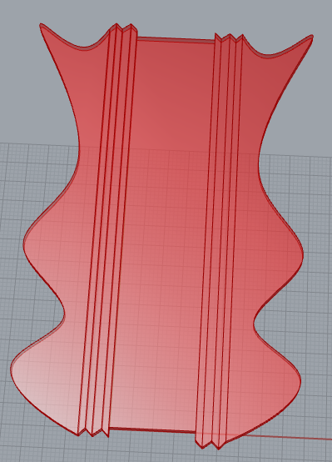
Ukulele Body
Built in different sections

Slide 5
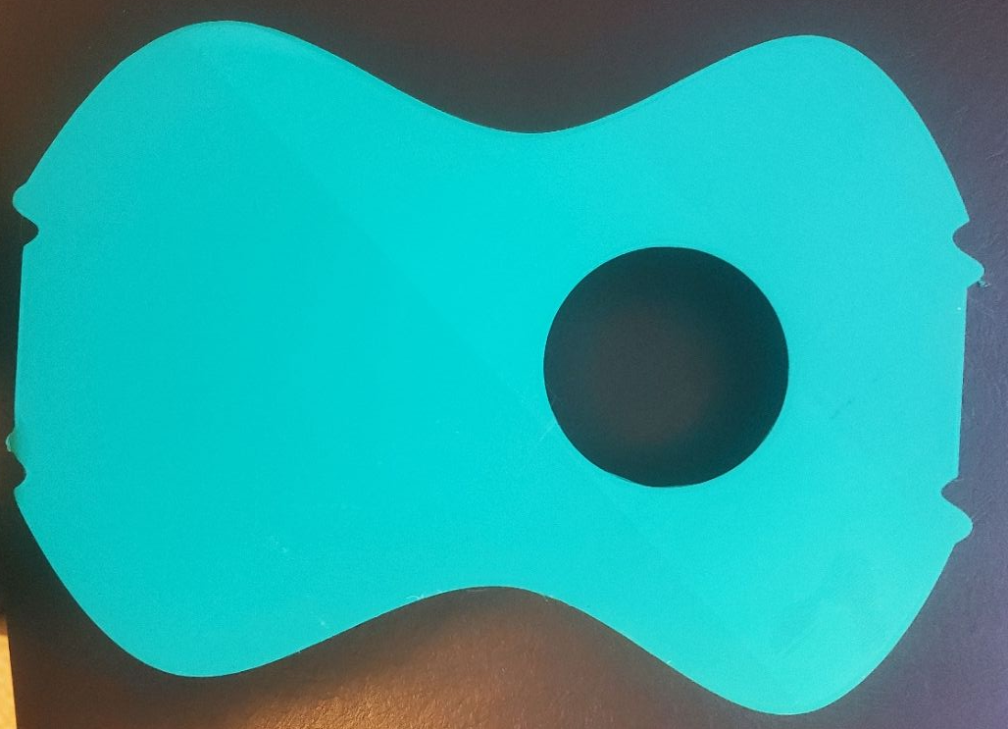
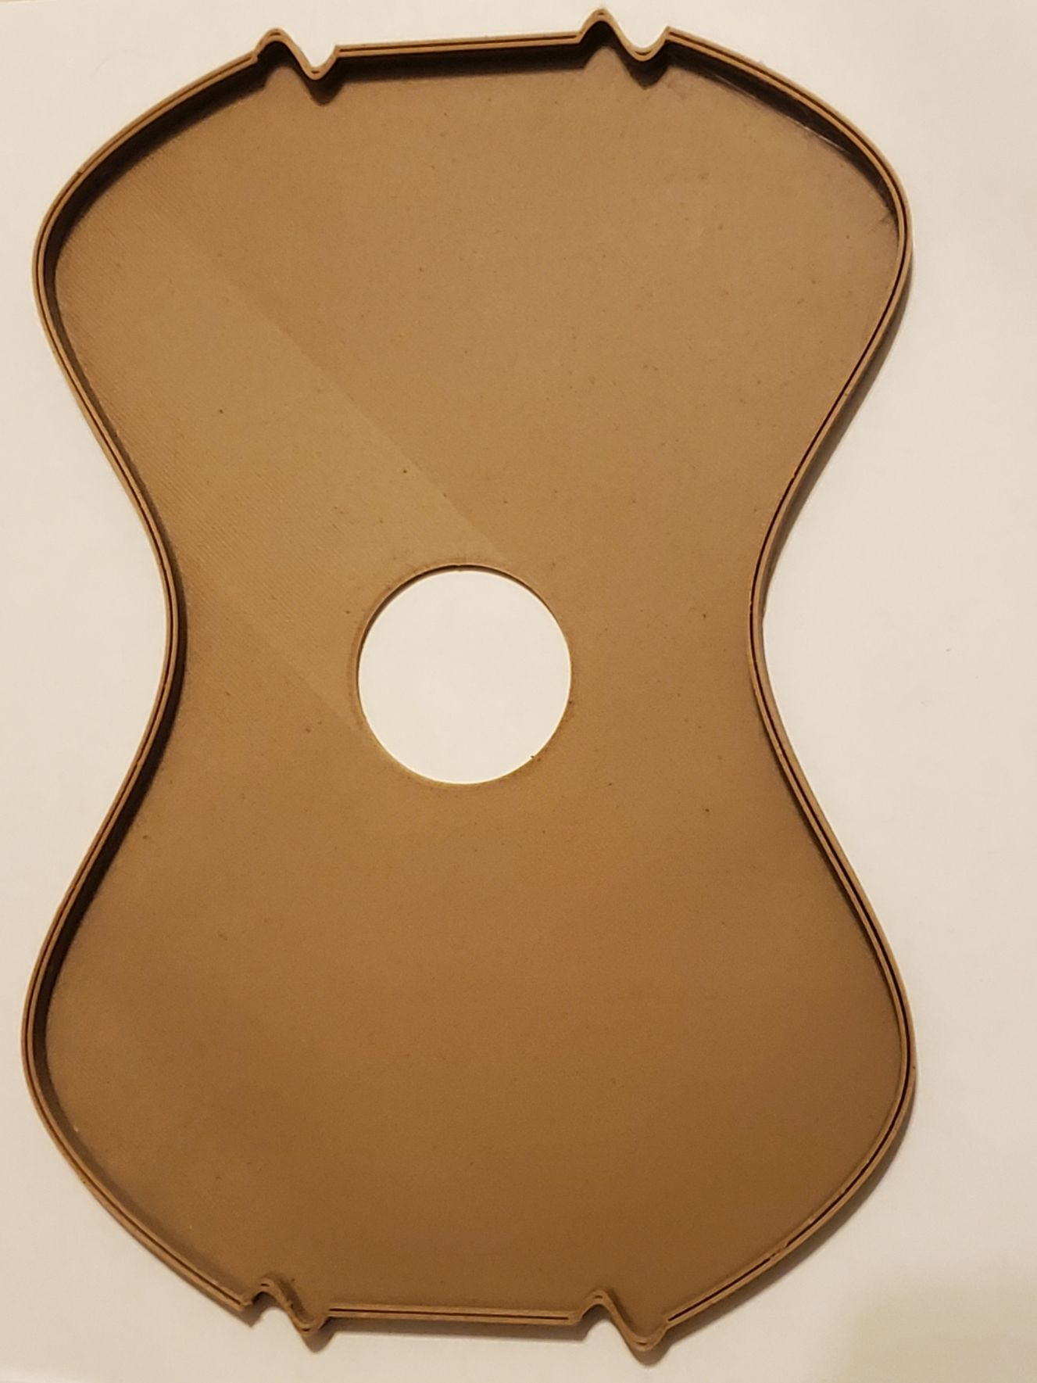
Secondary Tiling Ukulele Shape
Picture of Secondary Ukulele Shape

Slide 6
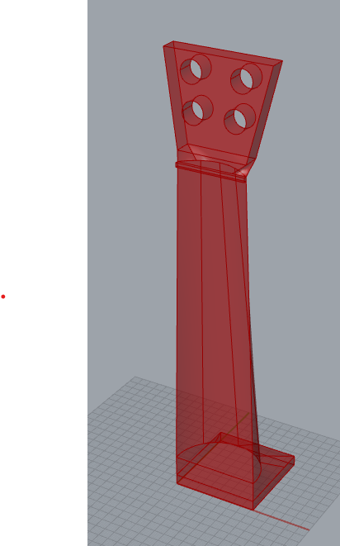
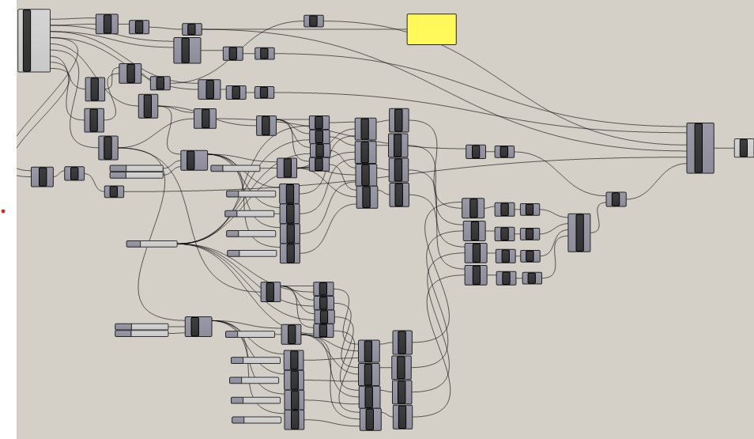
Ukulele Neck
Grasshopper Code:
Rhino Vessel

Slide 7
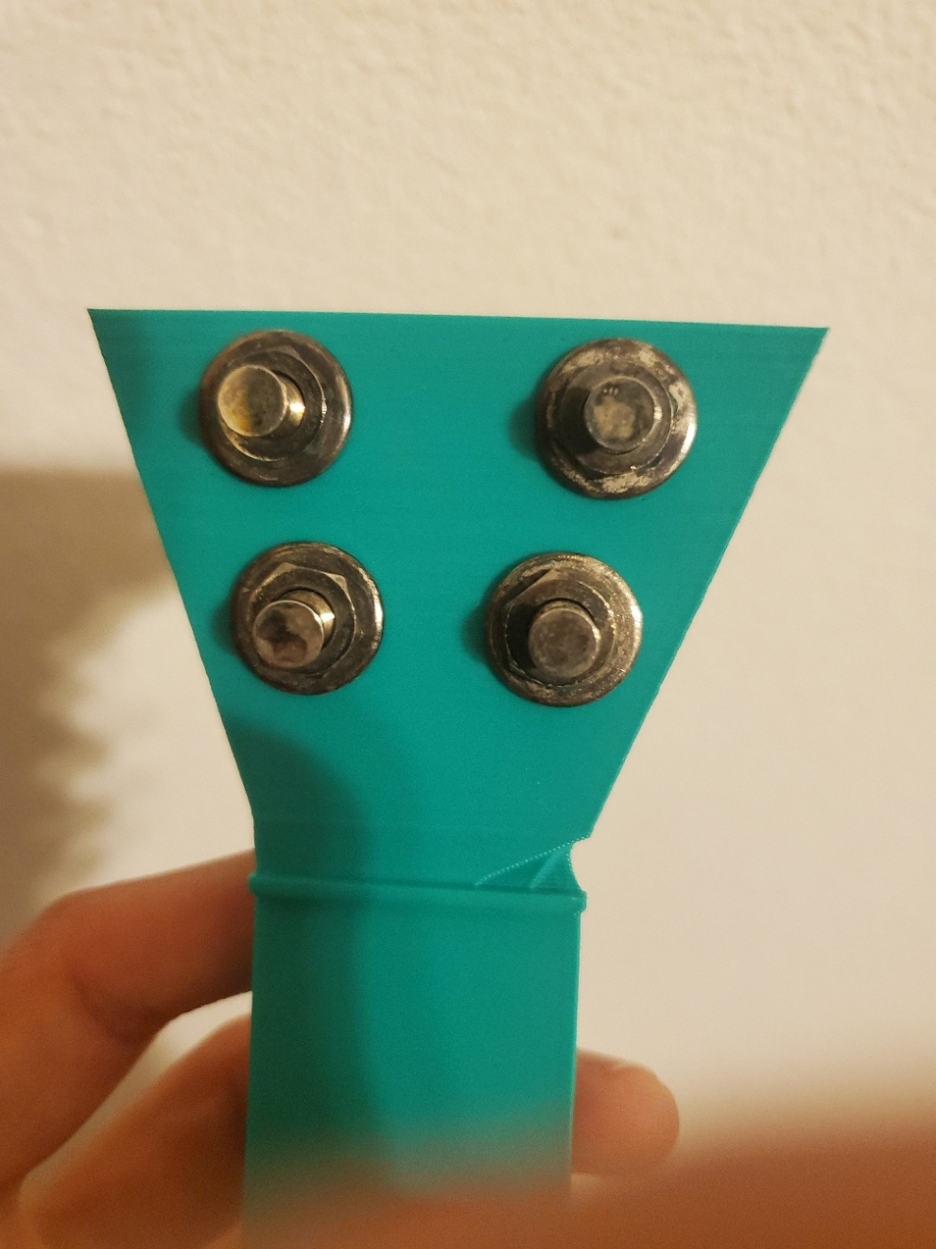
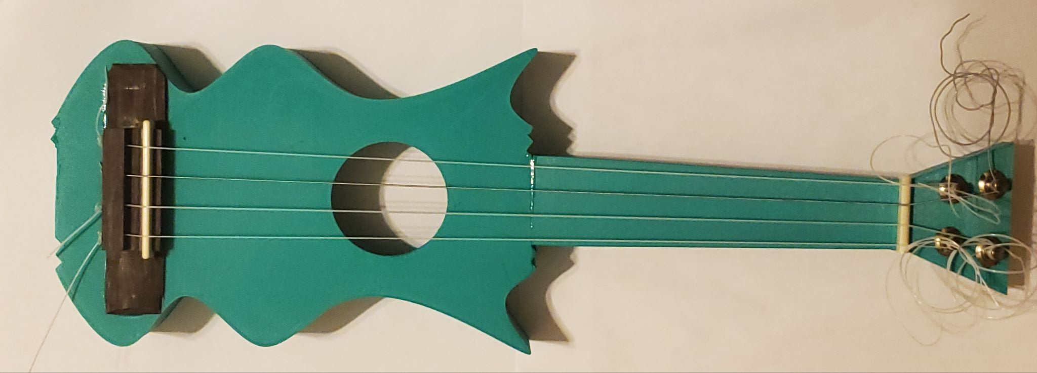
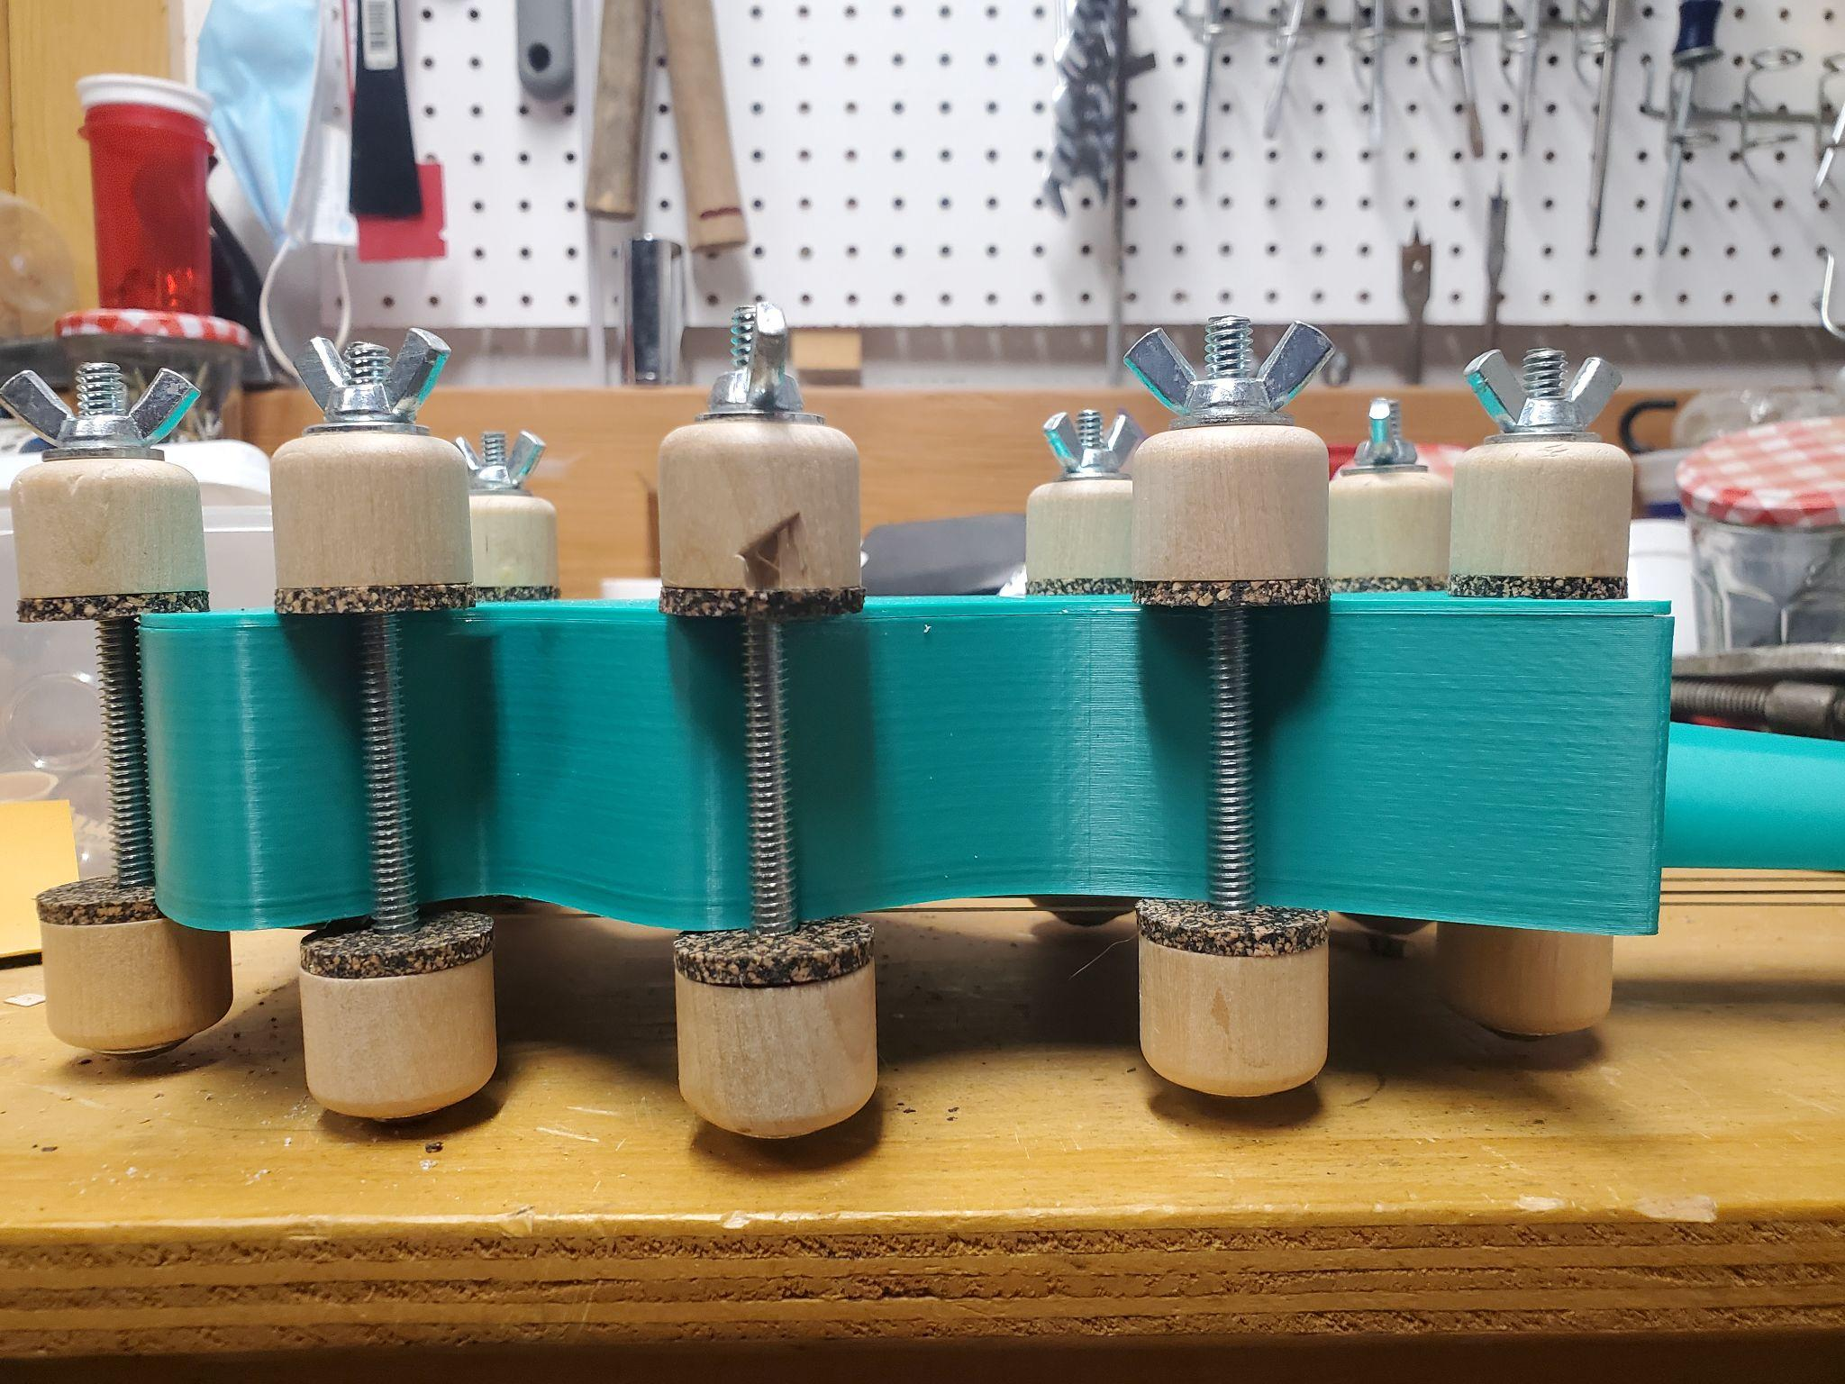
Assembly
Steps
After Tuning Pegs installation
Gluing Neck and Body of Ukulele
Installing tuning pegs
Installing bridge and saddle and nut
Filing down nut to match level of saddle
Installing strings
Glueing back plate
After saddle, nut and strings installation
Glueing the back plate on

Slide 8
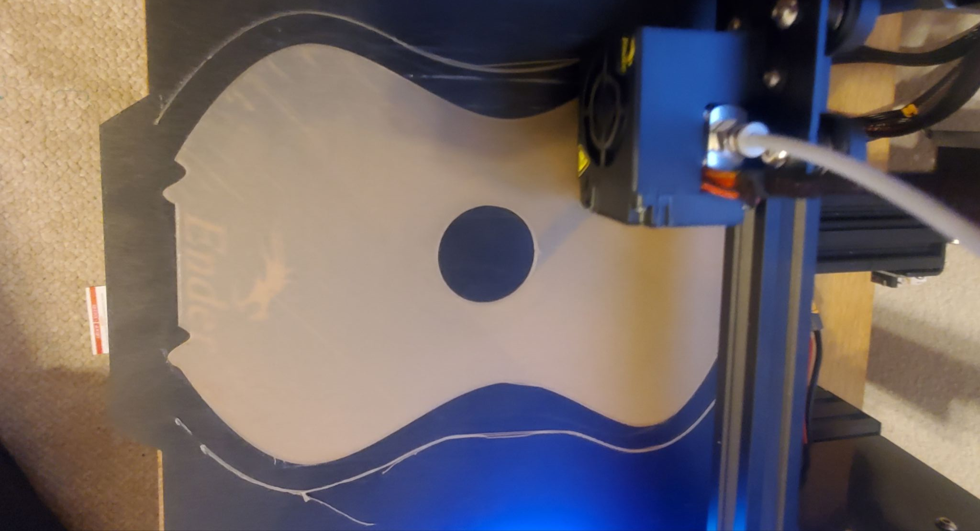
Challenges
Printing with wood PLA
Printing a Large Model

Slide 9
Thanks!
any
questions
?
Michel Robert and Daniel Morales

